Slide 1







American Airlines by the numbers
500,000
6,700
350
average daily customers
daily departures
destinations served
130,000
1,547
$1.9 billion
#AATeam members
airplanes in our fleet
2018 pre-tax profit

Slide 2
American WHY
To care for people on life’s journey

Slide 3
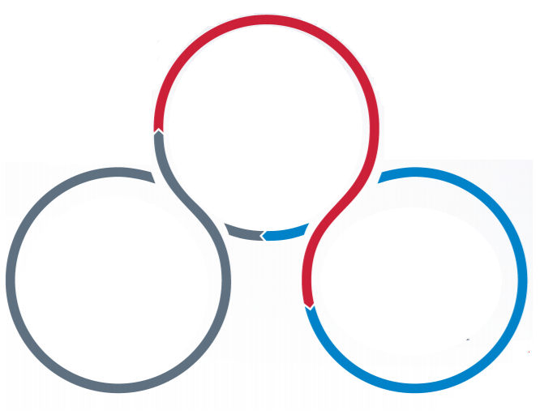
American Airlines One Team, One Plan
Make Culture a Competitive Advantage
Build American Airlines to Thrive Forever
Create a World Class Customer Experience

Slide 4





American Airlines by the business
Tech Ops
Airport, Corp.,
Dining, & Cabin
Human Resources
Information Technology
Corporate Real Estate
Fuel Purchasing

Slide 5
American Airlines supplier process
1
2
3
Advocate for certified suppliers who understand our business
Develop relationships
Insure diverse companies are included for bids
4
5
6
Evaluate products based on merit
Award contracts based on quality, delivery, & cost,
Review supplier performance
Supplier Portal -- aa.com/supplierdiverity

Slide 6





Notes:
Photo: PepsiCo sources an increasing number of agricultural commodities from growers around the world, such as the oats, oranges, tomatoes, corn, blueberries, tea leaves and chickpeas pictured here.
Good morning,
On behalf of PepsiCo, welcome to the 2nd Annual Diverse Supplier Partners Event. To kick off the day, I’d like to share with you a few insights into PepsiCo and our Performance with Purpose strategy as it impacts every aspect of our business.

Slide 7
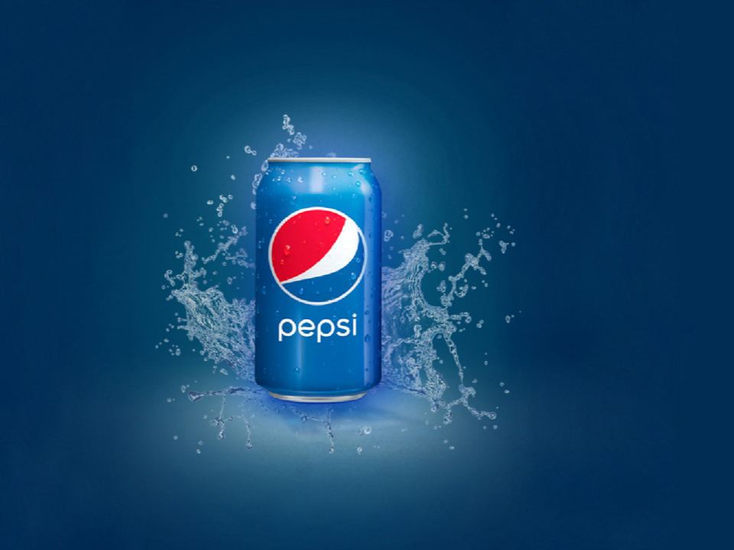
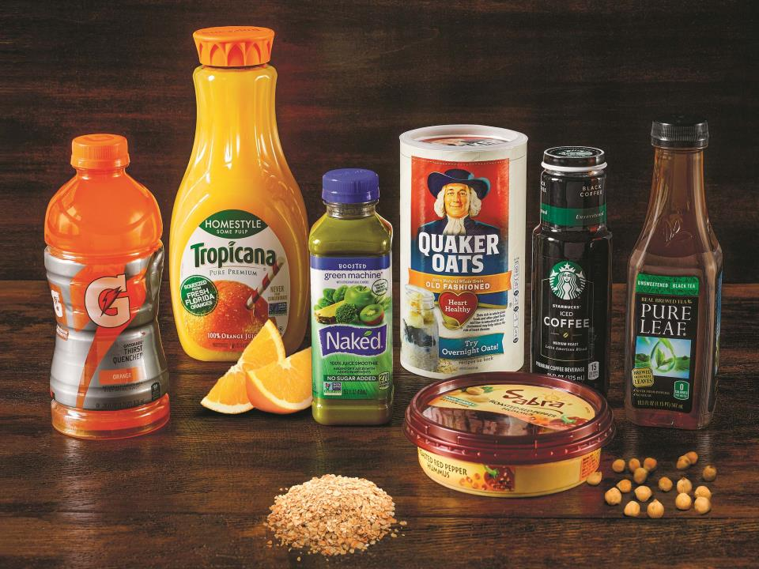
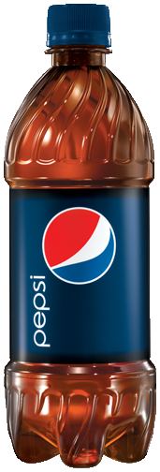
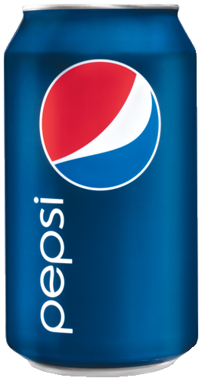
What comes to mind when thinking about PepsiCo?
Did you remember these?
Notes:
So what do you think of when you see “PepsiCo?”
[WILL REVEAL HEALTHY PORTFOLIO IMAGE]
Did you remember these?
According to the 2018 Forbes Global 2000 — the annual and comprehensive list of the world’s most powerful public companies as measured by a composite score of revenue, profit, assets and market value — Anheuser-Busch, Nestle and Pepsico are the top three food and drink companies in the world.

Slide 8
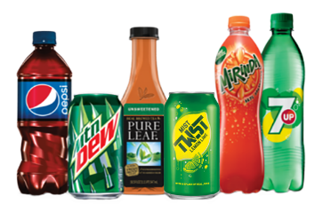
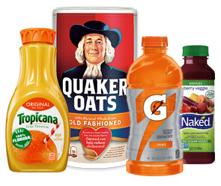
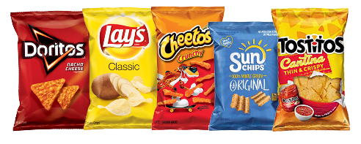



About PepsiCo
PepsiCo products are enjoyed by consumers one billion times a day in more than 200 countries and territories around the world. PepsiCo's product portfolio is comprised of a wide range of enjoyable foods and beverages, including 22 brands that each generates $1 billion or more in estimated annual retail sales.
GLOBAL BEVERAGES
GLOBAL SNACKS
GLOBAL NUTRITION
PERFORMANCE
BRANDS
SCALE
PEOPLE
Approximately
$63 billion
net revenue in 2017
22
billion-dollar
brands
More than 200
countries
& territories
More than 260,000
employees
Notes:
With approximately $63billion in net revenue and more than 250,000 employees, PepsiCo is among the largest food-and-beverage companies in the world.
Our foods and beverages are consumed nearly 1 billion times each day nearly every country around the world.
PepsiCo is made up of three global businesses – beverages, snacks and nutrition.
Twenty-two of the brands in our portfolio – including Pepsi-Cola, Quaker Oats, Tropicana, Lay’s and Gatorade – generate more than $1 billion each in retail sales every year.
PepsiCo is the #1 Food and Beverage company in North America
In Europe, we are #1 in juice, dairy, ready-to-drink tea, and savory snacks
In Russia, we are the largest food and beverage business in the country and the market leader in dairy
Fun Fact: Our foods and beverages are consumed nearly 1 billion times each day nearly every country around the world.
PepsiCo is made up of three global businesses – beverages, snacks and nutrition.

Slide 9
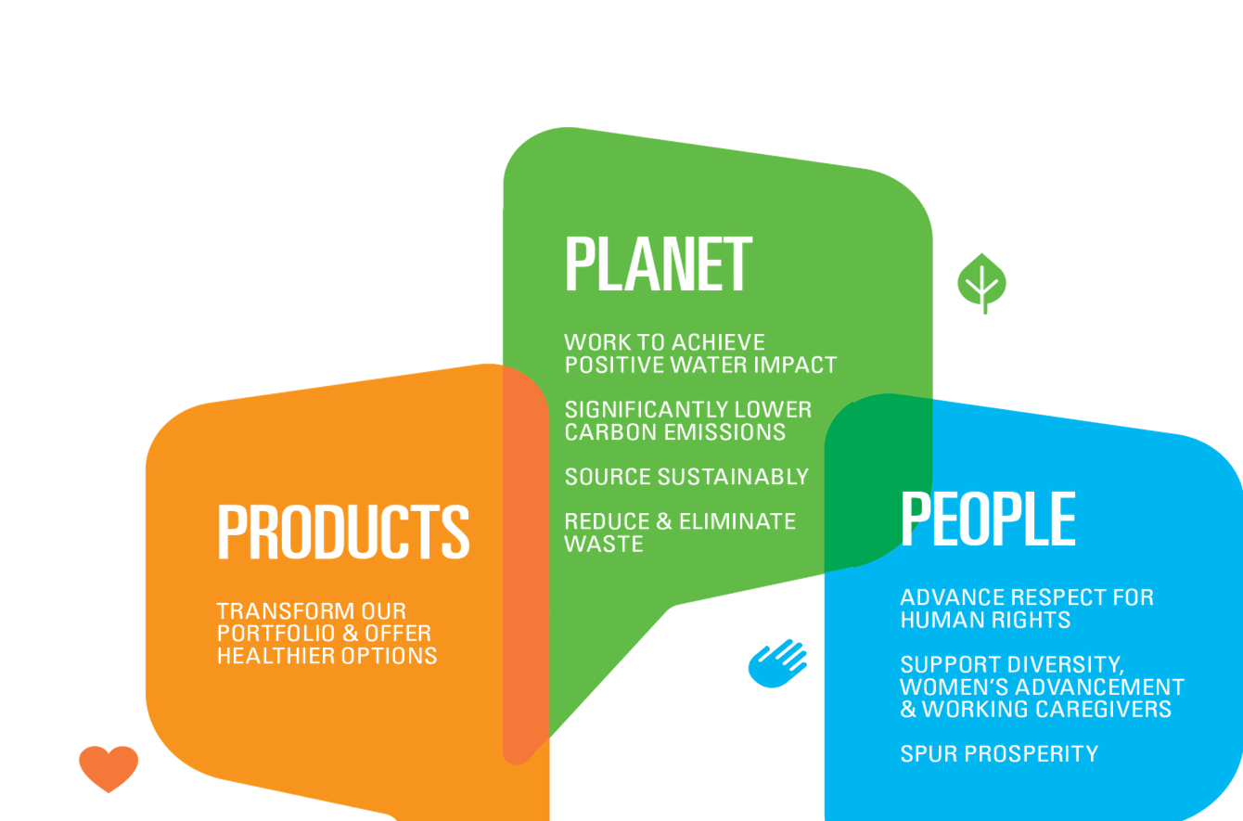
PERFORMANCE WITH PURPOSE:
OUR AGENDA FOR THE NEXT DECADE
To increase substantially our efforts to
improve the products we sell, protect our planet
and empower people around the world
in order to contribute solutions to
shared challenges
Notes:
A decade ago, we launched Performance with Purpose—PepsiCo’s vision to deliver top‑tier financial performance over the long term by integrating sustainability into our business strategy. Since then, we have demonstrated what’s possible when a company does well by also doing good.
This strategic agenda is designed to improve the products we sell, protect our planet better and empower people around the world in order to help find solutions to our shared challenges.
The three focus areas of Performance with Purpose, now referred to as “Products,” “Planet” and “People” emphasize the connected nature of our business to the world around it. Each of these three focus areas of the Performance with Purpose agenda contains a series of goals grouped under themes.

Slide 10
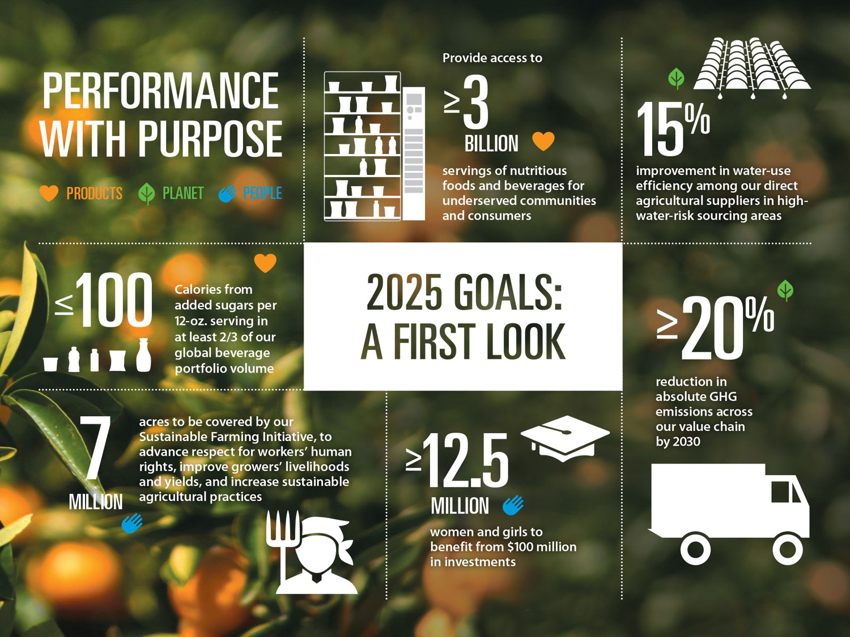
Notes:
Our headline goals highlight the ambition of the planned transformation across our global business.
Action to reduce added sugars across our beverage portfolio
More nutritious products, with a focus on meeting the needs of currently underserved communities and consumers
Increased water efficiency in agriculture among direct suppliers
A new, science-based target to cut absolute greenhouse gas (GHG) emissions across our entire value chain. We were among the first 30 companies in the world to have our target officially recognized as science-based (by the Science-Based Targets Initiative). This is recognition that PepsiCo is doing its part and working to contribute to the achievement of the global targets set in the Paris Agreement on climate change
Renewing our focus on the advancement of women and girls, with $100 million of investments
Further expansion of our global Sustainable Farming Initiative
We can now look at the detail of goals across each of the three pillars.

Slide 11

Our value stream: Where do you fit in?
Notes:
As we go through our business model, think about where you and your company could fit into our world

Slide 12
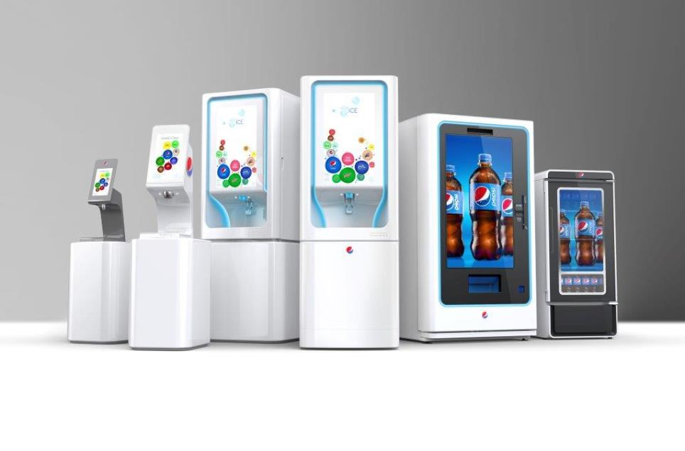
Innovate
Notes:
When I’m talking Innovate as part of our Value Chain, it’s all about new products. Whether it’s idea generating, R&D testing, or consumer testing.

Slide 13

Source
Notes:
How are we going to make this great new product? What awesome new flavors or ingredients will we need? Acai is out! Mangosteen is in! Is it time to get back on the super grain train?
What about the packaging? Will we need a newer light weight packaging to make our products easier to ship when you start ordering it from online from Amazon and dropped off by a drone?

Slide 14
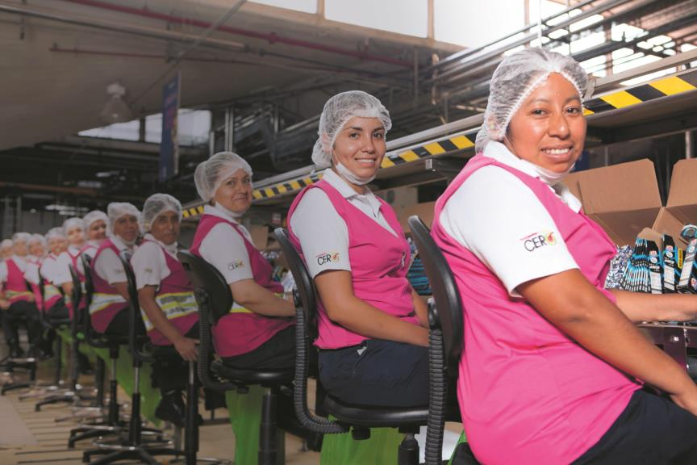
Make
Notes:
At the PepsiCo Vallejo Biscuit Plant in Mexico City, one of PepsiCo’s main manufacturing facilities for Gamesa cookies, there is one product packaging line that is a little different from the rest. The line is called “La Linea Rosa,” or “the Pink Line,” and it’s staffed entirely by women who wear pink vests and operate pink equipment. Today the Pink Line serves as a developmental program, training and preparing women for non-traditional jobs.
We have over 700 manufacturing facilities world wide. Just think of what it takes to keep those locations humming? We need expert engineers to help keep those machines running. We need partners to help bundle the products into variety packs.
The University of Iowa Power Plant biomass reactor uses 40,000 tons annually of Quaker Oats oat hulls to generate power!

Slide 15
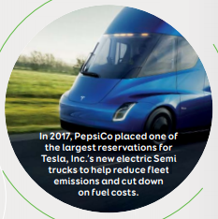
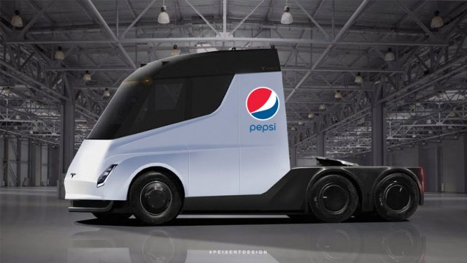
Move
Notes:
Did you know that PepsiCo made the biggest public pre-order of Tesla Electric Trucks?! Over 100. But in addition to the trucks we’ll still need warehouses and distribution centers to manage the products. We are working on doing this smarter through automated racks and automatic picking. (example of robotic picking / moving in warehouses).

Slide 16
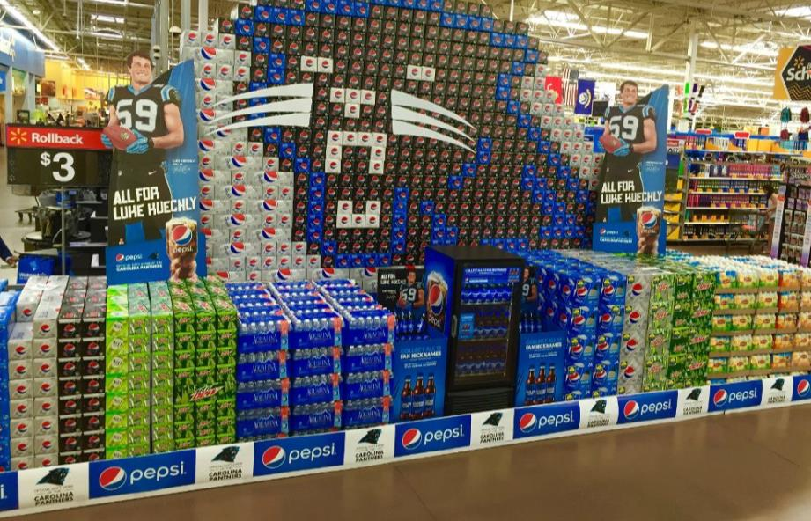
Sell
Notes:
This stuff doesn’t sell itself! We have an army of sales women and men that need all sorts of support to promote our items in-store and come up with great ideas to connect to our consumers.

Slide 17

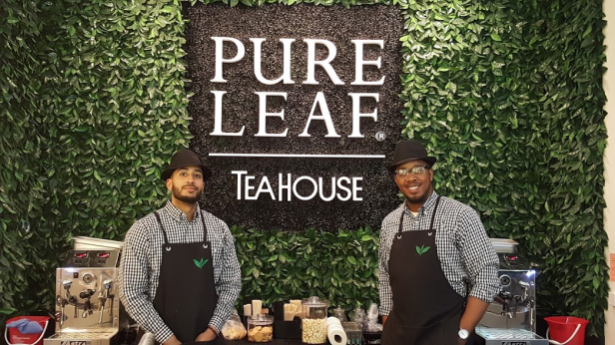
Market
Notes:
It doesn’t stop in the store, what are we doing to keep people excited about our products?

Slide 18


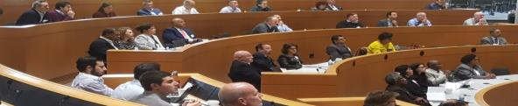
CURRENT SUPPLIER DIVERSITY PROGRAM
23
+35
CATEGORIES
YRS
contributing to PepsiCo’s supply chain
OF SPEND
AD PRODUCTION • AGENCIES • FULFILLMENT • POS - PREMIUMS • PERMANENT DISPLAYS • TEMPORARY DISPLAYS PRIMARY FREIGHT • FLEET FUEL • FOOD INGREDIENTS • BEVERAGE INGREDIENTS LICENSING AND REGISTRATION • •TRUCK/TRAILER - SERVICES •
2018 Engagement
12 national events, more than 20 regional events attended resulting in over 15,000 impressions not including social media
Tier 2 expansion
Achieved Platinum recognition in WBENC Tops Corps
2 Diverse Supplier Diversity Partner Events held within PepsiCo
IDENTIFY
VET
CULTIVATE
Notes:
So here’s a little about our Supplier Diversity Program
Reveal #1 – We’ve been around since 1982
Reveal #2a – We support every category of spend in the company. The official 23 categories and a multiple areas of rogue spend.
Reveal #2b – Over that 35 years generated 22 Billion dollars of spend with DivBEs
Reveal #3 – In 2017 we had a few key highlights
Reveal #4 – 12 national events, 20 regional events garnering us over 15K impressions even before social media
Reveal #5 – We aggressively encouraged our non-diverse suppliers to work with DivBEs
Reveal #6 – We achieved the Platinum level of WBENC’s Top Corporation recognition. FINALLY!
Reveal #7 – We inaugurated our Supplier Diversity Partner Event (in New York alone that generated 158 match maker meetings)
Reveal #8 – Our Primary Objectives with suppliers is to Identify – Vet - Cultivate

Slide 19
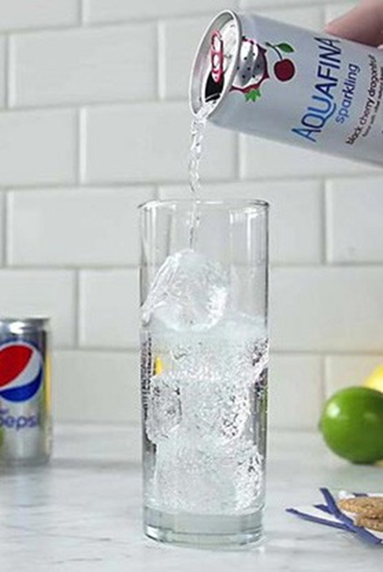



PepsiCo’s Supplier Diversity Team
Paige Adams
Sr. Manager, Supplier Diversity
Paige.Adams@pepsico.com
Plano, TX
Trung Tieu
Assoc. Manager Supplier Diversity
Trung.T.Tieu@pepsico.com
Purchase, NY
Milena Yoraschek
Supplier Diversity Coordinator
Milena.Yoraschek@pepsico.comPurchase, NY
Notes:
This is our small but mighty team!

Slide 20

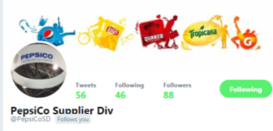
Get connected!
How to register your company
If you are a certified DivBE and are interested in registering with PepsiCo as part of our Supplier Diversity program, please go to: www.PepsiCo.com/SDRegistration .
Follow us on twitter
@PepsiCoSD
@PepsiCoTrung

Slide 21
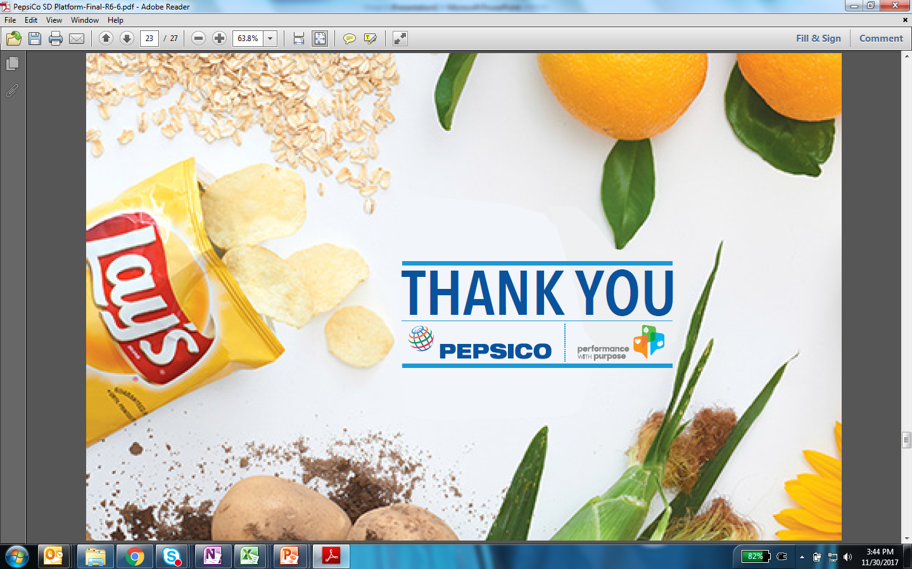

Slide 22

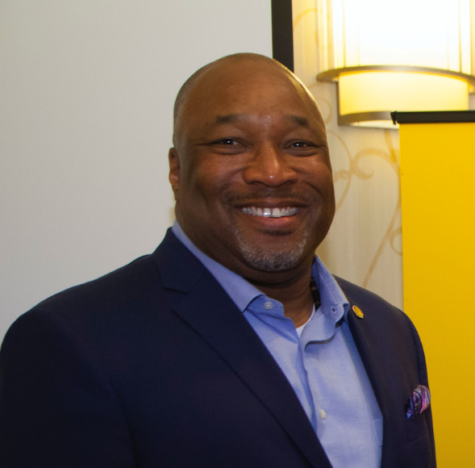
THIS IS SHELL
Brian Hall
Manager, Supplier Diversity, Advocacy & SBLO
Shell Oil Company

Slide 23
Definitions & cautionary note
The companies in which Royal Dutch Shell plc directly and indirectly owns investments are separate legal entities. In this presentation “Shell”, “Shell group” and “Royal Dutch Shell” are sometimes used for convenience where references are made to Royal Dutch Shell plc and its subsidiaries in general. Likewise, the words “we”, “us” and “our” are also used to refer to Royal Dutch Shell plc and its subsidiaries in general or to those who work for them. These terms are also used where no useful purpose is served by identifying the particular entity or entities. ‘‘Subsidiaries’’, “Shell subsidiaries” and “Shell companies” as used in this presentation refer to entities over which Royal Dutch Shell plc either directly or indirectly has control. Entities and unincorporated arrangements over which Shell has joint control are generally referred to as “joint ventures” and “joint operations”, respectively. Entities over which Shell has significant influence but neither control nor joint control are referred to as “associates”. The term “Shell interest” is used for convenience to indicate the direct and/or indirect ownership interest held by Shell in an entity or unincorporated joint arrangement, after exclusion of all third-party interest.
This presentation contains forward-looking statements (within the meaning of the U.S. Private Securities Litigation Reform Act of 1995) concerning the financial condition, results of operations and businesses of Royal Dutch Shell. All statements other than statements of historical fact are, or may be deemed to be, forward-looking statements. Forward-looking statements are statements of future expectations that are based on management’s current expectations and assumptions and involve known and unknown risks and uncertainties that could cause actual results, performance or events to differ materially from those expressed or implied in these statements. Forward-looking statements include, among other things, statements concerning the potential exposure of Royal Dutch Shell to market risks and statements expressing management’s expectations, beliefs, estimates, forecasts, projections and assumptions. These forward-looking statements are identified by their use of terms and phrases such as “aim”, “ambition’, ‘‘anticipate’’, ‘‘believe’’, ‘‘could’’, ‘‘estimate’’, ‘‘expect’’, ‘‘goals’’, ‘‘intend’’, ‘‘may’’, ‘‘objectives’’, ‘‘outlook’’, ‘‘plan’’, ‘‘probably’’, ‘‘project’’, ‘‘risks’’, “schedule”, ‘‘seek’’, ‘‘should’’, ‘‘target’’, ‘‘will’’ and similar terms and phrases. There are a number of factors that could affect the future operations of Royal Dutch Shell and could cause those results to differ materially from those expressed in the forward-looking statements included in this presentation, including (without limitation): (a) price fluctuations in crude oil and natural gas; (b) changes in demand for Shell’s products; (c) currency fluctuations; (d) drilling and production results; (e) reserves estimates; (f) loss of market share and industry competition; (g) environmental and physical risks; (h) risks associated with the identification of suitable potential acquisition properties and targets, and successful negotiation and completion of such transactions; (i) the risk of doing business in developing countries and countries subject to international sanctions; (j) legislative, fiscal and regulatory developments including regulatory measures addressing climate change; (k) economic and financial market conditions in various countries and regions; (l) political risks, including the risks of expropriation and renegotiation of the terms of contracts with governmental entities, delays or advancements in the approval of projects and delays in the reimbursement for shared costs; and (m) changes in trading conditions. No assurance is provided that future dividend payments will match or exceed previous dividend payments. All forward-looking statements contained in this presentation are expressly qualified in their entirety by the cautionary statements contained or referred to in this section. Readers should not place undue reliance on forward-looking statements. Additional risk factors that may affect future results are contained in Royal Dutch Shell’s Form 20-F for the year ended December 31, 2017 (available at www.shell.com/investor and www.sec.gov ). These risk factors also expressly qualify all forward-looking statements contained in this presentation and should be considered by the reader. Each forward-looking statement speaks only as of the date of this presentation, May 28, 2019. Neither Royal Dutch Shell plc nor any of its subsidiaries undertake any obligation to publicly update or revise any forward-looking statement as a result of new information, future events or other information. In light of these risks, results could differ materially from those stated, implied or inferred from the forward-looking statements contained in this presentation.
We may have used certain terms, such as resources, in this presentation that the United States Securities and Exchange Commission (SEC) strictly prohibits us from including in our filings with the SEC. U.S. Investors are urged to consider closely the disclosure in our Form 20-F, File No 1-32575, available on the SEC website www.sec.gov.

Slide 24

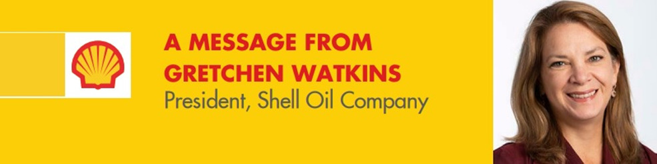
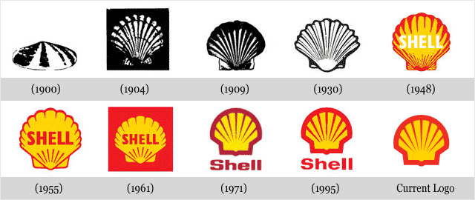
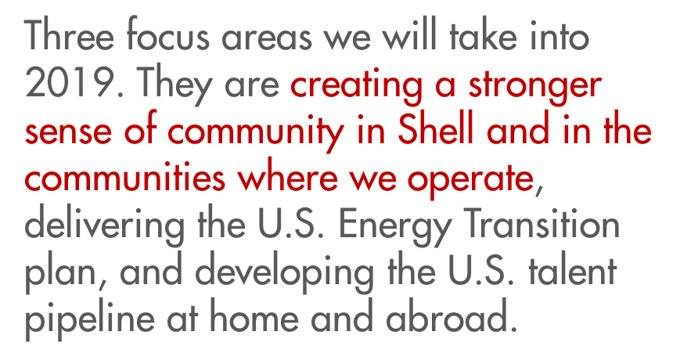
DELIVER TODAY, PREPARE FOR TOMORROW
SHELL FACTS AND IMPACT
Royal-Dutch Shell
70+ COUNTRIES
92,000 EMPLOYEES
57.1 MILLION TONNES OF LNG SOLD DURING THE YEAR
22 REFINERIES
3.7 MILLION BARRELS OF OIL EQUIVALENT WE PRODUCE PER DAY
https://eu001-sp.shell.com/sites/AAAAA1605/UI/ERUS/SR/default.aspx

Slide 25
Shell business overview
05
Sales and marketing
01
Exploration
Retail
Lubricants
Aviation
Power
Customers
Exploring for oil
and gas: offshore
Exploring for oil
and gas: onshore
04
Transport and trading
02
Development and extraction
Liquefying gas
by cooling (LNG)
Shipping
and trading
Regasifying
(LNG)
Supply and distribution
Developing
fields
Producing oil
and gas
Extracting
bitumen
03
Manufacturing and energy production
Upgrading
bitumen
Refining oil into
fuels and lubricants
Converting gas into liquid products (GTL)
Producing petrochemicals
Producing
biofuels
Generating
power

Slide 26

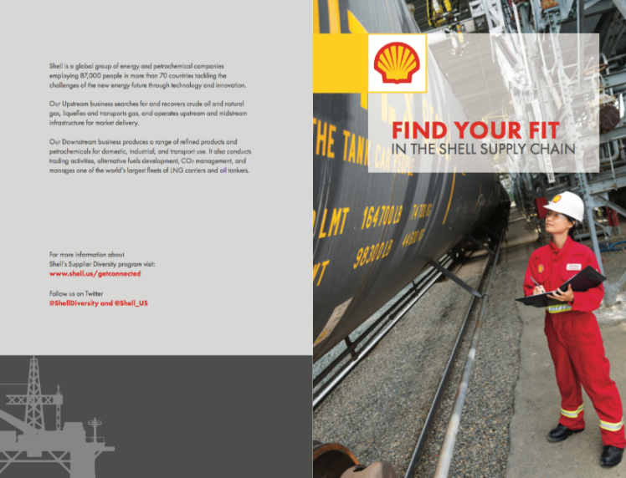
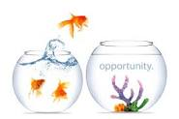


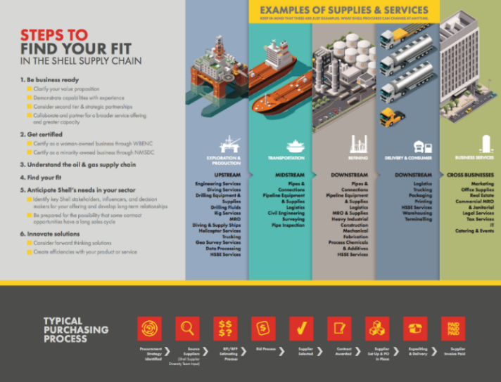

Keys to Business Development in the Oil & Gas Industry
10% (6%)
70/30
www.Shell.us/GetConnected

Slide 28

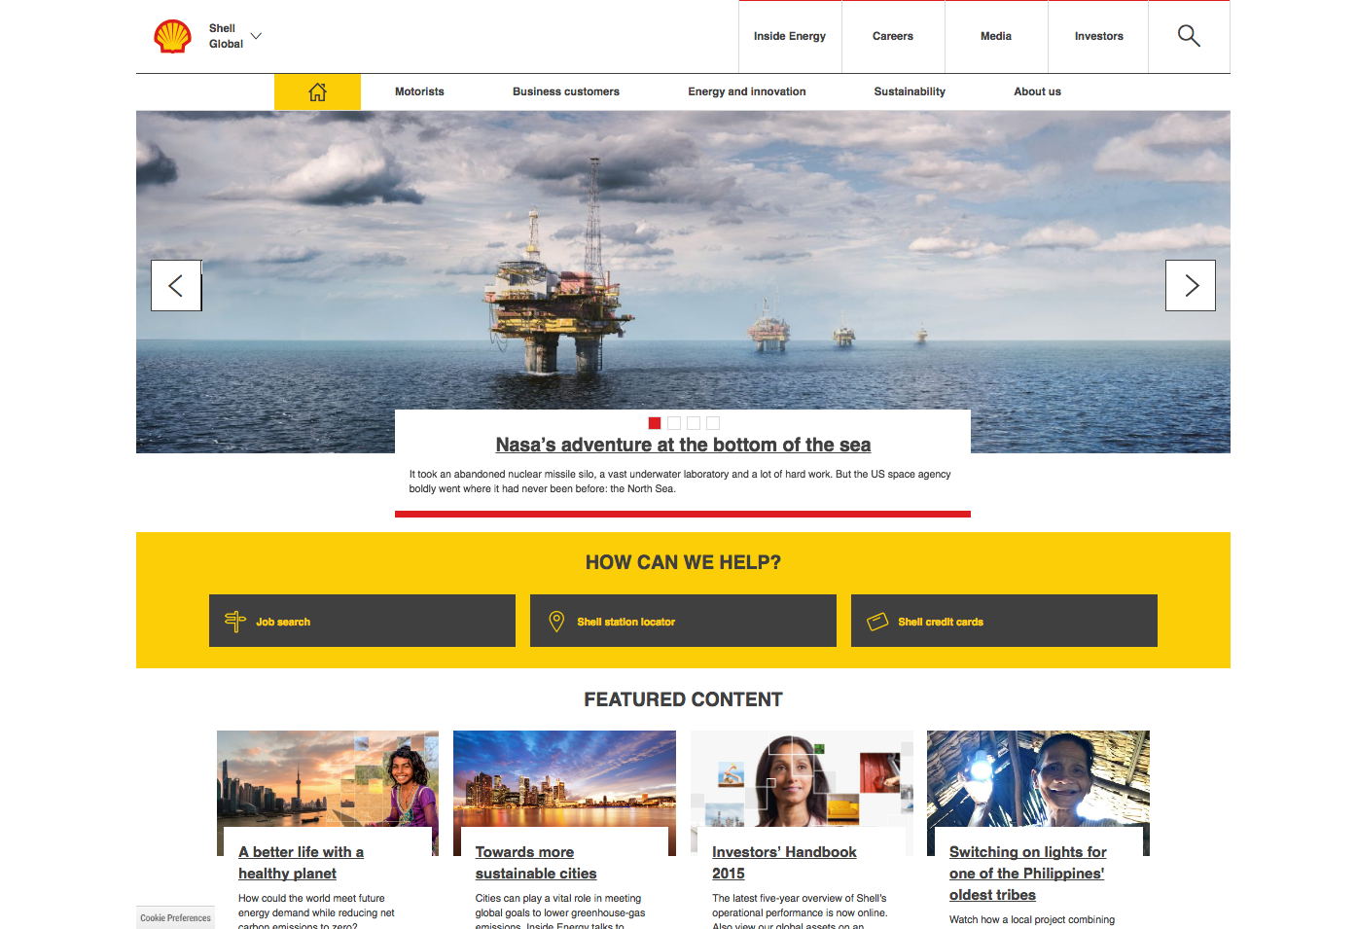

Discover more at www.shell.us/getconnected
youtube.com/shell
facebook.com/shell
@Shell on Twitter
flickr.com/photos/royaldutchshell
shell.com/inside_energy
Notes:
www.Shell.com
www.Shell.us

Slide 29
Notes and Key Points to Business Development
Legal - Not a commitment to buy or contract with any supplier in the room.
$ - Shell currently invests over $1.1bln in Small Business Concerns including VOB, VOSB, SD-VOSBs
10 % - Shell’s commitment to develop supply chain opportunities in the US. Being addressed by LOB Teams.
70/30 - Split of time for the Day in the life of an SBLO. Well, for THIS SBLO. I ask for Need. Why. Risks if not fulfilled.
WEBSITE: This is YOUR Tool. Ask for it from others. Go to www.Shell.us/GetConnected for reasons and resources.
FISHBOWL: Follow the opportunities! Does a Shell LoB have a current Opportunity/Need for your category?
CERTIFICATION: Focus on Supplier Development of current CERTIFIED suppliers for growth.
RELATIONSHIPS: Certification to me means, you have Expanded Access to our companies. Start with relationships.
FIND YOUR FIT! This is where most of your time should be spent…in ANY Supply Chain.
Be Strategic in your pursuit. Read a leader’s remarks. Learn Our Business (next slide) Align strategies.
Be clear on you value offering. Not what you do, but why it matters. Confirm the need.
Attend and Engage at events. Be patient. Be Clear on Expectations.
Know the Process for the opportunity and the company. Be aware of where you are in the sales cycle.

Slide 30
What is an Elevator Pitch?
30-60 second business description of your company
Here is what I do
Here is my value proposition
Here is how I solve your problem

Slide 31
Why is it so important?
Need to make a powerful impression
People need clearly understand what you do in a short amount time
Forces you to be clear and concise

Slide 32
10 Essential Elements of a
Powerful Elevator Pitch
Concise
Clear
Powerful
Passion
What, why, & how
Have a Hook
Goal-Oriented
Know your Audience
Practice
Feels natural

Slide 33
Getting Started
Write it ALL down. Everything you do. Get as many ideas down as you can
Decide on a goal. Do you want to make a sale, gain a prospect, or something else?
Write 1-20 action statements designed to spur the action associated with your goal.
Develop a story that illustrates your value proposition. Paint a picture with words.

Slide 34
Edit and Refine
Record your pitch.
Highlight the good stuff. Does it sound natural? Did you answer the What, how, and why questions? Do you sound excited or stressed?
Make edits and record again.

Slide 35
Final touches
Practice saying it. Find friends, clients, colleagues and get feedback. Get comfortable saying it to people. Watch for their reactions.
Say it naturally. Practice until it rolls of your tongue. Be so comfortable with it that you don’t get tripped up on any words, phrases.
Keep refining. Add new phrases; keep it fresh and interesting.

Slide 36
REMINDER
Empower me to go back to my buyers and champion your message!

Slide 37
Understanding the Elements
Concise: No longer than 30-60 seconds.
Clear: Use language that everyone understands.
Powerful: Use words that are powerful and strong; results oriented.
Passion: People expect energy and dedication from entrepreneurs

Slide 38
Understanding the Elements
What, how, and why: you need to be able to answer ALL of these questions AND how it will solve their problem
Has a Hook: An interesting fact or stat; something to get gets/keeps their attention
Goal-Oriented: What is your desired outcome? You may have different pitches depending on different objectives.

Slide 39
Understanding the Elements
Know your audience: If you have different audiences you might want to tailor to them.
Practice: Get feedback from colleagues, clients you trust, friends and family. Then PRACTICE over and over again
Feels natural: the best pitches feel like a conversation and are comfortable to give and hear

