Slide 1


SAN ANTONIO
2019
9th Annual Veteran Entrepreneur Training Symposium
May 29 – 31, 2019 | San Antonio, Texas

Slide 2

CPARS and Open Ratings:
How Do They Impact Your Company’s Bid?

Slide 3

Cindy Gaddis
Vice President, TargetGov
U.S. Army Veteran
Co-author, The Veterans Business Guide: How to Build a Successful Government Contracting Business
PMI.org certified Project Management Professional (PMP)
Business Development Expert with over $1 Billion in Federal Contract wins
Master’s Computer Information Systems
National Contract Management Association (NCMA) member
CindyGaddis@targetgov.com

Slide 4
Agenda
How the CPARS and Open Ratings impact current bids
How the government rates contractor performance
How companies can achieve the highest CPARS rating
9th Annual Veteran Entrepreneur Training Symposium
May 29 – 31, 2019 | San Antonio, Texas
© TargetGov 2019

Slide 5

How the CPARS and Open Ratings Impact Current Bids
The Past = The Greatest Predictor of the Future
  Contract Termination
  Liability
  Legal Expenses
  Disbarred

Slide 6
Evaluation Criteria
Typically, the Past Performance is one of the highest rated elements of a solicitation; in order to obtain the highest possible rating, CPARS, Open Rating, and other positive past experience MUST be demonstrated

Slide 7

Evaluation Criteria
CPARS
Effective January 15, 2019, PPIRS was officially retired to conclude its merger with the CPARS
D & B
Recognized source to obtain financial viability and past performance

Slide 8

Evaluation Criteria
References
  Suppliers
  Commercial Customers
  Subcontractors
  Government Agencies
  Business and Trade Associations

Slide 9

Evaluation Criteria
Metrics
PROOF: Quantitative measures of demonstrated success

Slide 10
HOW THE GOVERNMENT RATES CONTRACTOR PERFORMANCE
FAR 9.104 Meet Applicable General Standards
FAR 9.105-1 Determine Responsibility

Slide 11

FAR 9.104 Meet Applicable General Standards
Adequate finance resources or ability to obtain
Ability to comply with required or proposed delivery
Satisfactory performance record
Satisfactory record of integrity and business ethics
Have or demonstrated ability to obtain equipment, facilities
Otherwise qualified and eligible to receive award

Slide 12
FAR 9.105-1 Determine Responsibility
Meet applicable general standards
Pre-award surveys
Other sources to determine financial resources and performance capability
CPARS
Records and experience data; to include verifiable knowledge of personnel
SAM.gov registrations and certifications
Questionnaire responses, financial data, and personnel
Commercial sources
Other sources; i.e. publicly available information, suppliers, subcontractors, current customers, financial institutions, Government agencies, along with business and trade associations

Slide 13
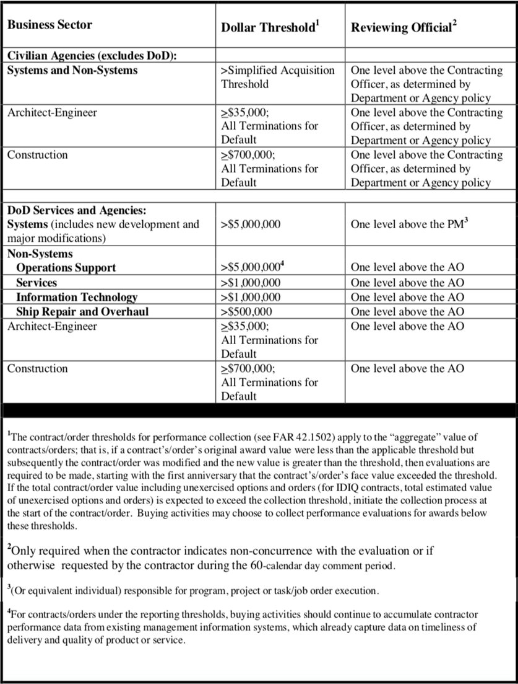
HOW COMPANIES CAN ACHIEVE THE HIGHEST CPARS RATING
CPARS Applicability – not all contracts require a CPARS rating
CPARS Ratings are based upon the following business sector and dollar threshold

Slide 14
CPARS Applicability
Business Sector | Dollar Threshold | Reviewing Official
Civilian Agencies (excludes DoD)
Systems and Non-Systems | >Simplified Acquisition | One level above the Contracting Officer, as determined by Department or Agency policy
Architect-Engineer | ≥$35,000; All Terminations for Default | One level above the Contracting Officer, as determined by Department or Agency policy
Construction | ≥$700,000; All Terminations for Default | One level above the Contracting Officer, as determined by Department or Agency policy

Slide 15
CPARS Applicability
Business Sector | Dollar Threshold | Reviewing Official
DoD Services and Agencies: Systems (includes new development and major modifications) | >$5,000,000 | One level above the PM
Non-Systems Operations Support | >$5,000,000 | One level above the AO
Services | >$1,000,000 | One level above the AO
Information Technology | >$1,000,000 | One level above the AO
Ship Repair and Overhaul | >$500,000 | One level above the AO
Architect-Engineer | ≥$35,000; All Terminations for Default | One level above the AO
Construction | ≥$700,000; All Terminations for Default | One level above the AO

Slide 16

CPARS Applicability – not all contracts require a CPARS rating
It is in the best interest of the vendor to know if their contract requires a CPAR evaluation
FAR Case 2018-004: Increased Micro-Purchase and Simplified Acquisition Thresholds

Slide 17
What do I have to do to get an “A”…or in this case EXCEPTIONAL!
Know what you have to do get EXCEPTIONAL before you begin work on the contract
Set deliberate goals to achieve the EXCEPTIONAL criteria
Track and report these successes to the reporting official
Provide the supporting verbiage to the reporting official BEFORE they complete the initial CPARS
ALWAYS provide a response to your CPARS evaluation, even if they gave you the best possible rating; it’s your opportunity to “speak” to your future customers; do not squander the opportunity

Slide 18
CPARS Evaluation Ratings Definitions
(FAR 42.1503)

Slide 19
CPARS Evaluation Ratings Definitions
Reference: FAR 42.1503, Table 42-1
Rating | Definition | Note
Exceptional | Performance meets contractual requirements and exceeds many to the Government’s benefit. The contractual performance of the element or sub-element being evaluated was accomplished with few minor problems for which corrective actions taken by the contractor were highly effective. | To justify an Exceptional rating, identify multiple significant events and state how they were of benefit to the Government. A singular benefit, however, could be of such magnitude that it alone constitutes an Exceptional rating. Also, there should have been NO significant weaknesses identified.

Slide 20
CPARS Evaluation Ratings Definitions
Reference: FAR 42.1503, Table 42-1
Rating | Definition | Note
Very Good | Performance meets contractual requirements and exceeds some to the Government’s benefit. The contractual performance of the element or sub-element being evaluated was accomplished with some minor problems for which corrective actions taken by the contractor was effective. | To justify a Very Good rating, identify a significant event and state how it was a benefit to the Government. There should have been no significant weaknesses identified.

Slide 21
CPARS Evaluation Ratings Definitions
Reference: FAR 42.1503, Table 42-1
Rating | Definition | Note
Satisfactory | Performance meets contractual requirements. The contractual performance of the element or sub-element contains some minor problems for which corrective actions taken by the contractor appear or were satisfactory. | To justify a Satisfactory rating, there should have been only minor problems, or major problems the contractor recovered from without impact to the contract/order. There should have been NO significant weaknesses identified. A fundamental principle of assigning ratings is that contractors will not be evaluated with a rating lower than Satisfactory solely for not performing beyond the requirements of the contract/order.

Slide 22
CPARS Evaluation Ratings Definitions
Reference: FAR 42.1503, Table 42-1
Rating | Definition | Note
Marginal | Performance does not meet some contractual requirements. The contractual performance of the element or sub-element being evaluated reflects a serious problem for which the contractor has not yet identified corrective actions. The contractor’s proposed actions appear only marginally effective or were not fully implemented. | To justify Marginal performance, identify a significant event in each category that the contractor had trouble overcoming and state how it impacted the Government. A Marginal rating should be supported by referencing the management tool that notified the contractor of the contractual deficiency (e.g., management, quality, safety, or environmental deficiency report or letter).

Slide 23
CPARS Evaluation Ratings Definitions
Reference: FAR 42.1503, Table 42-1
Rating | Definition | Note
Unsatisfactory | Performance does not meet most contractual requirements and recovery is not likely in a timely manner. The contractual performance of the element or sub-element contains a serious problem(s) for which the contractor’s corrective actions appear or were ineffective. | To justify an Unsatisfactory rating, identify multiple significant events in each category that the contractor had trouble overcoming and state how it impacted the Government. A singular problem, however, could be of such serious magnitude that it alone constitutes an unsatisfactory rating. An Unsatisfactory rating should be supported by referencing the management tools used to notify the contractor of the contractual deficiencies (e.g., management, quality, safety, or environmental deficiency reports, or letters).
NOTE: N/A (not applicable) should be used if the ratings are not going to be applied to a particular area for evaluations.

Slide 24

Handouts
Session Slides
TargetGov Rule of Three™
TargetGov Matchmaking and Briefing Pitch
TargetGov Sample Capability Statement

Slide 25

Questions?
Cindy Gaddis
TargetGov Vice President
Contact:
  CindyGaddis@TargetGov.com
  Toll-free: 866.579.1346 x325
  www.TargetGov.com

