Slide 1
SAN ANTONIO
2019
Smart Pursuit and Teaming Effectively
9th Annual Veteran Entrepreneur Training Symposium
May 29 – 31, 2019 | San Antonio, Texas

Slide 2
Introductions
Al Saxon – SVP, Sales & Marketing, Principal
Federal B&P Experience
VETS GWAC ($200 Million)
GSA Schedule 70 ($50 Million)
GSA Schedule 84 (<$1 Million)
GSA Connections II ($75 Million)
Direct Awards
Full & Open
Set-Aside
Multiple BPA’s
First fed sale ruined me for life

Slide 3
VA Martinsburg
OUR FIRST:
Federal Contract
Sch 70 Contract
DAS Sale!
SDVOSB Set-Aside, Sole Source
Urgent Need to cover the Coop
In-Building Cellular
Delivered on time, on budget
(6 week timeframe)
Rooftop work in January
Six Carriers

Slide 4
Vision Technologies
Service Disabled Vet (SDVOSB)
Founded May 2000
Revenue on track to eclipse $130 Million in 2019
Over $1 Billion in revenue since opening our doors
Offices in Maryland, Northern VA, Las Vegas, South Carolina
Diverse National Workforce consisting of 550+ teammates
Geographically Dispersed Workforce in 23 States
National Delivery (800+ VPP Partners)
Prime on CNX 2, Schedule 70, 84
Multiple BPA’s – NIH and VA

Slide 5
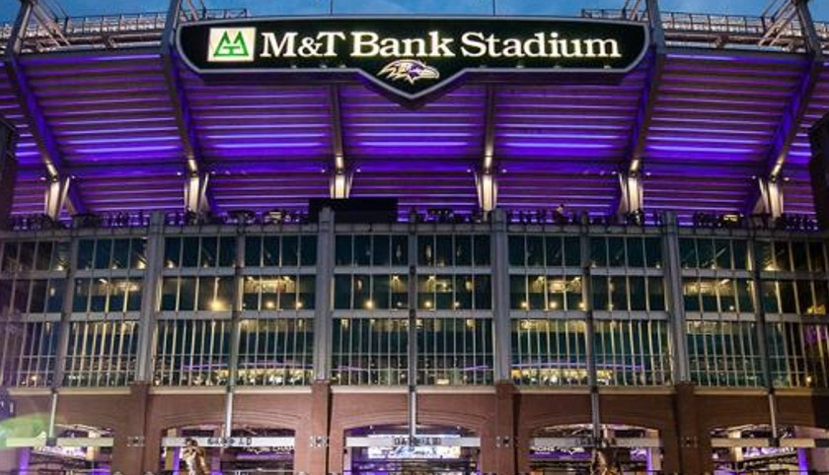
Vision Services
Official AV Partner to the Baltimore Ravens
Security Systems
Audio Visual
WiFi
DAS
Cabling
Data Center Support
O&M
Professional Services
Commercial and FED/SLED customer Mix

Slide 6
Key Learning Objectives
Teaming Structures
Pursuit Strategies
The structure of your team is critical to the success of the pursuit and the achievement of your revenue.
How to attack the deal? Prime or sub? Assemble the best and brightest?
Teaming
Pursuit
Pre-vs-Post Award BD Strategies
Workshare Commitment
Team now or later? Wait for the winner to be selected, and roll the dice on team composition?
No commitment, no loyalty. Define your value proposition up front.
BD Strategies
Workshare

Slide 7
Teaming Structures
Finding the right structure is part of your winning strategy
Prime-Sub
Joint Ventures
Traditional structure. One company leads, fills gaps with subcontractor teammates.
A business entity created by two or more parties, generally characterized by shared ownership, shared returns and risks, and shared governance
Contractor Teaming Agreement
Partnerships
GSA Schedules. All teammates have privity to customer. Invoicing direct to customer on Schedule
Address the purpose of the partnership and the authority and responsibility of each partner.

Slide 8
Prime vs Sub
Prime
Manages the contract
Recognizes all revenue
Privity with customer
Sub
Responsible for their piece
Reports to the Prime
Paid by Prime
Responsible for all deliverables
Financial Responsibility
No privity on contract

Slide 9
Pre- or Post- Award Teaming
Pre-Award Teaming
Post Award Teaming
Capture Team Support
Pursuit Support
Proposal Support
Stake out swimlanes
Establish(ed) relationships
Leverage team past performance
Mentoring
Pricing guidance
You know who won ☺
Targeted BD to fill gaps
Leverage customer relationship
Price-points are known

Slide 10
Workshare Commitment
4
Hunter Killer You find it, kill it, cook it and eat it.
3
Swim Lanes Pre-defining each teammates role and responsibility
2
Best Effort SubK agreement fails to define specific workshare. A good Prime looks to maximize sub’s portion
1
Team Assembly
Slotting your skillset(s) into the team to meet defined criteria in the RFP

Slide 11
You want Defined Workshare
Best Effort means you help them win, hope they find something for you ☹
Workshare can be defined many ways
Percentage of revenue
Specific billets
Project types
Get it in writing
Subcontract agreement
Teaming agreement
Win Parties – 5
Revenue - 0

Slide 12
GSA Schedule Contractor Team Arrangement
A GSA Schedule CTA is an arrangement between two or more MAS contractors to work together to meet Government requirements.
It enables two or more vendors to present a team approach to providing solutions; this is different from a prime contractor/subcontractor type of relationship.
A GSA Schedule Contractor Team Arrangement (CTA) is an arrangement in which two or more GSA Schedule contractors team together to provide a total solution to meet a customer's needs. Under Schedule CTAs, contractors complement each other and it allows teams to compete for orders for which they may not qualify independently. GSA encourages the use of CTAs to meet buyer’s requirements.

Slide 13
CTA
No “Prime” Contractor
Each contractor has privity to govt
Multiple Schedules
Individual Invoices by Schedule
GSA pays each invoice directly to contractor
One consolidated invoice
Cash distributed upon payment to team members
Contractor 2 GSA Schedule
Contractor 3-X GSA Schedules
Contractor 1
GSA Schedule

Slide 14
Pursuit & Qualification Strategies
Do you know the customer’s environment?
Do you understand their issues?
Do you have a solution?
Do you have a vehicle?

Slide 15
Pursuit & Qualification Strategies
Do you know the customer’s environment?
Do you REALLY know the customer’s environment?
Do you know their Strategic Plan?
Do you know the competition?
Do you know the incumbent?
Are you familiar with the scale and scope of the engagement?
Can a partner provide a competitive edge?
Can you bring value to the incumbent?
Would you fill a gap for an existing team?
Can you handle the scale and scope of the engagement?

Slide 16
Pursuit & Qualification Strategies
Do you understand their issues?
Do you have a handle on their pain points?
What benefits will translate to a winning proposal?
How do you address their issues – stated and unstated?
Will your response be credible?

Slide 17
Pursuit & Qualification Strategies
Do you have a solution?
Just because you have a hammer doesn’t mean they have nails.
What is your win theme?
Does your response address TCO and ROI?
What’s the VALUE you bring to the table?

Slide 18
Pursuit & Qualification Strategies
Do you have a vehicle?
If there’s no vehicle, there’s no sale
The customer needs a way to buy
Credit cards
Schedules
BPA’s
Teaming partner vehicles
Set-Asides and partnering

Slide 19
Prime or Sub?
After answering these questions, what’s the winning strategy?
Fill the holes in your strategy to create a winning team.
Do you know the customer’s environment?
Do you understand their issues?
Do you have a solution?
Do you have a vehicle?

Slide 20
$100 Million? Surely there’s something for me!

Slide 21
A real-world example

Slide 22
By LCAT
100 Positions, 8 years
Prime – 51 slots
PM, High Value LCATS
Sub1 – 35 slots
Mid-tier positions
Sub 2 – 14 slots
Whatever is left…
What’s the opportunity if you weren’t on the team at the beginning?

Slide 23
And on the re-compete…You flip it!
When you outgrow the NAICS, you have a ready-made team with all the right past performance!
51/49 becomes 49/51
Score!

Slide 24
Against the Grain
Example of other winning strategies
Bidding off of FBO for Niche Solutions
It’s not always “too late”
Distributed Antenna Systems
In-building Cellular
Not many competitors
Demonstrated expertise
Channel support
Total exceeds $3 Million over the last 4 years
Cooperative Purchasing
Schedule 70 to SLED customers
$2 Million over the last 3 years

Slide 25
Contact Information
Al Saxon
Sr. VP, Sales & Marketing
443-690-3768
asaxon@visiontech.biz
Tom Cuneo
VP, Federal Business Development
540-454-6929
tcuneo@visiontech.biz

