Slide 1
Competitive Intelligence—Harnessing the Power of the Federal Procurement Data System (Part II)
SAN ANTONIO
2019
Presented by:
Wayne Simpson, CFCM, CSCM
May 30, 2019
9th Annual Veteran Entrepreneur Training Symposium
May 29 – 31, 2019 | San Antonio, Texas

Slide 2
FPDS-NG ezSearch Reports
FPDS-NG ezSearch
Reports

Slide 3
FPDS-NG “ezSearch”
Still in Beta version
Keyword search—type in one or more keywords
Refine search using four filler boxes to drill down by
Department/agency
Vendor and Vendor State
Clicking on links in documents returned in search allows further refining of search
FPDS-NG ezSearch
Reports

Slide 4
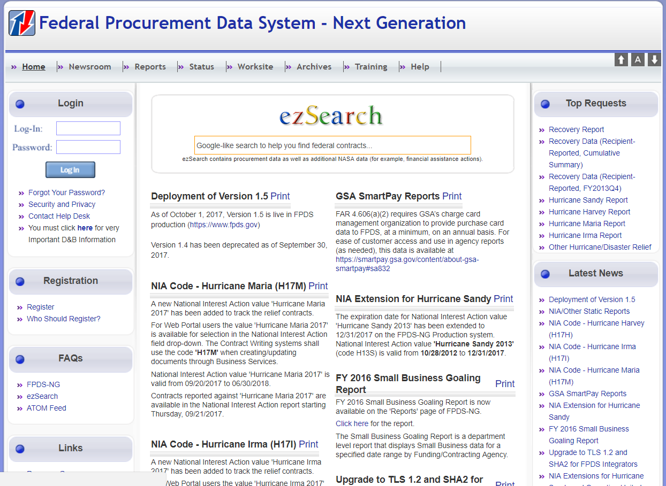
FPDS-NG ezSearch
Type in your search criteria
You do not have to be logged in to FPDS-NG to use ezSearch
FPDS-NG ezSearch
Reports

Slide 5
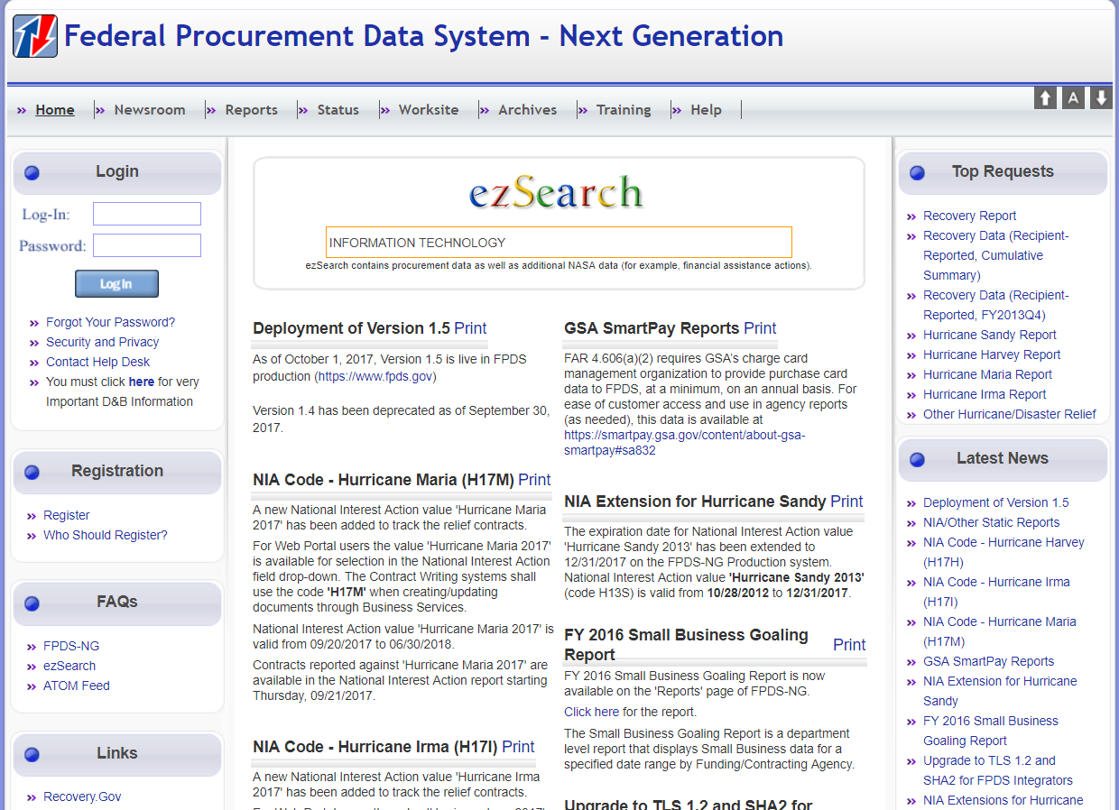
FPDS-NG ezSearch
Example: “Information Technology””
FPDS-NG ezSearch
Reports

Slide 6
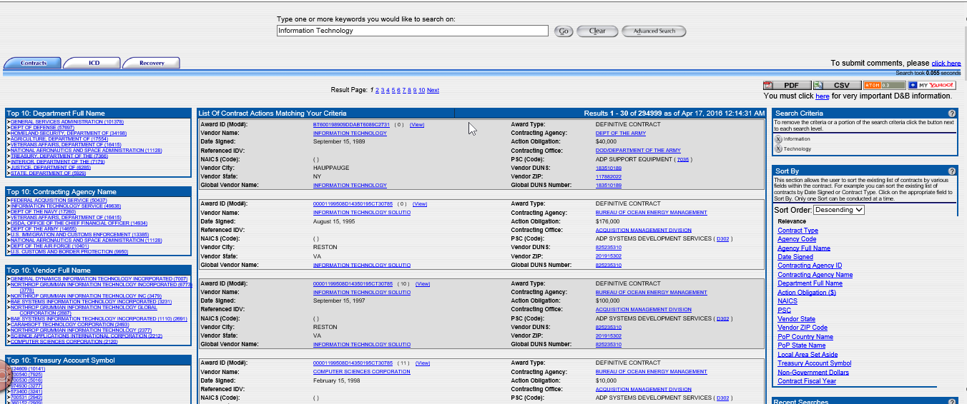
Returned results for “Information Technology”
Click on hyperlink for company name
FPDS-NG ezSearch
Reports

Slide 7
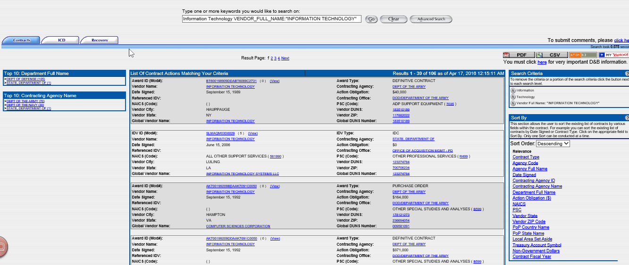
FPDS-NG ezSearch
Results returned from clicking on
Vendor Name hyperlink
FPDS-NG ezSearch
Reports

Slide 8
FPDS-NG Standard Reports
FPDS-NG Standard
Reports

Slide 9
FPDS-NG Standard Reports
The who…
The what…
When…
Where…
How…
FPDS-NG Standard Reports address all of these
FPDS-NG Standard
Reports

Slide 10
FPDS-NG Standard Reports
Start by logging in to your FPDS-NG Account
FPDS-NG Standard
Reports

Slide 11
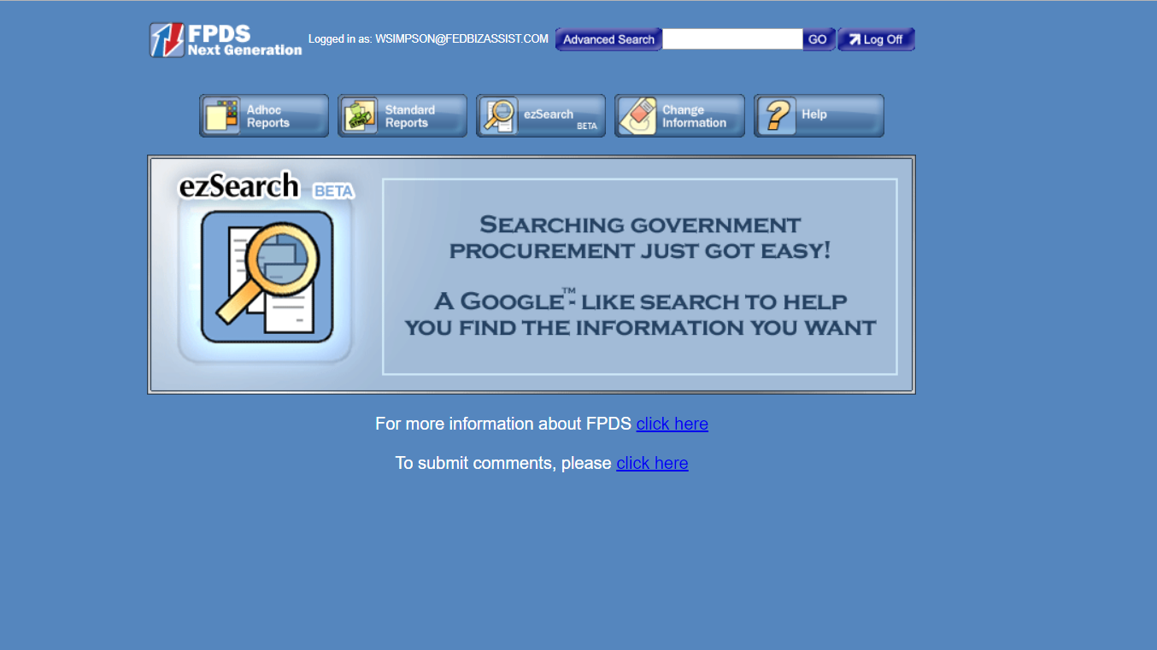
FPDS-NG Standard Reports
Click on
Standard Reports Tab
FPDS-NG Standard
Reports

Slide 12
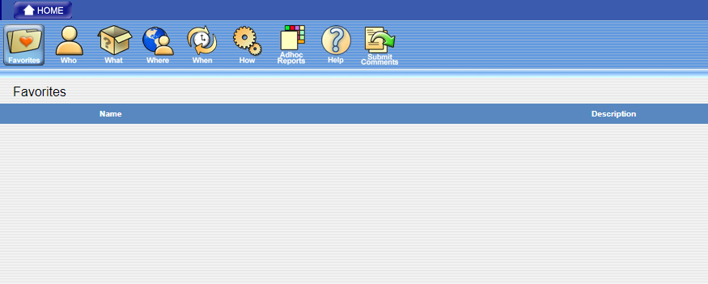
FPDS-NG Standard Reports
Standard Reports provide some of the “who,” “what,” “where,” “when,” and “how.” By clicking on each of these tabs all standard reports available are shown by name along with a description of the respective report.
Save frequently run reports in your “Favorites” Folder to save time
FPDS-NG Standard
Reports

Slide 13
FPDS-NG Ad hoc Reports
FPDS-NG Ad Hoc
Reports

Slide 14
FPDS-NG Adhoc Reports
1
Start by logging in to your FPDS-NG Account
Type Log-In
Type Password
Click “Log In”
Reminder:
Passwords must be changed every 90 days
FPDS-NG Ad Hoc
Reports

Slide 15
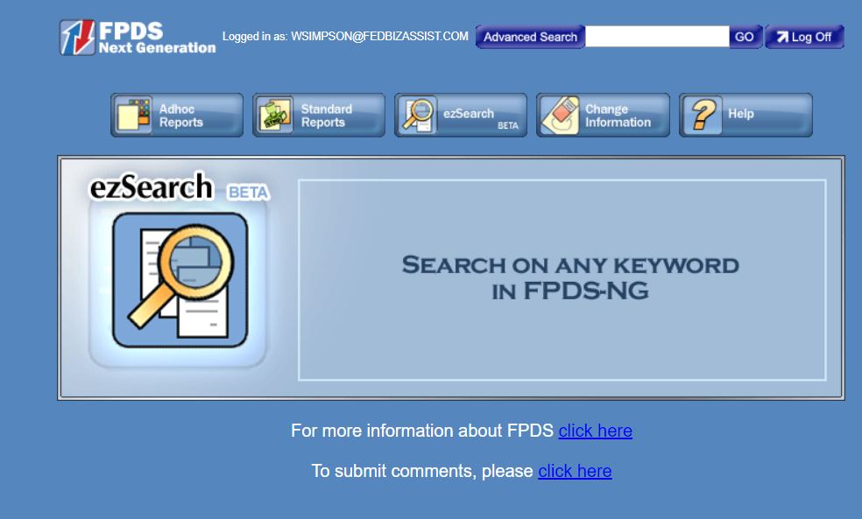
FPDS-NG Adhoc Reports
2
Select the Adhoc Reports Tab
FPDS-NG Ad Hoc
Reports

Slide 16
FPDS-NG Adhoc Reports
3
This is how a new account will appear the first time you access your personal folder – there are no Adhoc reports showing until they are created by you
Click on “Personal Folder”
FPDS-NG Ad Hoc
Reports

Slide 17
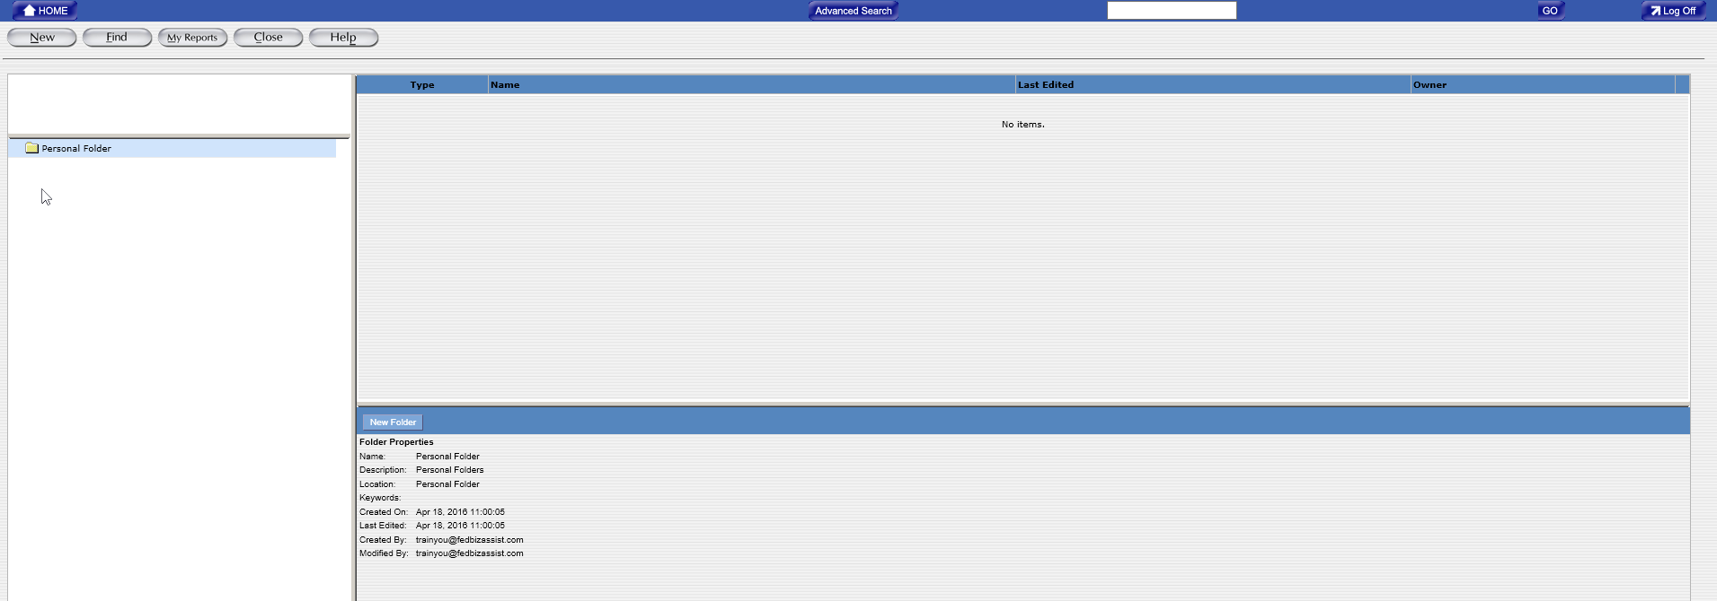
This is how a new account will appear the first time you access your personal folder – there are no Adhoc reports showing until they are created by you
Folder properties
FPDS-NG Ad Hoc
Reports

Slide 18
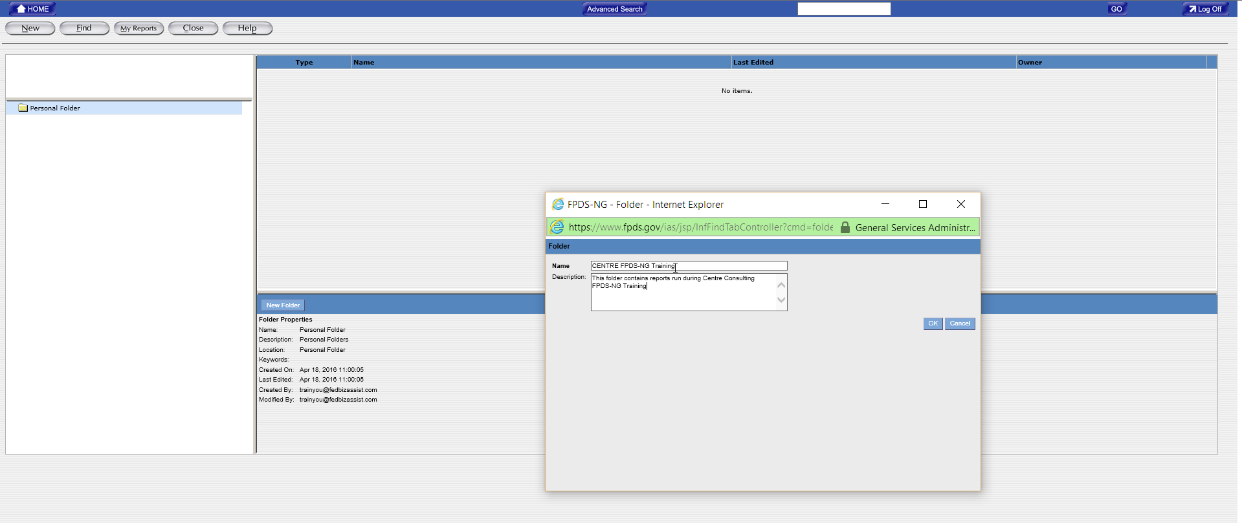
5
Give the folder a name “CENTRE FPDS-NG TRAINING”
4
Click on “New Folder”
6
Provide a description for the folder
FPDS-NG Ad Hoc
Reports

Slide 19
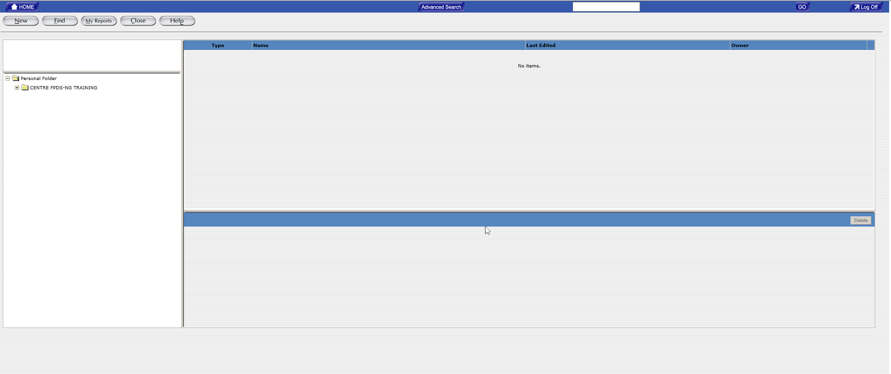
New folder created
You may want to give some thought as to how you organize your folders and reports
FPDS-NG Ad Hoc
Reports

Slide 20
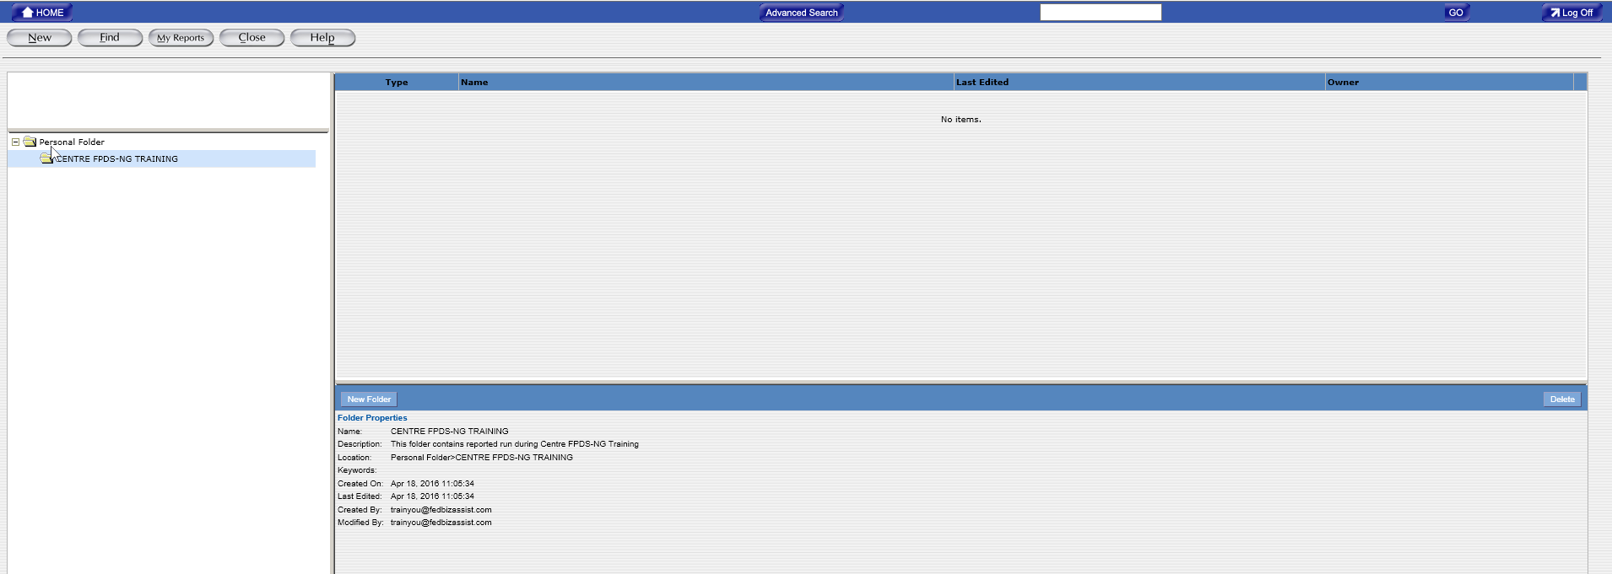
7
Click on new folder
Properties of your new folder
FPDS-NG Ad Hoc
Reports

Slide 21
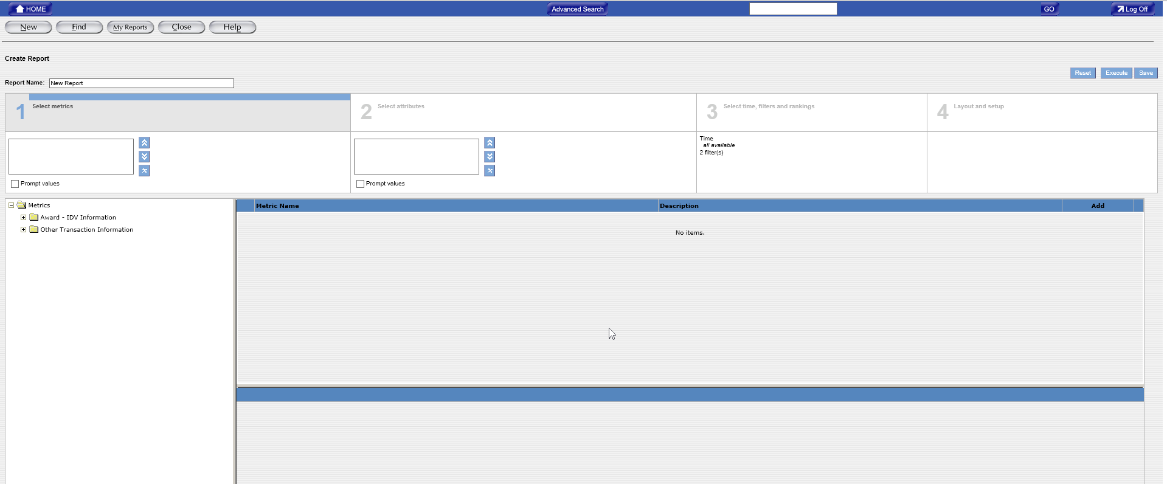
FPDS-NG Adhoc Reports
8
Click on “New”
FPDS-NG Ad Hoc
Reports

Slide 22
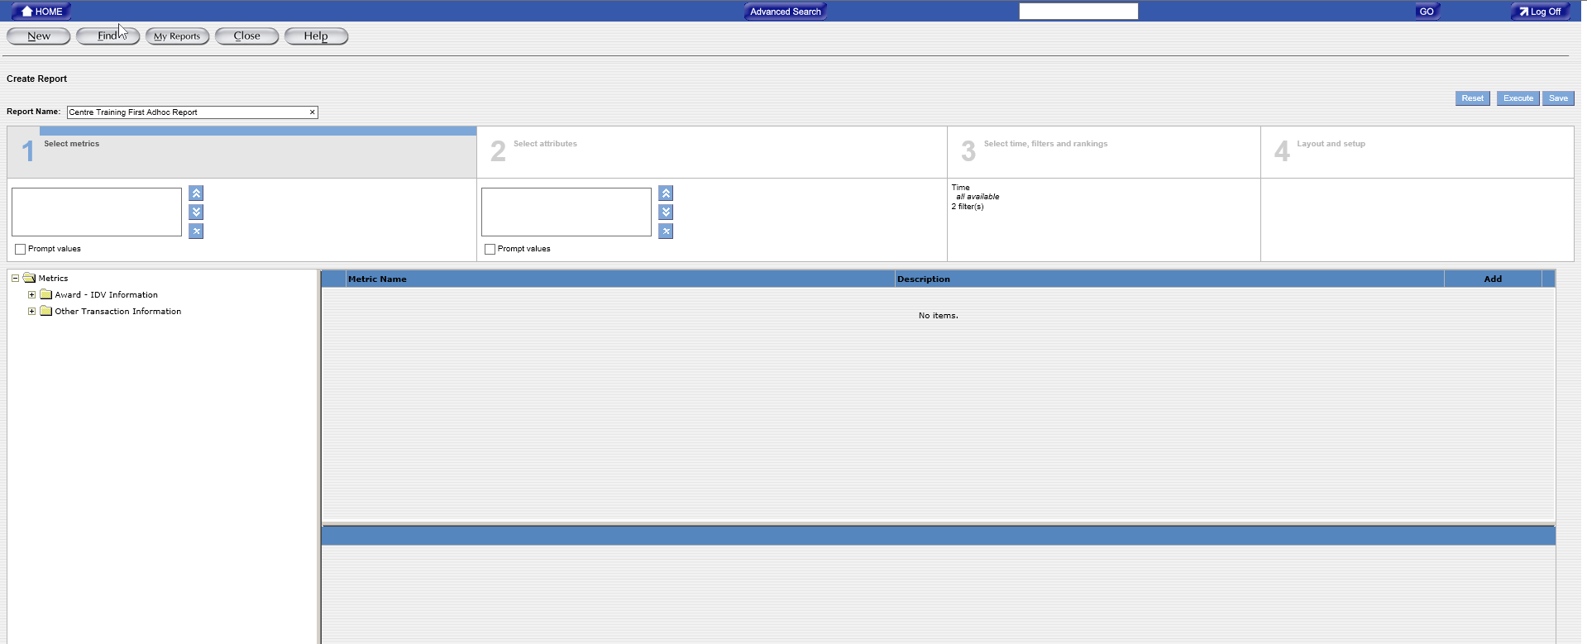
9
Name report
“Centre First Adhoc Report”
FPDS-NG Ad Hoc
Reports

Slide 23
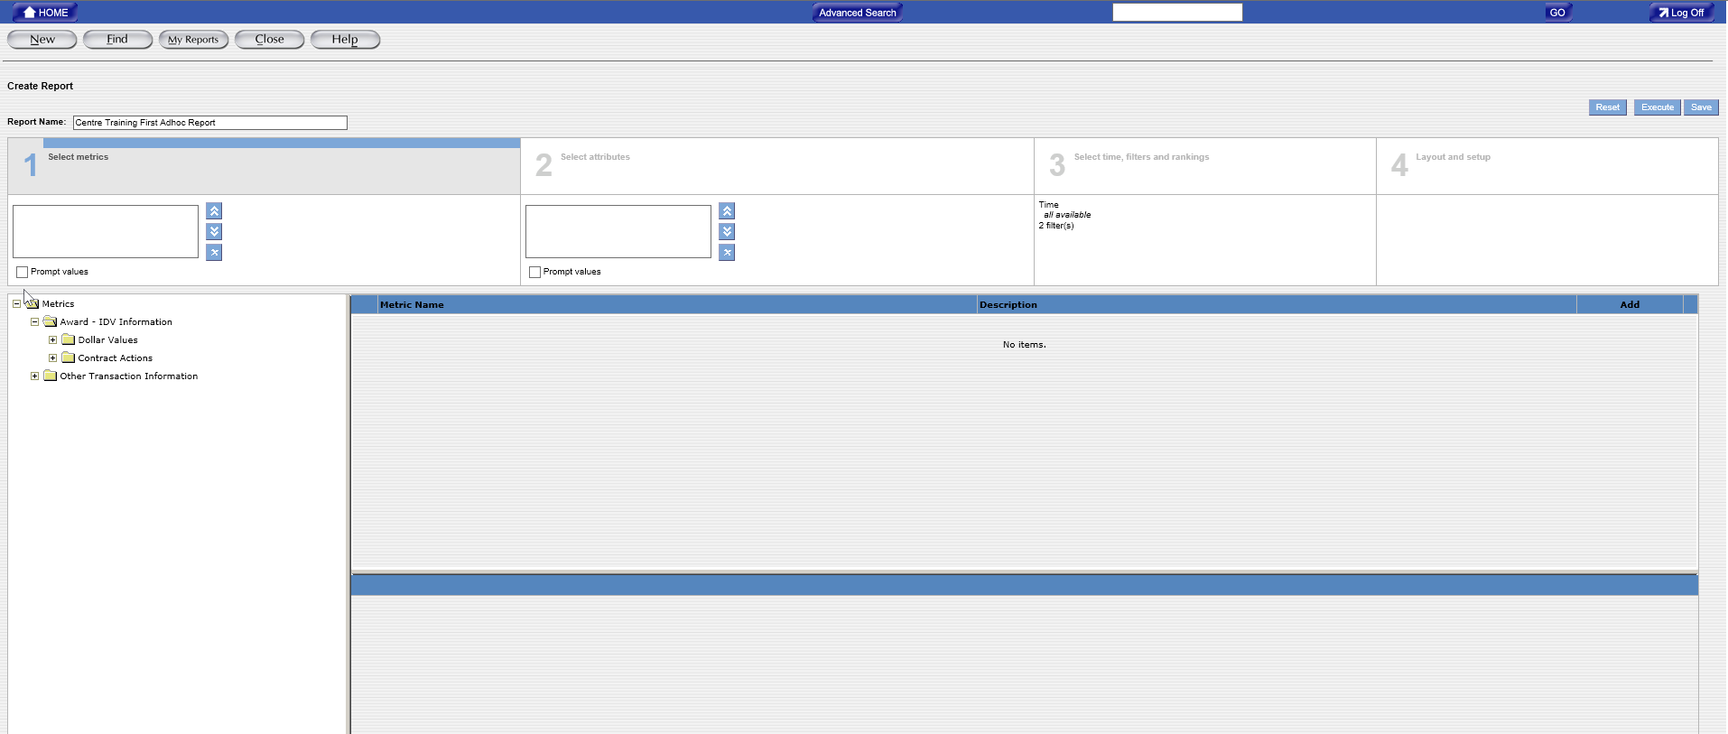
Selecting Metrics is done in Create Report Tab 1
10
First step in creating Adhoc report is to select Metrics. Click on “Award – IDV Information” to show subfolders
FPDS-NG Ad Hoc
Reports

Slide 24
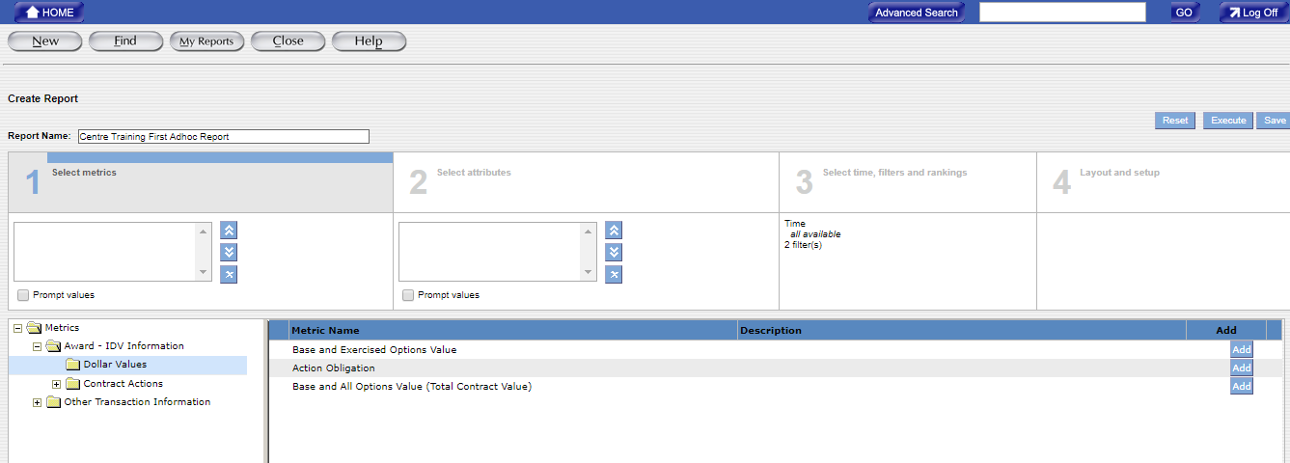
Available metrics display
11
Click on “Dollar Values” to show available metrics
FPDS-NG Ad Hoc
Reports

Slide 25
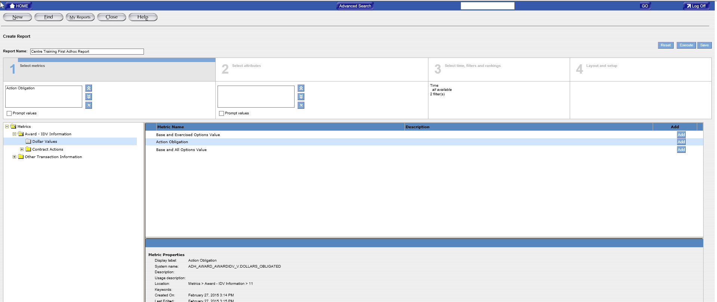
As you add metrics they move to a box which shows all metrics you select.
Click “Action Obligation” metric (line becomes highlighted in light blue once selected)
Click “Add” Button
12
13
FPDS-NG Ad Hoc
Reports

Slide 26
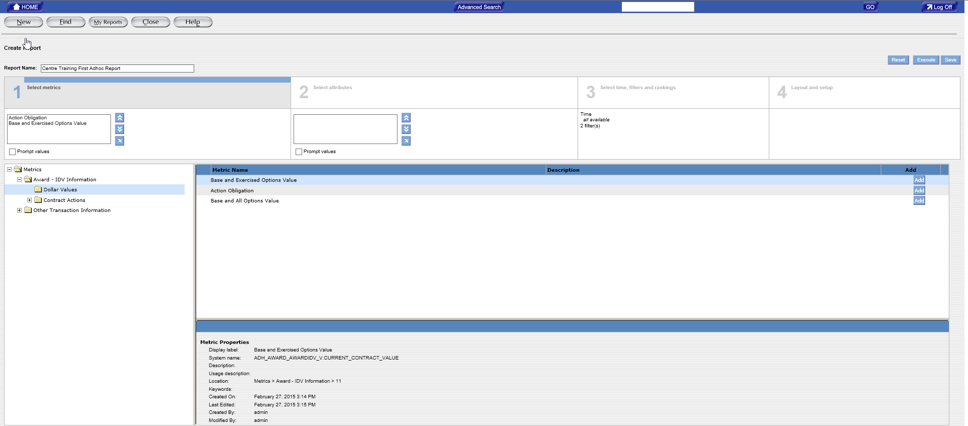
Click “Base and Exercised Option Value” metric (line becomes highlighted in light blue once selected)
Click “Add” Button
14
15
FPDS-NG Ad Hoc
Reports

Slide 27
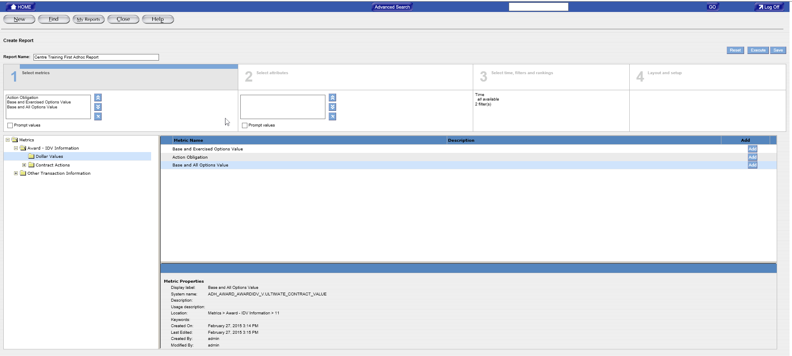
Click “Base and All Options Value” metric (line becomes highlighted in light blue once selected)
Click “Add” Button
16
17
FPDS-NG Ad Hoc
Reports

Slide 28
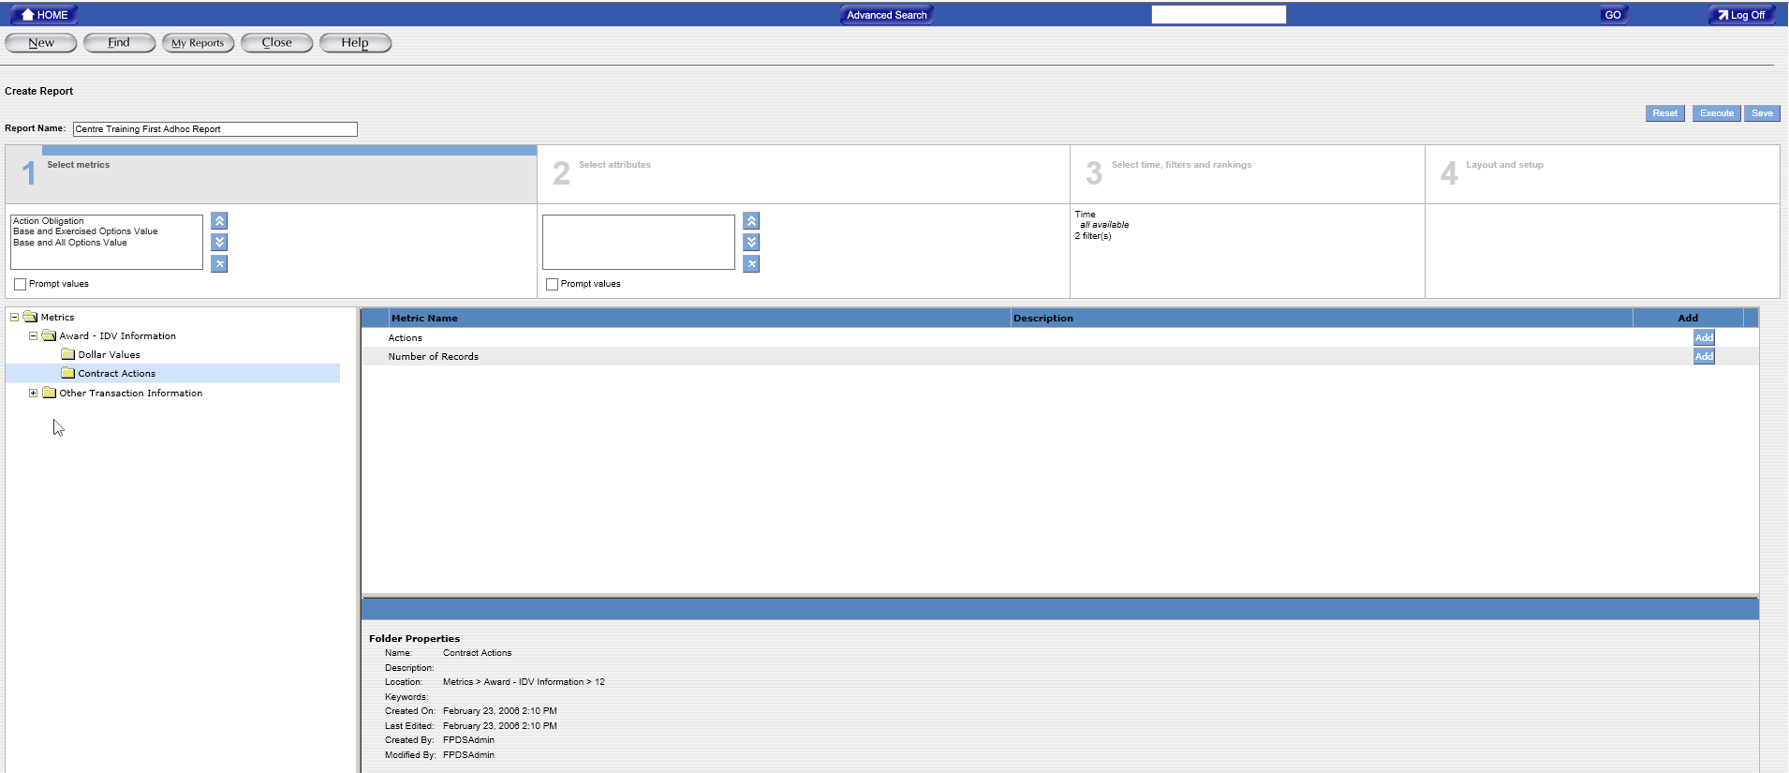
Note: For purposes of this report we will not be selecting any “Contract Actions” Metrics
18
Available metrics
Click on “Contract Actions” to view available metrics
FPDS-NG Ad Hoc
Reports

Slide 29
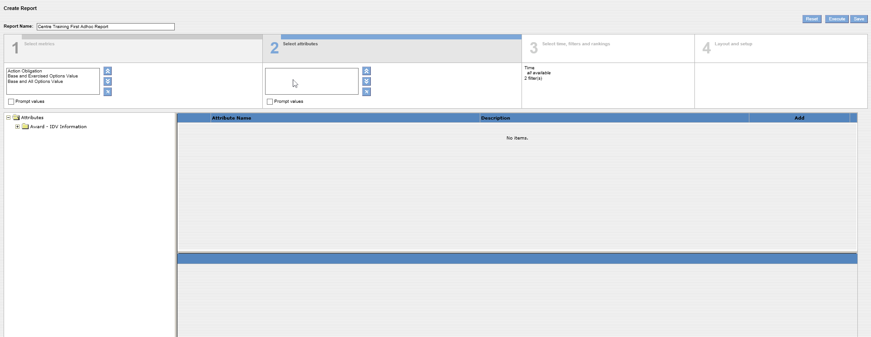
Attributes are selected under Create Report Tab 2
To begin attribute selections, click on “Award – IDV Information” Folder to expand to show available attributes
19
FPDS-NG Ad Hoc
Reports

Slide 30
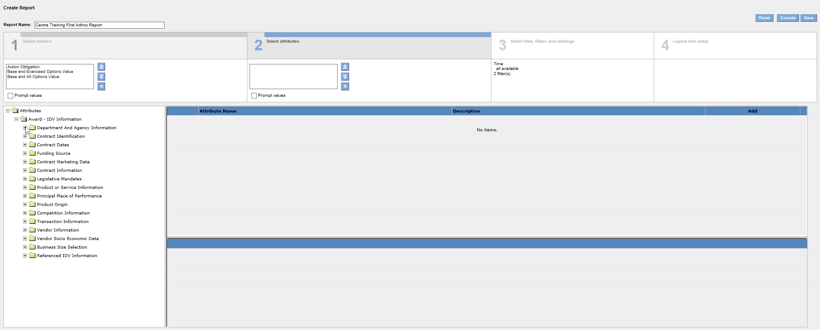
Available Attribute Folders
FPDS-NG Ad Hoc
Reports

Slide 31
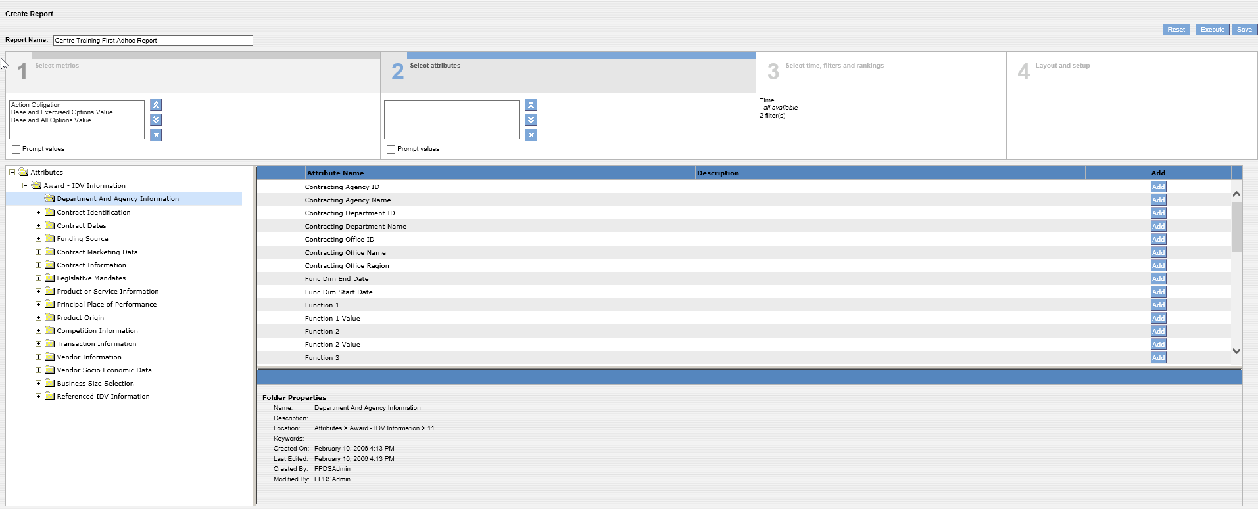
20
Click on “Department and Agency Information” Attributes Folder
Available attributes
FPDS-NG Ad Hoc
Reports

Slide 32
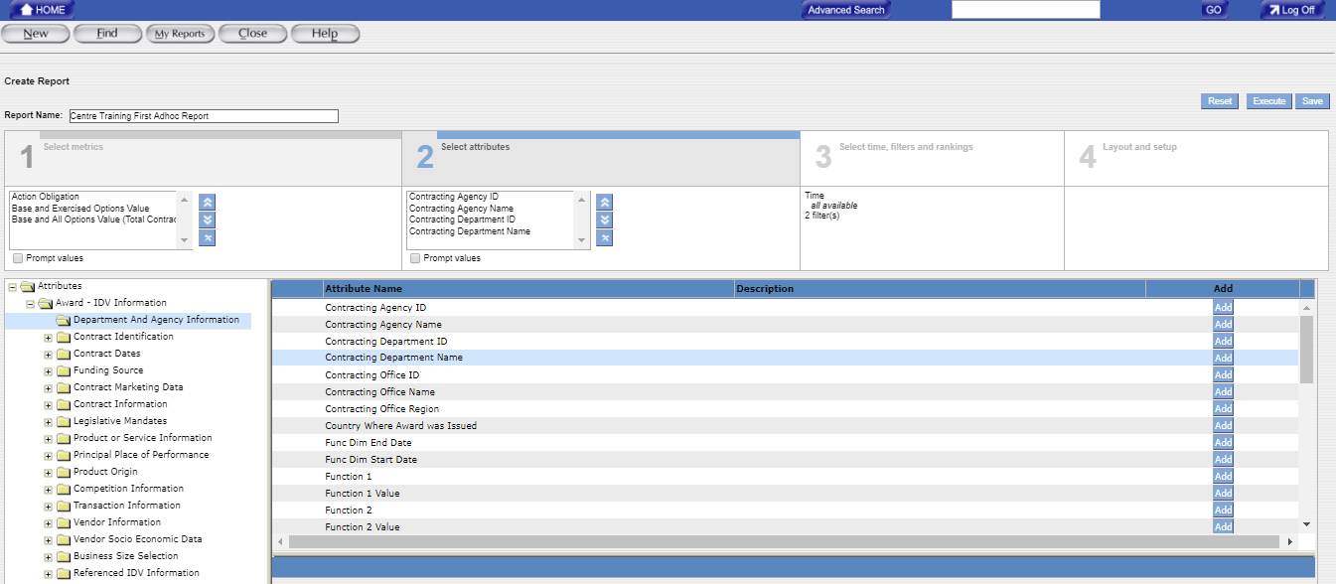
FPDS-NG Adhoc Reports
As attributes are added they appear in the selected attributes table. Added attributes can be moved or deleted by using the blue/white arrow keys to immediate right of the table.
21
22
Highlight and click “ADD” for the six attributes shown with a red arrow for this report. Repeat Steps 21 and 22 until all attributes with arrows are selected and added
Click “ADD” Button for each selected attribute
FPDS-NG Ad Hoc
Reports

Slide 33
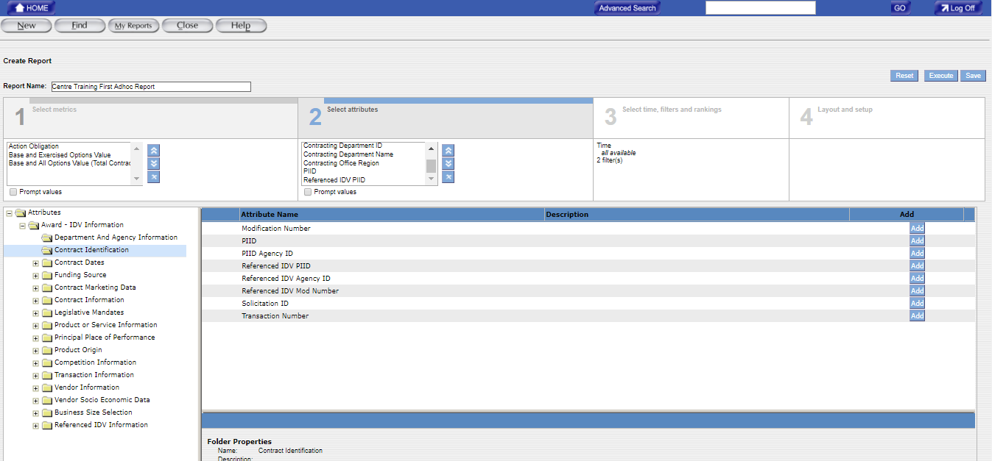
You can move the blue highlighted arrow keys to move the order of items up or down, or delete a selected
As attributes are selected for your report they continue to be added here
23
Highlight and add the two attributes shown with a red arrow for this report
(repeat until all attributes with arrows are selected and added)
23
24
Click “ADD” Button for each selected attribute
FPDS-NG Ad Hoc
Reports

Slide 34
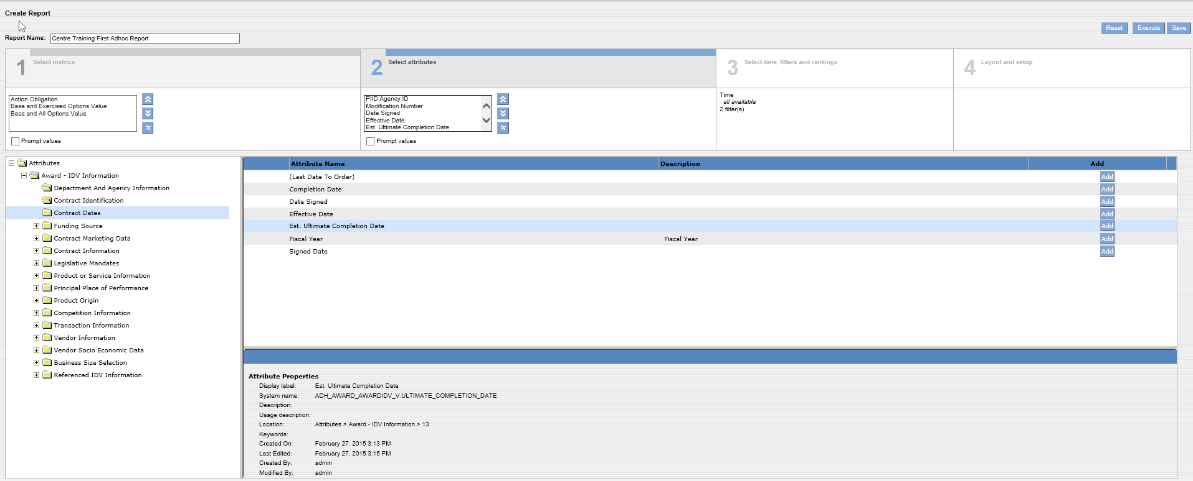
25
Highlight and add the three attributes shown with a red arrow for this report
(repeat until all attributes with arrows are selected and added)
26
Click “ADD” Button for each selected attribute
FPDS-NG Ad Hoc
Reports

Slide 35
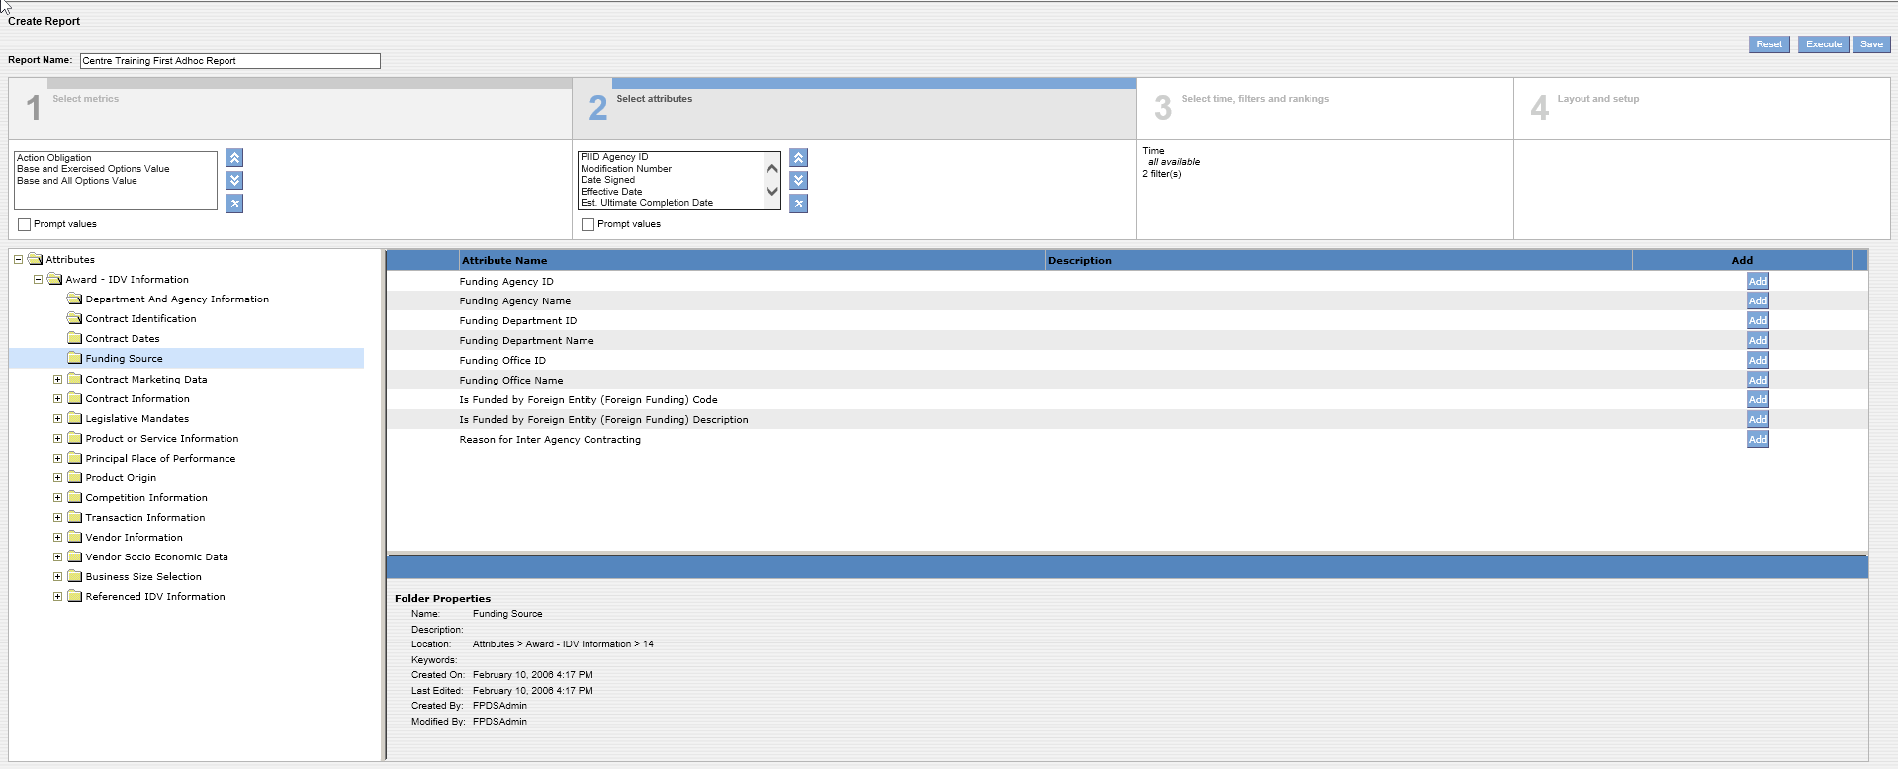
FPDS-NG Adhoc Reports
For purposes of this report we will not be selecting “Funding Source” – but this attribute does exist and the attributes are shown here.
Note: Socioeconomic procurement preference program category accomplishments accrue to the funding agency, which may not always be the procuring agency.
FPDS-NG Ad Hoc
Reports

Slide 36
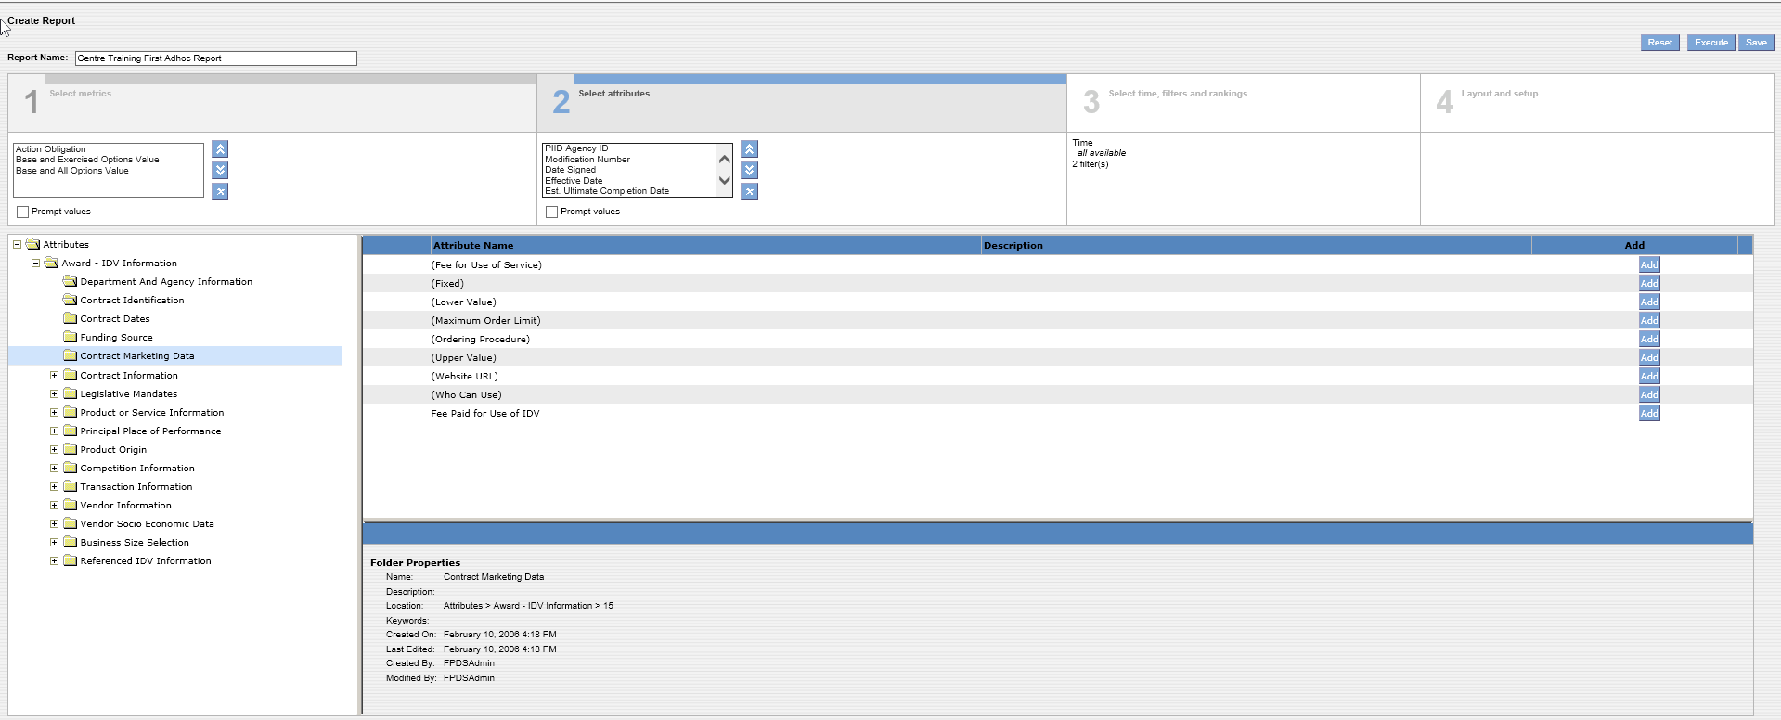
FPDS-NG Adhoc Reports
For purposes of this report we will not be selecting “Contract Marketing Data” – but this attribute does exist and the attributes are shown here.
FPDS-NG Ad Hoc
Reports

Slide 37
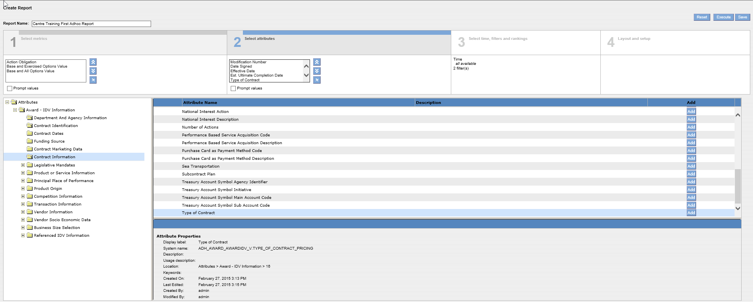
27
28
Highlight and add “Type of Contract” attribute shown with a red arrow for this report
Click “ADD” Button for each selected attribute
FPDS-NG Ad Hoc
Reports

Slide 38
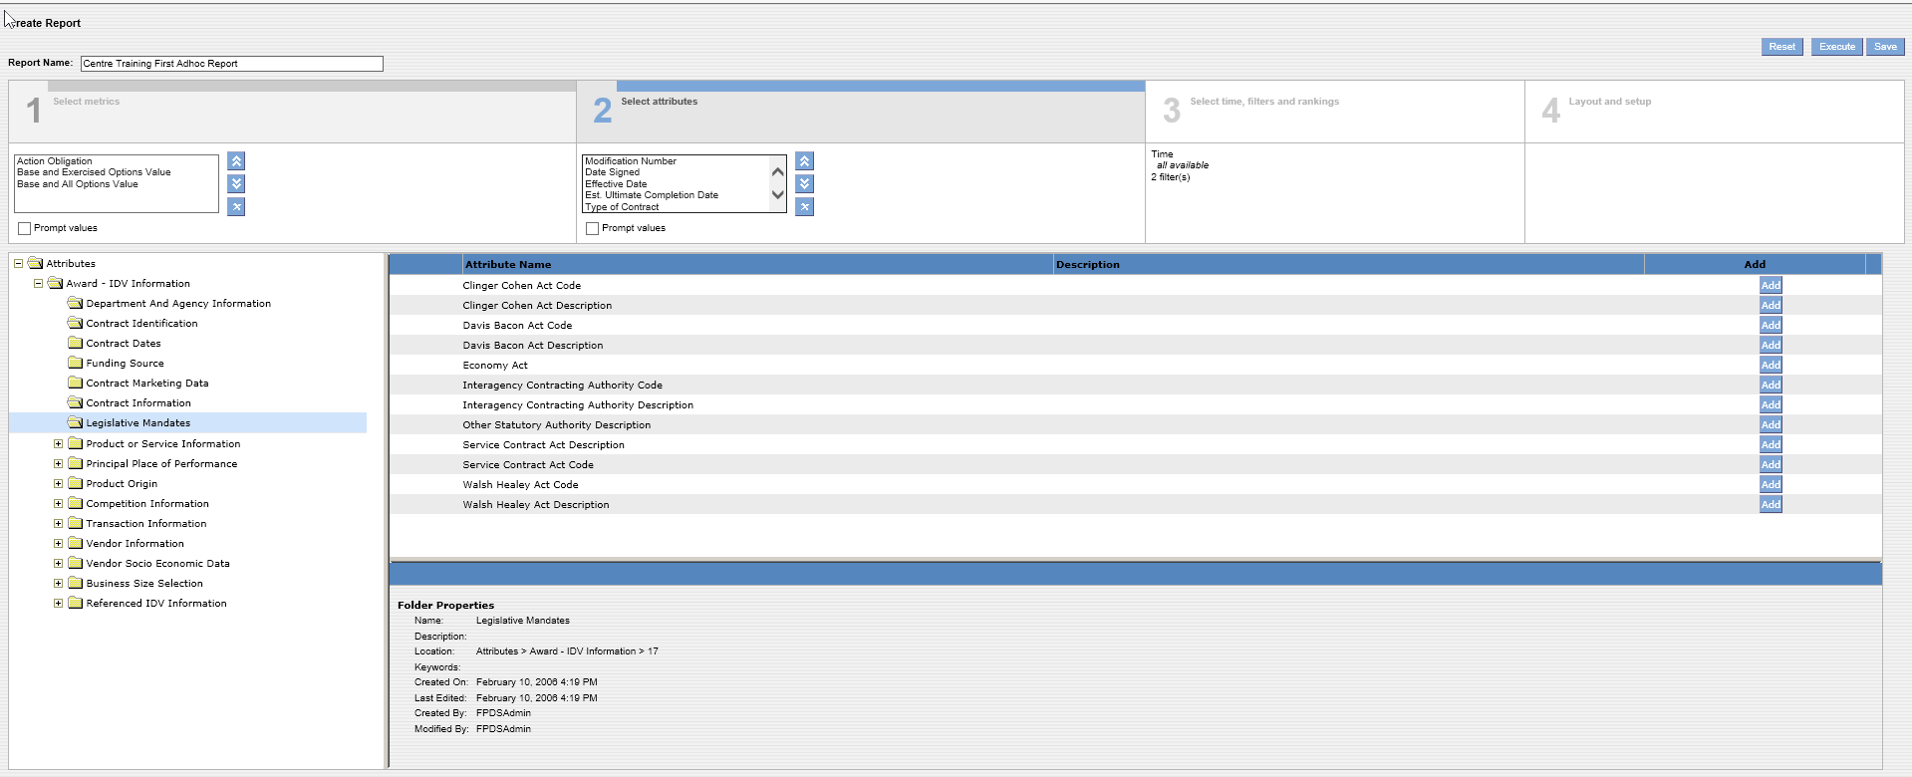
FPDS-NG Adhoc Reports
For purposes of this report we will not be selecting “Legislative Mandates” – but this attribute does exist and the attributes are shown here
FPDS-NG Ad Hoc
Reports

Slide 39
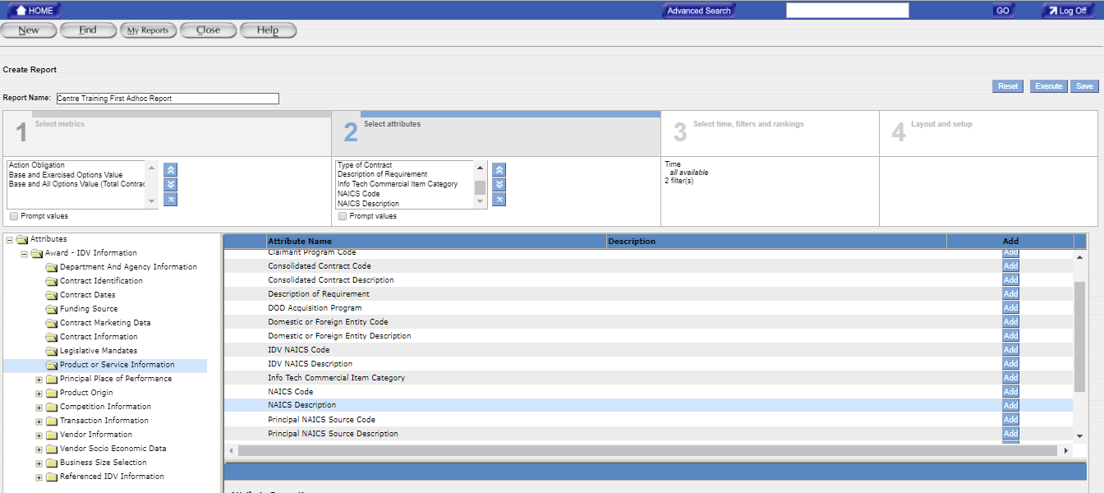
Note: Use the scroll bar to the right of “ADD” to scroll and move through the various attributes available
Highlight and add the three attributes shown with a red arrow for this report (repeat until all attributes with arrows are selected and added)
30
29
Click “ADD” Button for each selected attribute
FPDS-NG Ad Hoc
Reports

Slide 40
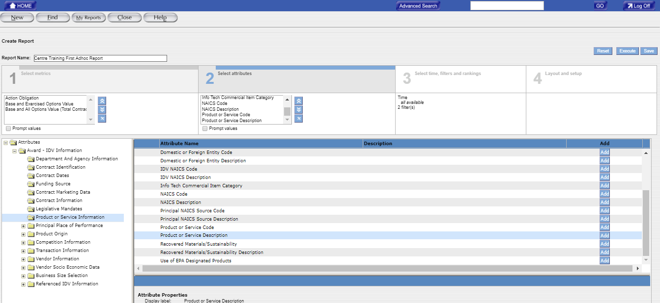
FPDS-NG Adhoc Reports
This slide continues Steps and
29
30
Note: Use the scroll bar to the right of “ADD” to scroll to select the remaining two attributes from Steps and Product or Service Information attributes
29
30
Highlight and add the remaining two attributes shown with a red arrow for this report (repeat until all attributes with arrows are selected and added)
30
29
Click “ADD” Button for each selected attribute
FPDS-NG Ad Hoc
Reports

Slide 41
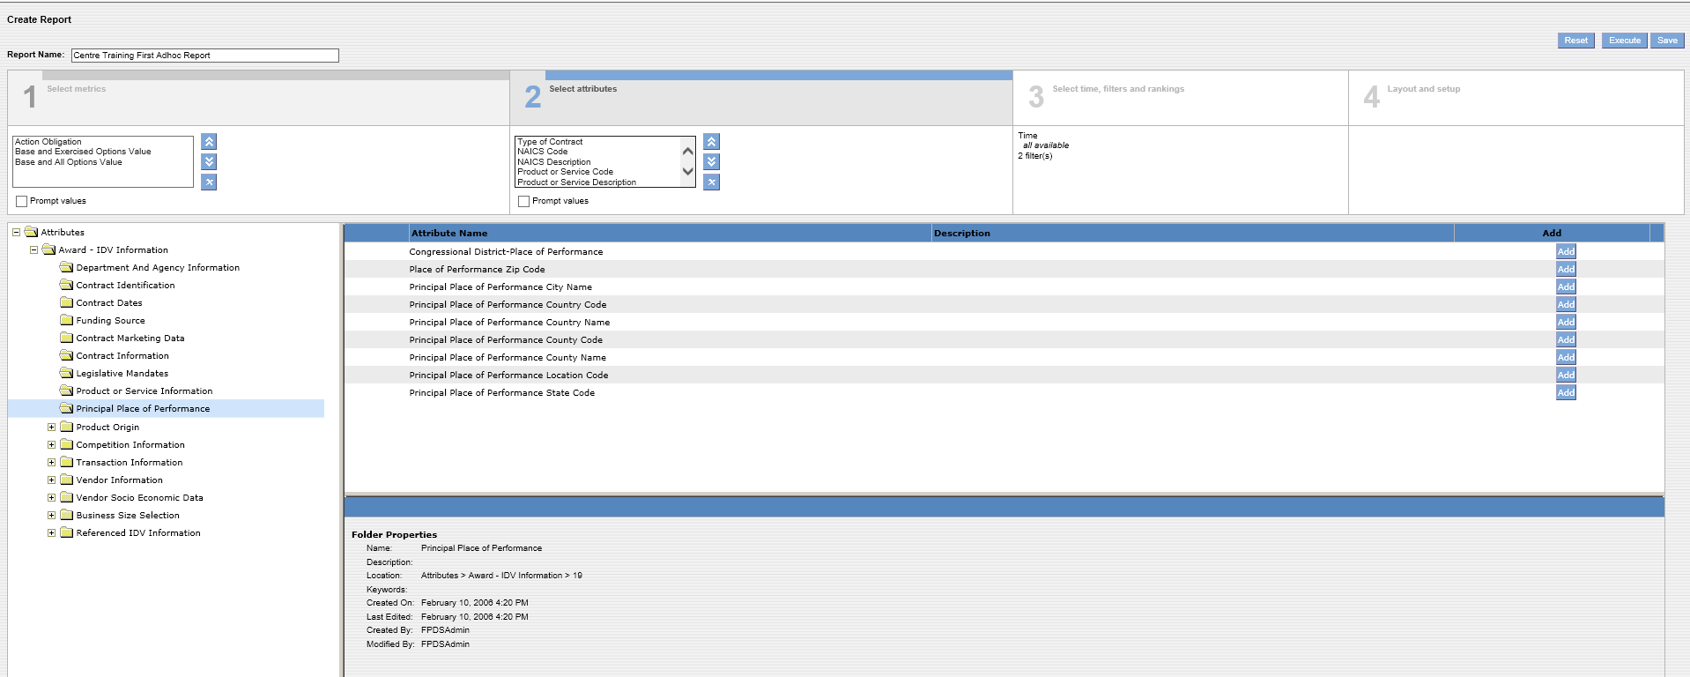
FPDS-NG Adhoc Reports
For purposes of this report we will not be selecting “Principal Place of Performance” – but this attribute does exist and the attributes are shown here.
FPDS-NG Ad Hoc
Reports

Slide 42
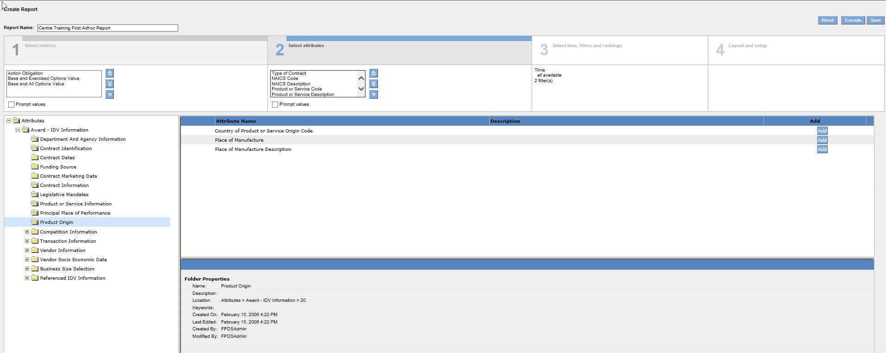
For purposes of this report we will not be selecting “Product Origin” – but this attribute does exist and the attributes are shown here.
FPDS-NG Ad Hoc
Reports

Slide 43
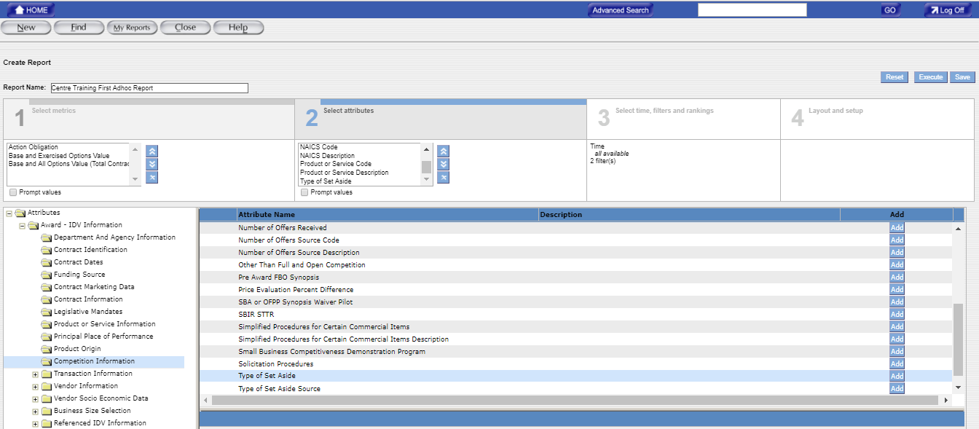
FPDS-NG Adhoc Reports
Highlight and add the 1 attribute shown with a red arrow for this report
(repeat until all attributes with arrows are selected and added)
31
32
Click “ADD” Button for each selected attribute
FPDS-NG Ad Hoc
Reports

Slide 44
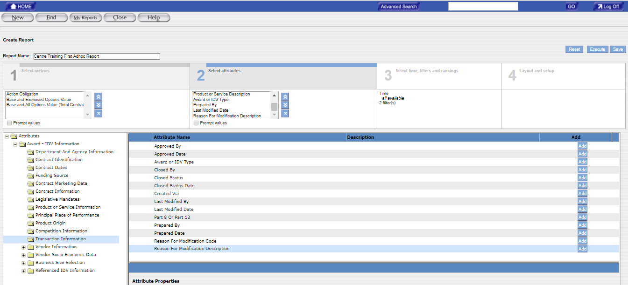
Highlight and add the three attributes shown with a red arrow for this report
(repeat until all attributes with arrows are selected and added)
33
34
Click “ADD” Button for each selected attribute
FPDS-NG Ad Hoc
Reports

Slide 45
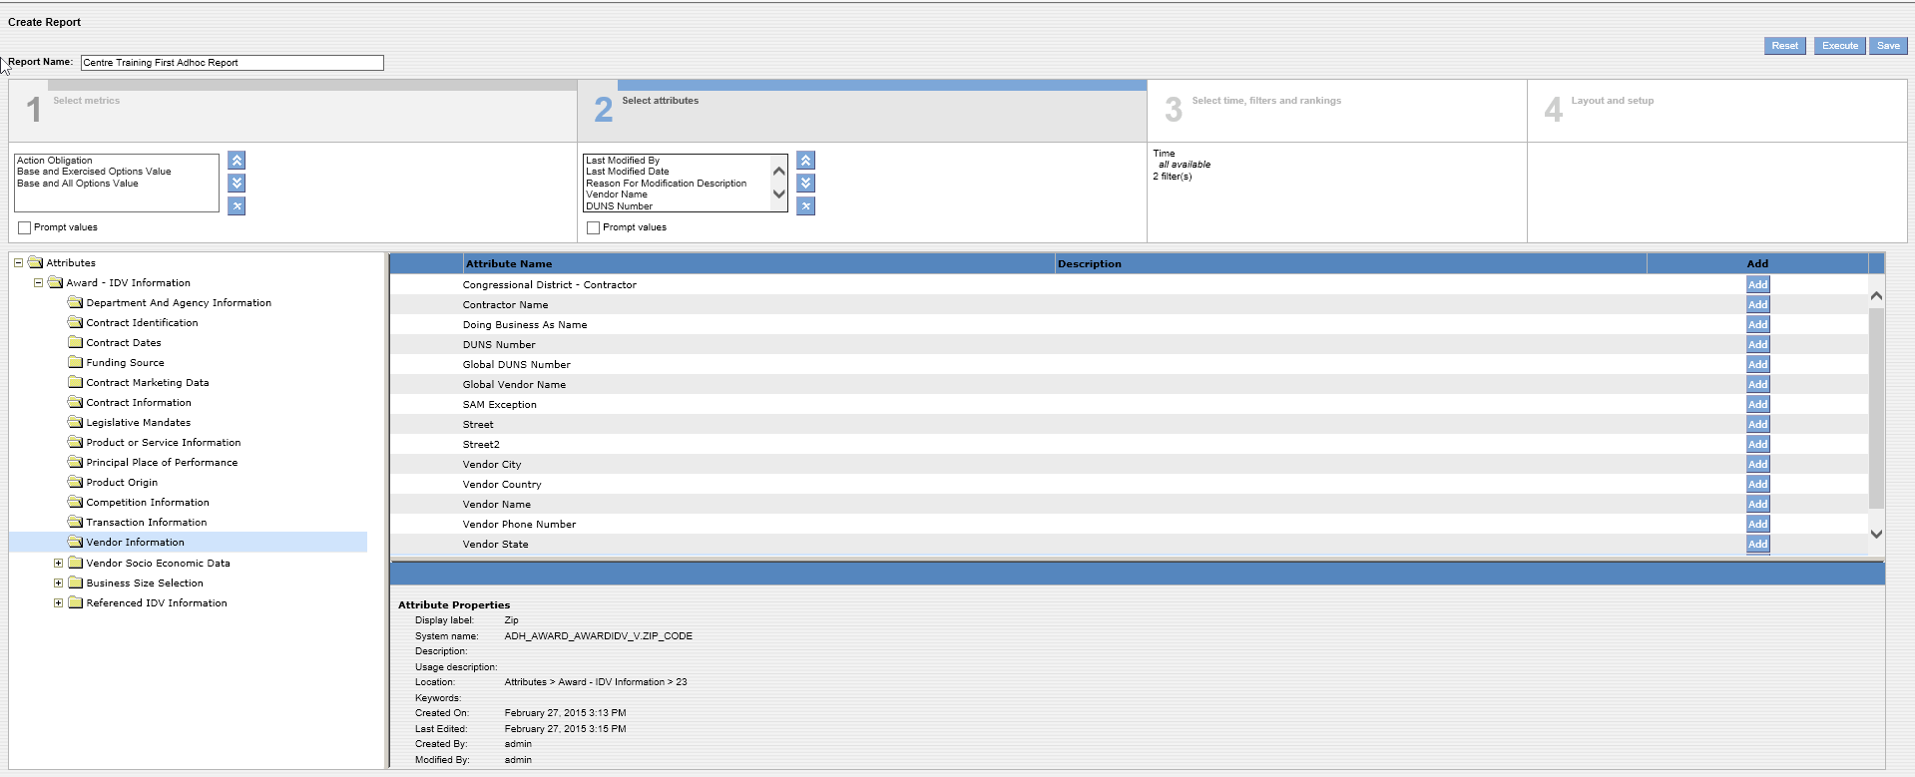
35
36
Highlight and add the 2 attributes shown with a red arrow for this report
(repeat until all attributes with arrows are selected and added)
Click “ADD” Button for each selected attribute
FPDS-NG Ad Hoc
Reports

Slide 46
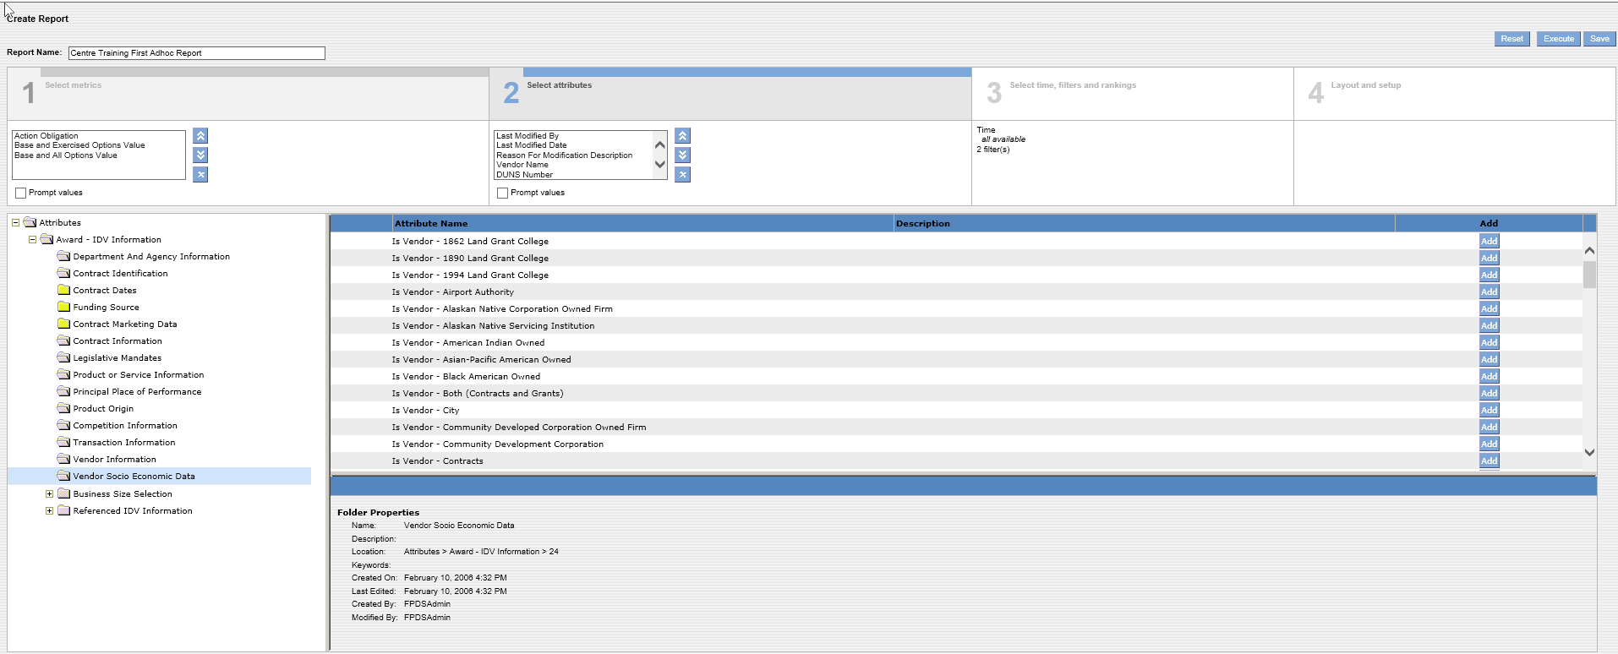
FPDS-NG Adhoc Reports
For purposes of this report we will not be selecting “Vendor Socioeconomic Data” – but this attribute does exist and some of the attributes are shown here, scroll down when in this attribute to see the many selections
FPDS-NG Ad Hoc
Reports

Slide 47
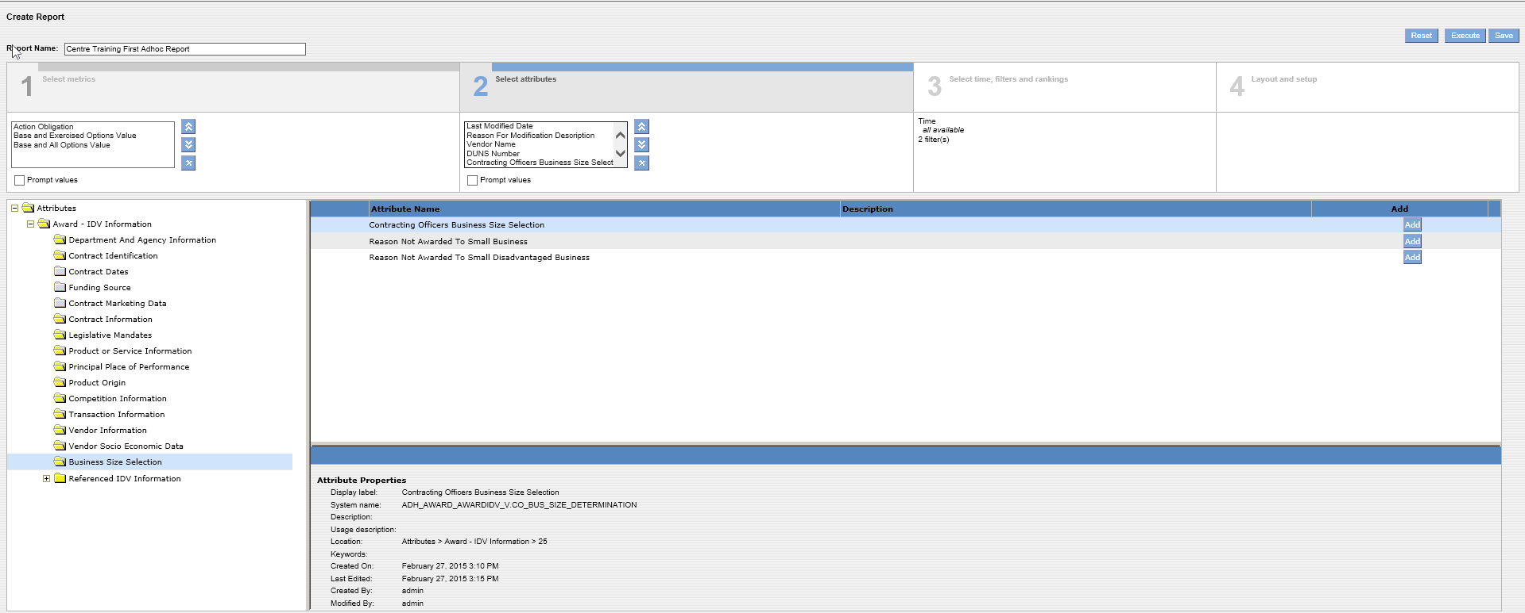
FPDS-NG Adhoc Reports
37
38
Highlight and add the 1 attribute shown with a red arrow for this report
(repeat until all attributes with arrows are selected and added)
Click “ADD” Button for each selected attribute
FPDS-NG Ad Hoc
Reports

Slide 48
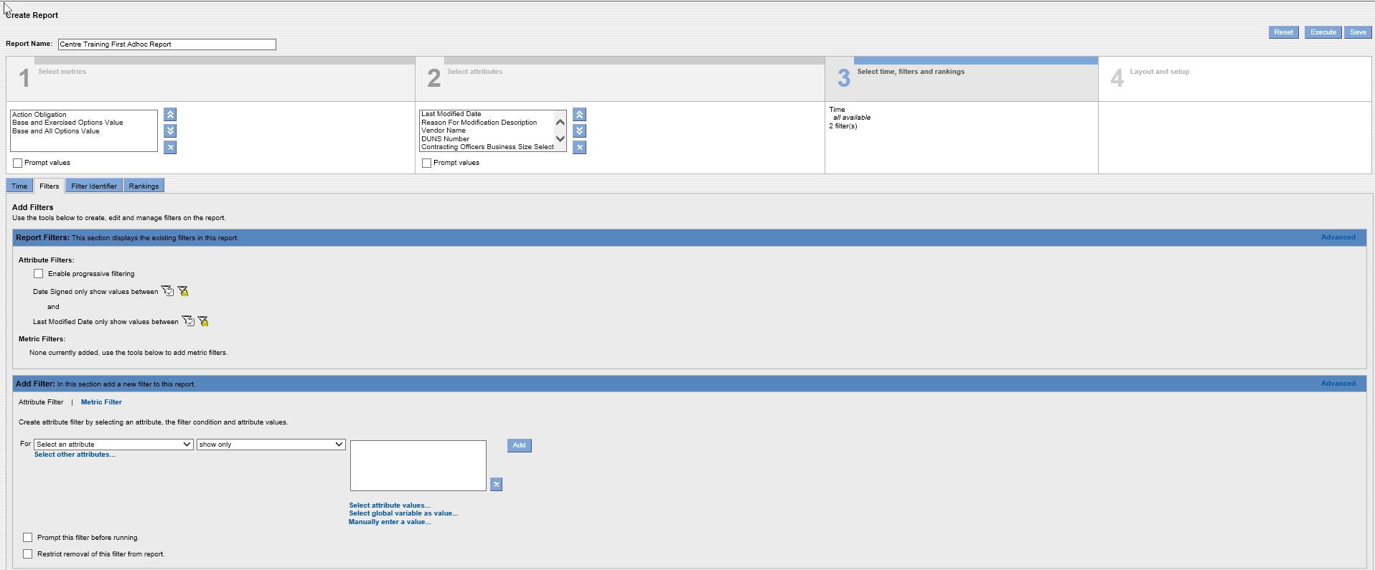
FPDS-NG Adhoc Reports
Time, filters, and rankings are selected in Create Report Tab 3
39
Select as the first attribute to apply a filter to “Contracting Department ID” using drop down menu
40
Select “Show only values equal to” using the drop down menu
41
Insert 1200 as the attribute value for the U.S. Department of Agriculture
42
Click the “ADD” Button
FPDS-NG Ad Hoc
Reports

Slide 49
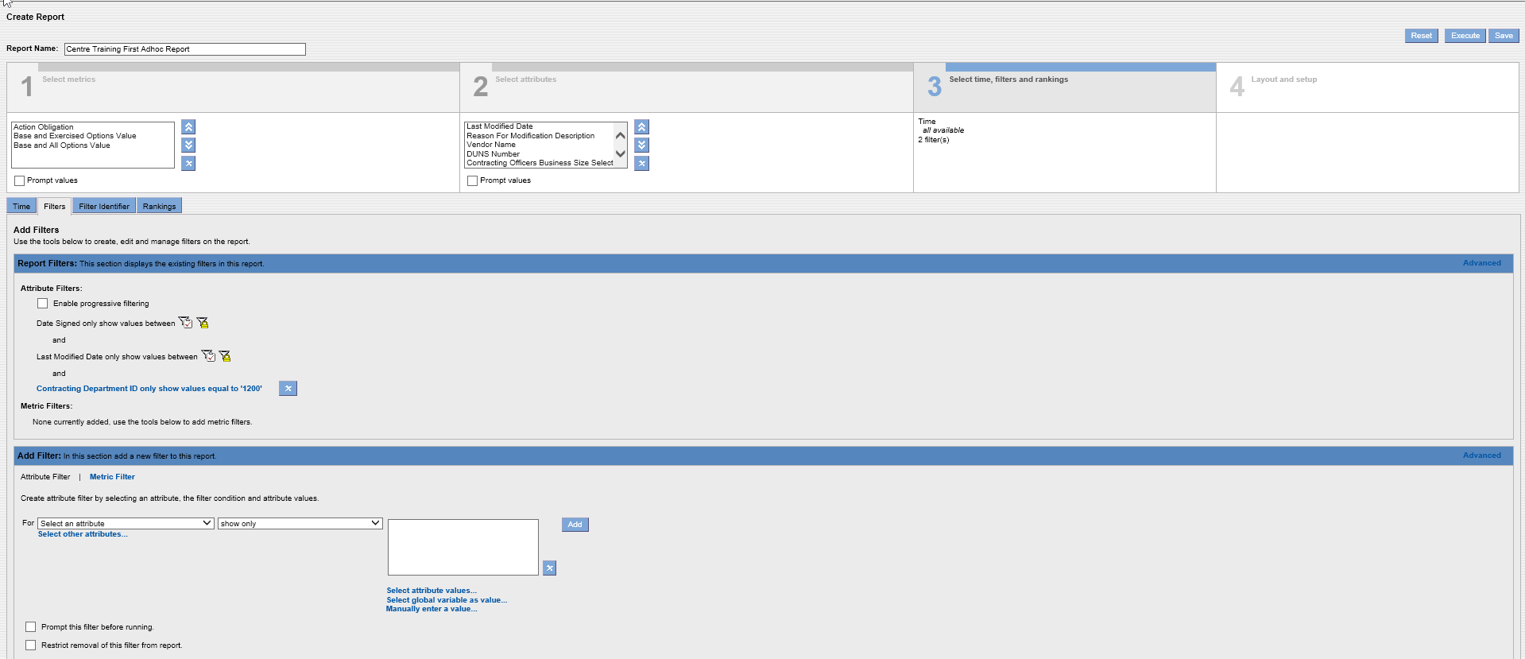
FPDS-NG Adhoc Reports
After you add an attribute filter, they appear here. You can delete the filter by clicking the X or you can click on the attribute shown in blue and make changes. In this case if you wanted to change the report from USDA to Veterans Affairs you could click the blue text on and in the values box change 1200 to read 3600 which is VA
FPDS-NG Ad Hoc
Reports

Slide 50
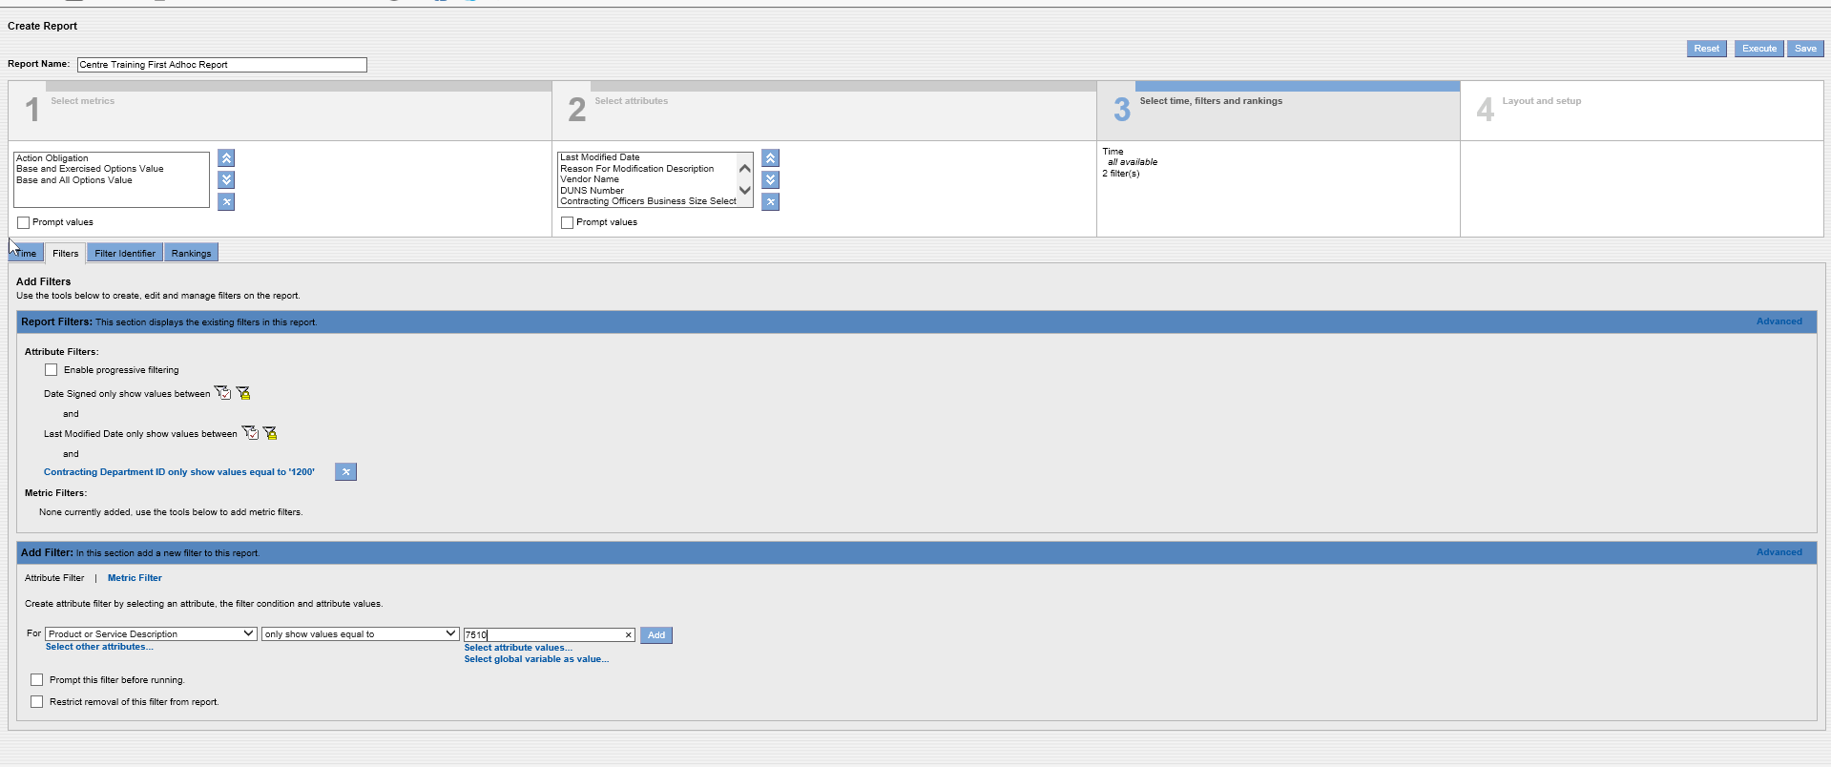
43
From the attribute drop down menu, add an additional attribute to the report: Product or Service Code
44
From the drop down menu, select “only show values equal to”
45
In the values table, show Product Service Code 7510
46
Click the “ADD” button
FPDS-NG Ad Hoc
Reports

Slide 51
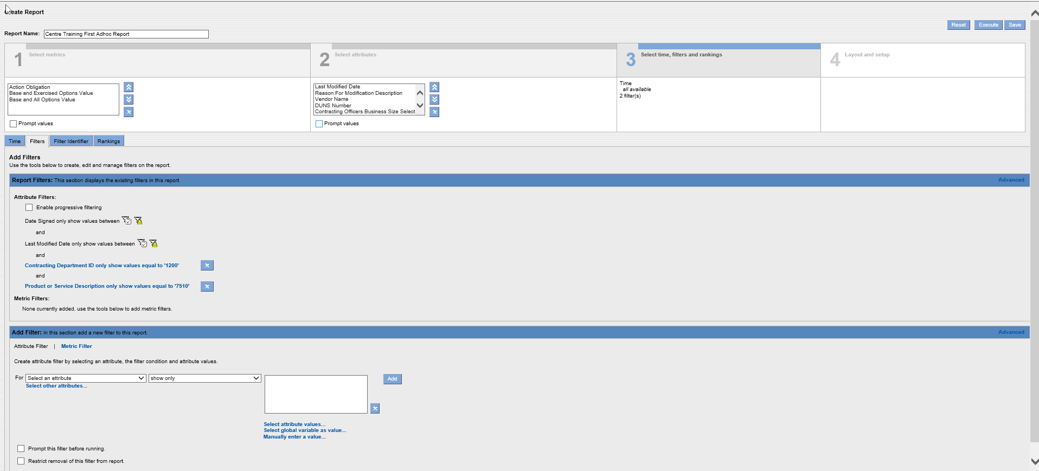
47
All selected filters appear here. These filters will pull up all transactions for the USDA for office products under PSC 7510
Click “Execute”
FPDS-NG Ad Hoc
Reports

Slide 52
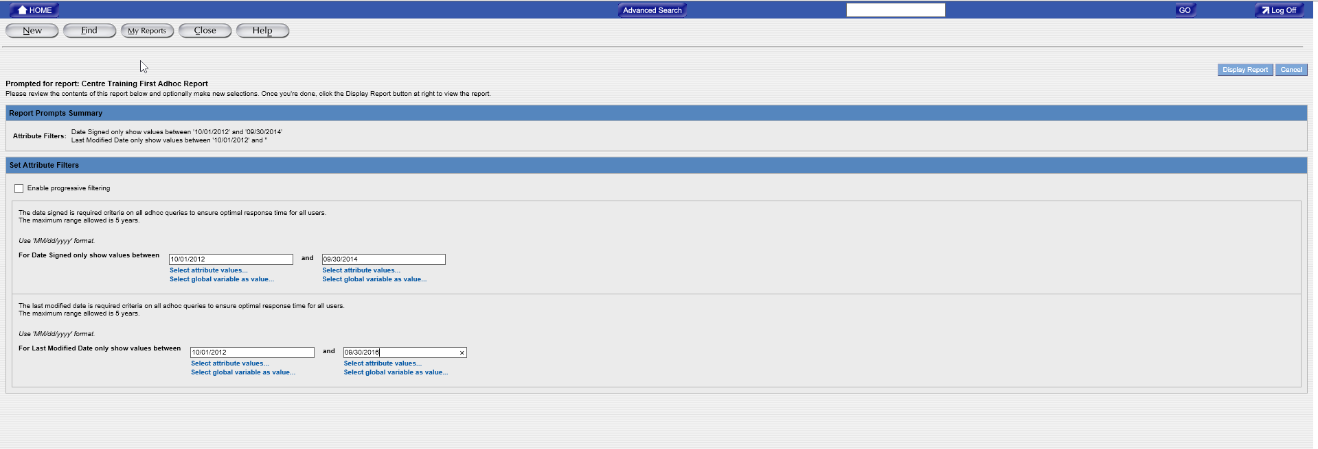
Note: Dates cannot exceed five years
48
Insert the dates for your report. In this case we are requesting the data for FYs 2013 and 2014 based on dates signed
Insert last modified date values here. Recommend including dates beyond the period for date signed to capture any modifications made to transactions subsequent to the date signed period.
50
49
Click “Display Report”
Note: Dates cannot exceed five years
FPDS-NG Ad Hoc
Reports

Slide 53
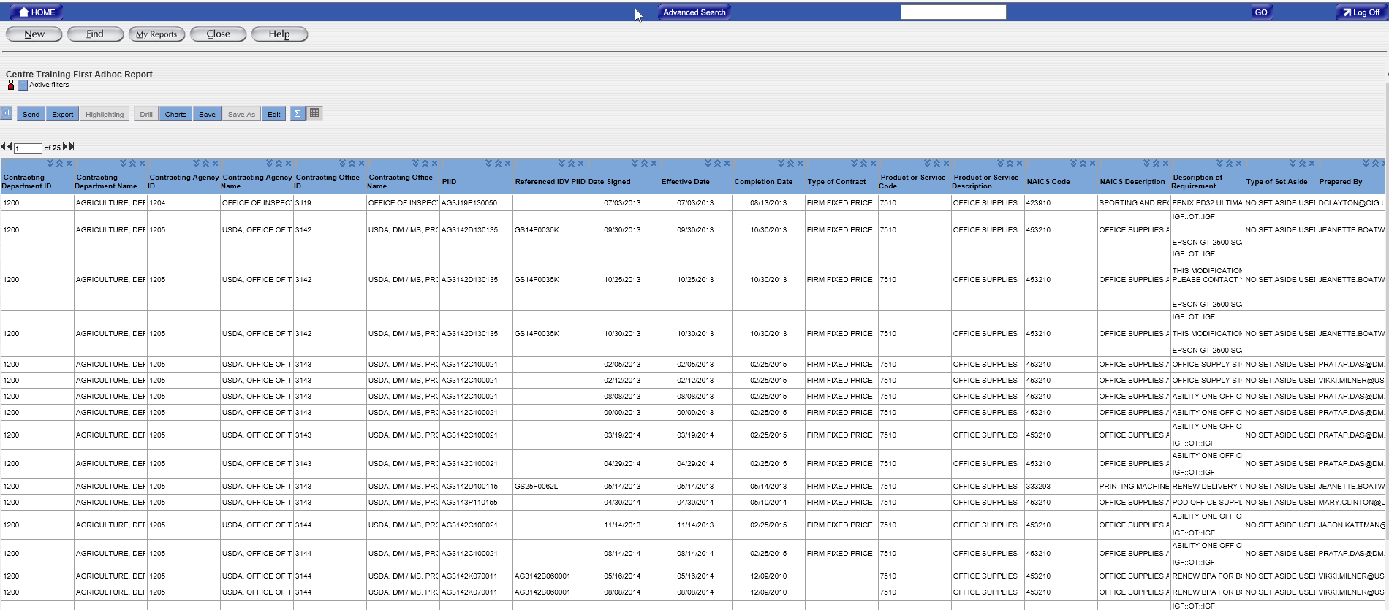
Your report displays
FPDS-NG Ad Hoc
Reports

Slide 54
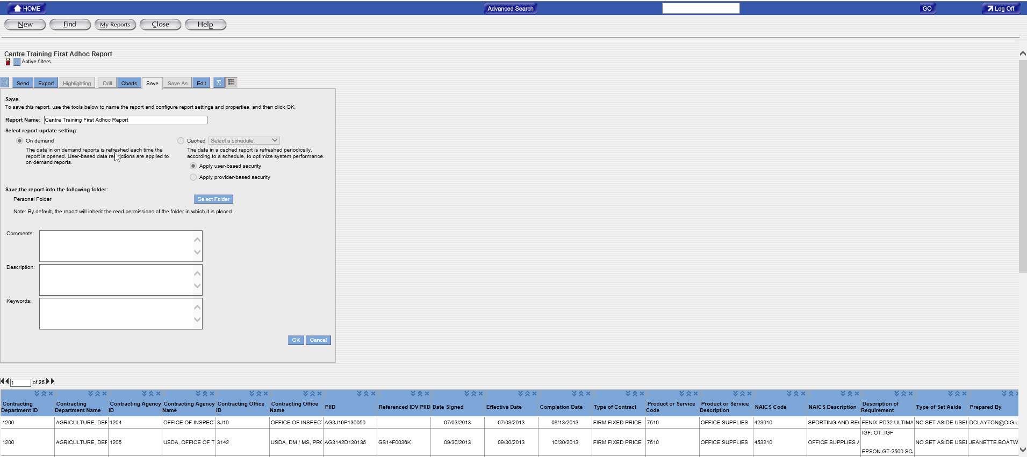
51
Click “Save” and enter comments, description and keywords for the report (not required--optional)
52
Click “OK”
FPDS-NG Ad Hoc
Reports

Slide 55
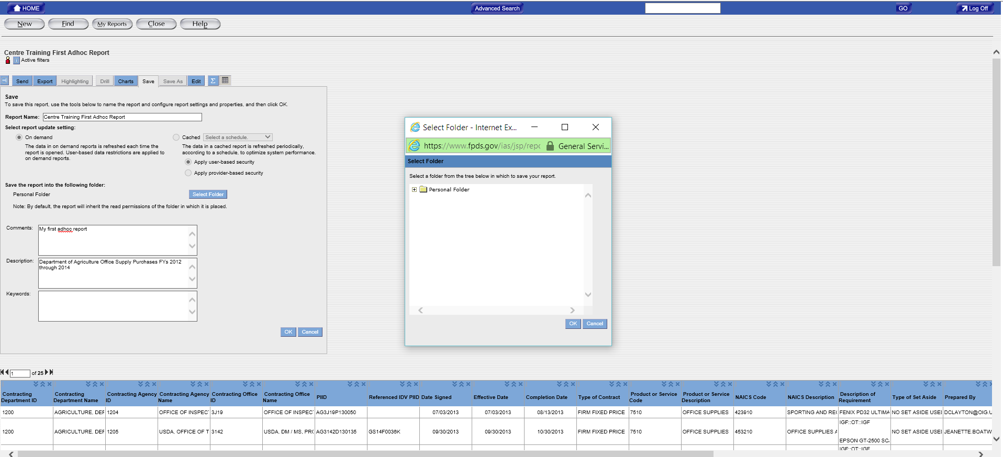
FPDS-NG Adhoc Reports
53
Dialogue box opens (you may have to use mouse to expand its size)
Click on “Select Folder”
FPDS-NG Ad Hoc
Reports

Slide 56
54
Click on Personal Folder to expand to see subfolders – you can file in Personal Folder, but it best to organize work if you have many reports
55
Click “OK”
FPDS-NG Ad Hoc
Reports

Slide 57
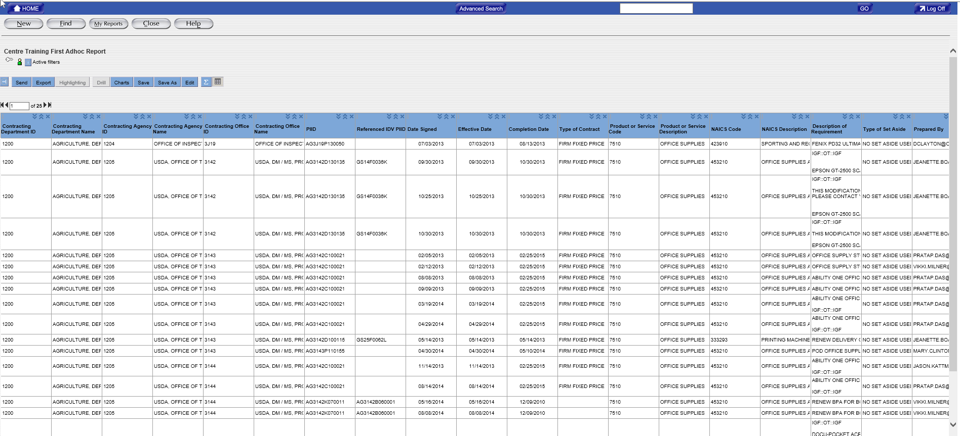
After saving your report in FPDS-NG, your screen returns you here
FPDS-NG Ad Hoc
Reports

Slide 58
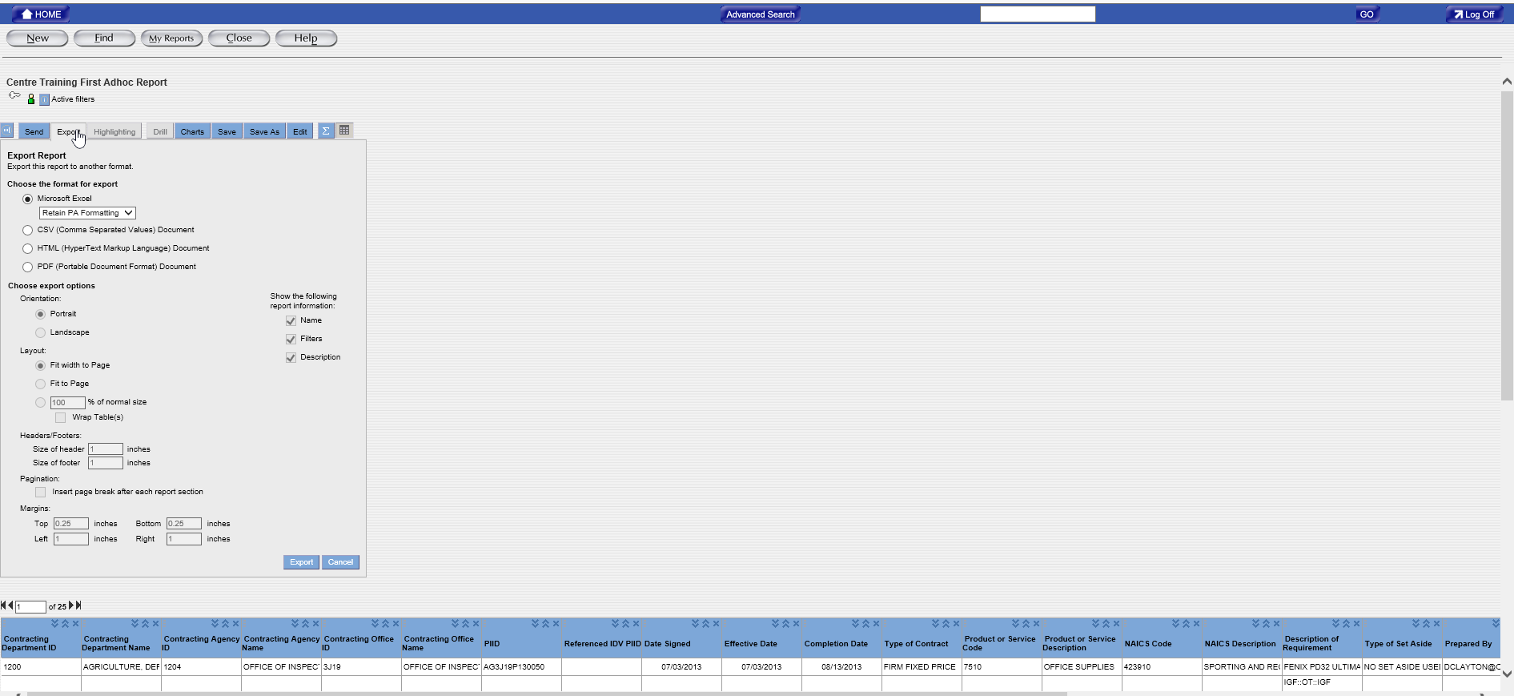
You can “export” your report from FPDS-NG to your computer
Click on “Export” – Select the format you want for the export (default is Microsoft Excel)
56
57
Click “Export”
FPDS-NG Ad Hoc
Reports

Slide 59
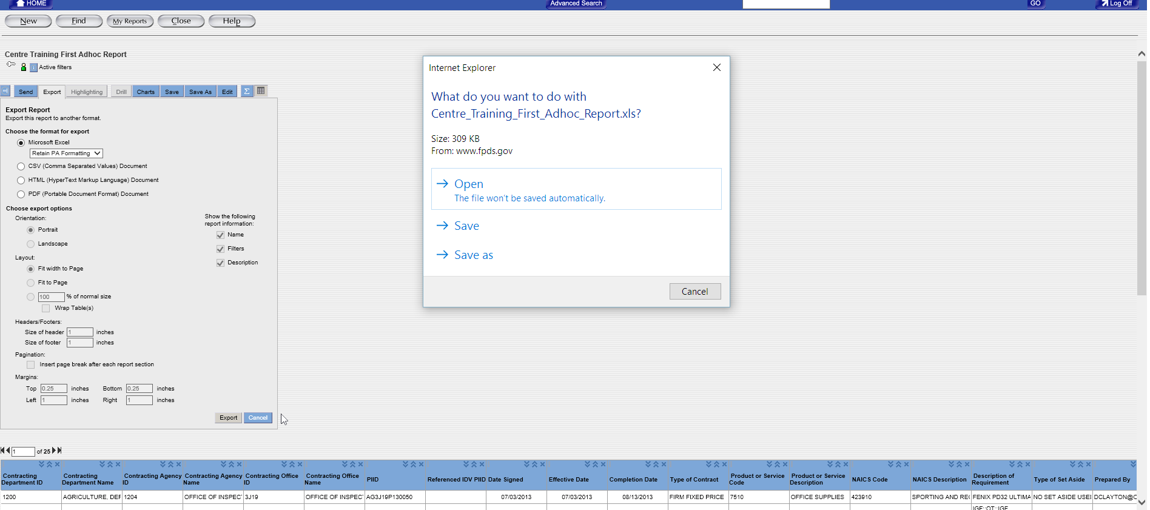
FPDS-NG Adhoc Reports
58
Choose how and where you want to save your report
FPDS-NG Ad Hoc
Reports

Slide 60
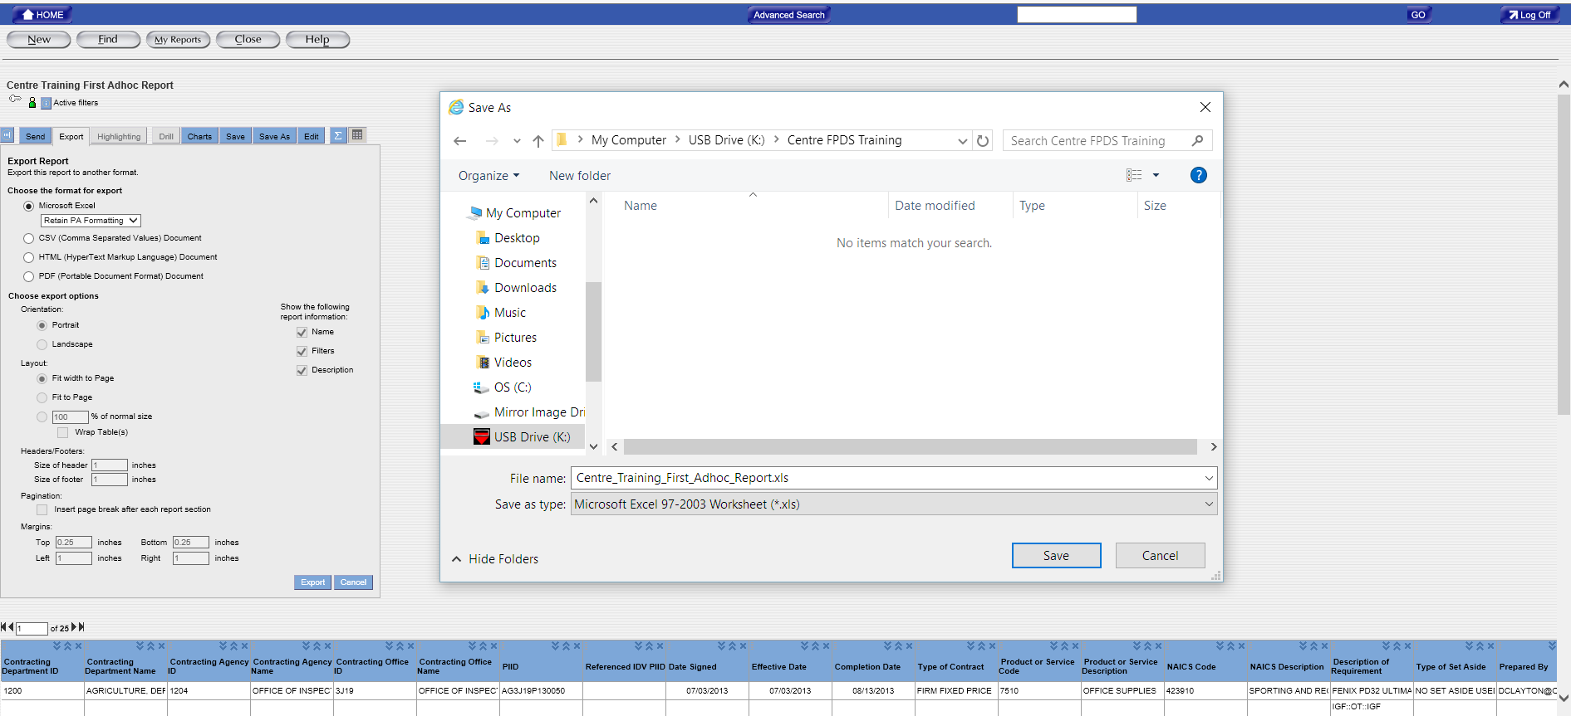
File name defaults to Report Name used in FPDS-NG
Click “Save”
59
FPDS-NG Ad Hoc
Reports

Slide 61
60
Excel notifies when download is completed
Click “Open” to view your report
FPDS-NG Ad Hoc
Reports

Slide 62
Your downloaded report appears in Microsoft Excel
Horizontal Scroll Bar
FPDS-NG Ad Hoc
Reports

Slide 63
FPDS-NG Adhoc Reports
Layout and setup
Allows you to change the layout of your table
Use the >> arrows to move attribute to the right, << to move attribute to the left, or X to delete attribute
You may also set-up table layout by dragging attribute labels to the cross-hatched areas here
FPDS-NG Ad Hoc
Reports

Slide 64
FPDS-NG Adhoc Reports
Layout and setup
Allows you to insert calculations in your report
FPDS-NG Ad Hoc
Reports

Slide 65
Layout and setup
FPDS-NG Ad Hoc
Reports

Slide 66
FPDS-NG Adhoc Reports
Layout and setup
Click Execute
FPDS-NG Ad Hoc
Reports

Slide 67
Enter Date Ranges and Click Display Report
FPDS-NG Ad Hoc
Reports

Slide 68
FPDS-NG Adhoc Reports
“Sum” Calculation adds Total for Action Obligations (use horizontal scroll bar to scroll over to see total)
FPDS-NG Ad Hoc
Reports

Slide 69
“Sum” Calculation adds Total for Action Obligations (use horizontal scroll bar to scroll over to see total)
FPDS-NG Ad Hoc
Reports

Slide 70
FPDS-NG Adhoc Reports
Layout and setup
Allows you to format your report
Specify your formatting criteria, then Execute
FPDS-NG Ad Hoc
Reports

Slide 71
FPDS-NG Adhoc Reports
Layout and setup
Allows you to sort the data in your report
Specify your sorting preferences, if any
Click Execute
FPDS-NG Ad Hoc
Reports

Slide 72
Layout and setup
Allows you to create and customize charts from the data in your report
Click “Add New” & Select Type of Chart/Graph “Pie”
Click Execute
FPDS-NG Ad Hoc
Reports

Slide 73
Enter Date Ranges and Click Display Report
FPDS-NG Ad Hoc
Reports

Slide 74
FPDS-NG Adhoc Reports
Use vertical scroll bar to scroll down to view entire chart/graph
Pie Chart based on action obligation
FPDS-NG Ad Hoc
Reports

Slide 75
FPDS-NG Adhoc Reports
Complete View of Pie Chart
FPDS-NG Ad Hoc
Reports

Slide 76
FPDS-NG Adhoc Reports
Layout and setup
Select “Add New” and choose “Standard Bar”
Click Execute
FPDS-NG Ad Hoc
Reports

Slide 77
Enter Date Ranges and Click Display Report
FPDS-NG Ad Hoc
Reports

Slide 78
FPDS-NG Adhoc Reports
View of Standard Bar Chart
FPDS-NG Ad Hoc
Reports

Slide 79
Common
Error
Messages
9
FPDS-NG Ad Hoc
Reports

Slide 80
Maximum allowable rows per report – 30,000
Fix:
Reduce Date Range
Provide more specific search criteria narrowing search
FPDS-NG Ad Hoc
Reports

Slide 81
FPDS-NG Adhoc Reports
Reports exceeding 5,000 rows may only be exported in CSV format (can convert CSV formatted files into Excel Spreadsheets in Microsoft Excel)
FPDS-NG Ad Hoc
Reports

Slide 82
Maximum date range is 5 years
FPDS-NG Ad Hoc
Reports

Slide 83
FPDS-NG Adhoc Reports
Reports which run for long periods of time (e.g., > 1 min.) are generally because date ranges are excessive and the search criteria may be too general
Fix:
Reduce Date Range
Provide more specific search criteria narrowing search
FPDS-NG Ad Hoc
Reports

Slide 84
Thank you for the privilege of your time today! But most importantly, thank you for your service! Best wishes to you for every continued success in the Federal Marketplace!!
Wayne Simpson, CFCM, CSCM
POB 12417, RTP, NC 27709-2417
Tel: 571.255.1000 Fax: 571.255.1001
https://fedbizassist.com

