Slide 1
SAN ANTONIO
2019
9th Annual Veteran Entrepreneur Training Symposium
May 29 – 31, 2019 | San Antonio, Texas

Slide 2
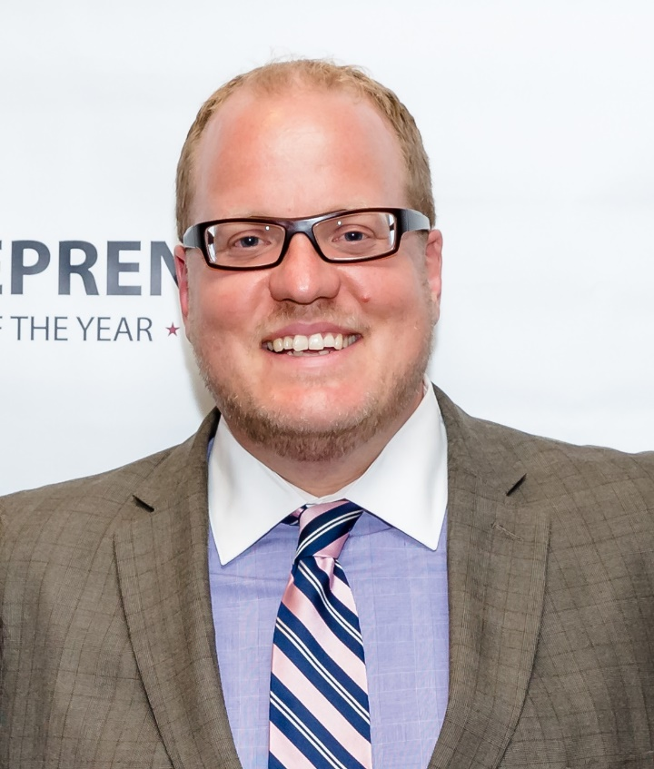
Matthew Pavelek, M.A.
President & CEO

Slide 3
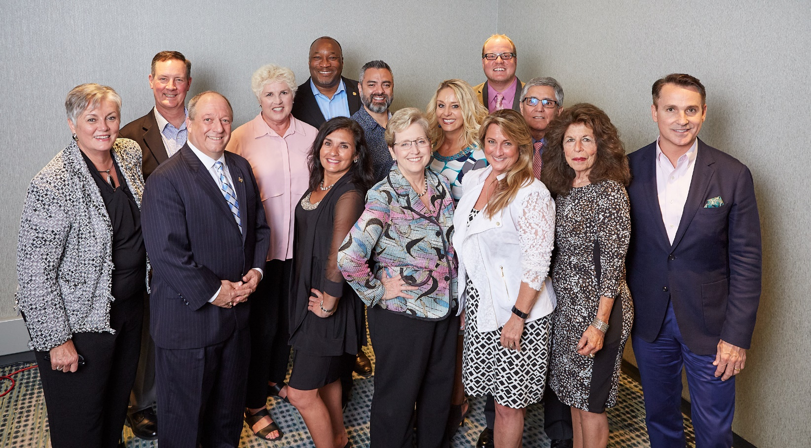
NaVOBA VISION
To be the conduit for America’s Veteran Business Enterprises and Service Disabled Veteran Business Enterprises to become sustainable participants and contributors to U.S. and Global Corporate Supply Chains.

Slide 4
NaVOBA MISSION
to facilitate corporate contracting opportunities for America’s Veteran’s and Service-Disabled Veteran’s Business Enterprises (VBEs/SDVBEs) through certification, advocacy, outreach, recognition and education.

Slide 5
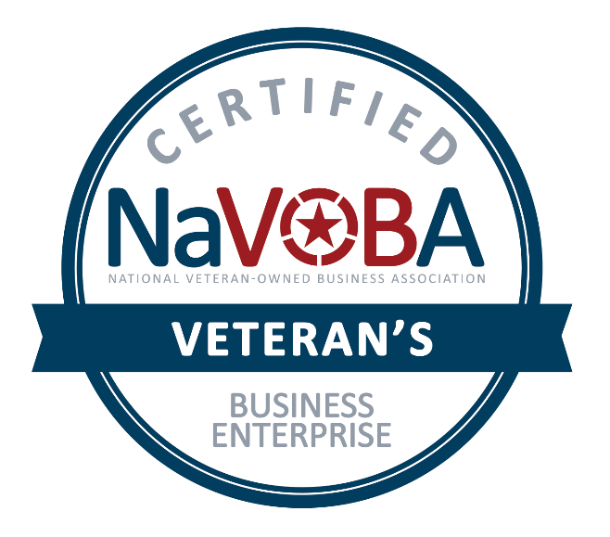
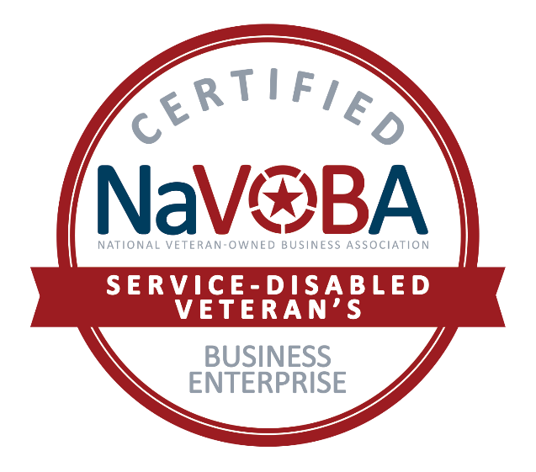
Why target the Private Sector?
Diversify Prospective Customers
Greater Access
Excellent Timing
And…

Slide 7
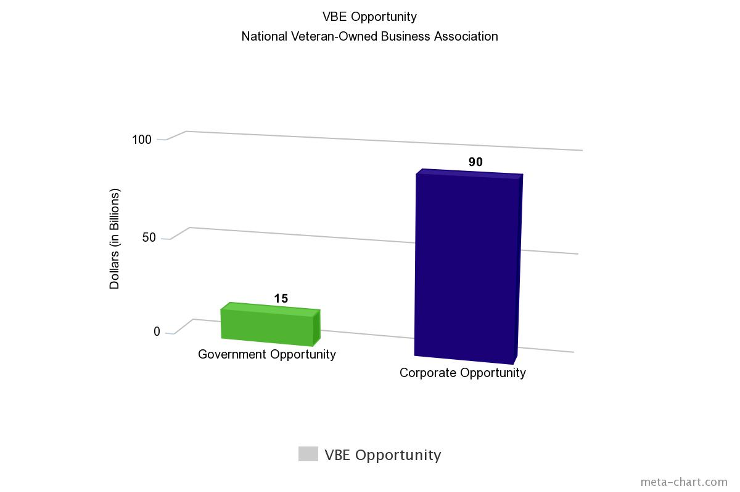
Why target the Private Sector?
The federal government’s VOSB /SDVOSB goal is 3% of contracts:
Equals $15 billion (2017 numbers)
If Corporate America’s goal was 3%:
Equals $90 billion in contract opportunities
More than 400 of FORTUNE® 1000 companies set goals to include VBEs and SDVBEs in their Supplier Diversity Programs

Slide 8
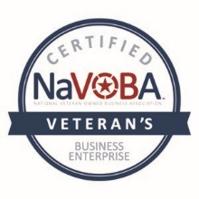
Certifying America’s Veteran and Service Disabled Veteran Owned Businesses

Slide 9
FAQs
How is it different than the VA’s Veteran Business Verification?
Why do I have to get certified?

Slide 10
Differentiators
NaVOBA has trademarked the “Certified Veteran’s Business Enterprise™” and “Certified Service-Disabled Veteran’s Business Enterprise™”
Lowest Cost Certification
VBE/SDVBE certifications are good for two years.
ID.ME confirms Veteran Status before completing application.
QuikCert fastracks applicants already verified by the VA.

Slide 11
Getting Ready for a Corporate Contract
Do your homework:
Identify Corporations of interest
Research the industry and the company
Websites—products and services, news clips, annual reports
Competitors
New products, business developments, issues and challenges
Seek to understand issues and problems
Talk to employees, suppliers or competitors
Register on the Corporate Supplier Diversity/Procurement portal

Slide 12
Getting Ready for a Corporate Contract
Build Relationships: Corporate Supplier Diversity and procurement staff, company managers, current suppliers
Be There: Don’t miss opportunities to attend events to meet and build relationships with people that control or direct bid & contracting opportunities—Procurement and Supplier Diversity
Be Active: Work in organizations that involve the corporate people you want to meet
Partner: Work jointly with another VBE to expand capacity
Tier I or Tier II: Start with a smaller contract and grow

Slide 13
Getting Ready for a Corporate Contract
Ask yourself important questions:
Does the corporation have a need for what my company does?
Do we have the capacity to win a contract and deliver as required?
Can we meet the requirements of a contract?
Proper licenses
Bonding
Available financing
Ability to meet timelines
Etc.

Slide 14
The Wrong Way in Corporate Contracting
Don’t lead in your first conversation with your Veteran/Service Disabled Veteran’s status.
Don’t ask dumb questions:
“What does your corporation do?”
“What do you guys buy?”
Don’t be a “Jack of all trades”!
“I can do anything you need!”

Slide 15
The Right Way in Corporate Contracting
Emphasize the VALUE your company can provide:
Better design, Shorter delivery time, Cost saving, etc.
Corporations Buy Value, Not Status
Provide specific examples

Slide 16
The Right Way in Corporate Contracting
Understand there may not be a prime contract opportunity
They don’t ever buy what you sell (NEXT!)
Current contract in place—a time before it comes up for bid again
Consider becoming a Tier I or Tier II supplier to current contract holder
If a RFI or RFP is received, respond with all information in requested format, within the timelines, etc.
Follow Up: Be professional and persistent but not aggressive
Do what you say you will do!

Slide 17
The Right Way in Corporate Contracting
Emphasize the VALUE your company can provide:
Better design, Shorter delivery time, Cost saving, etc.
Corporations Buy Value, Not Status
Provide specific examples

Slide 18
FAQs
Why do I have to pay to get certified?
I’m already certified in another area (e.g. WBE, MBE, 8a, etc.) Why do I need this?
Who authorized NaVOBA to certify my business?

Slide 19
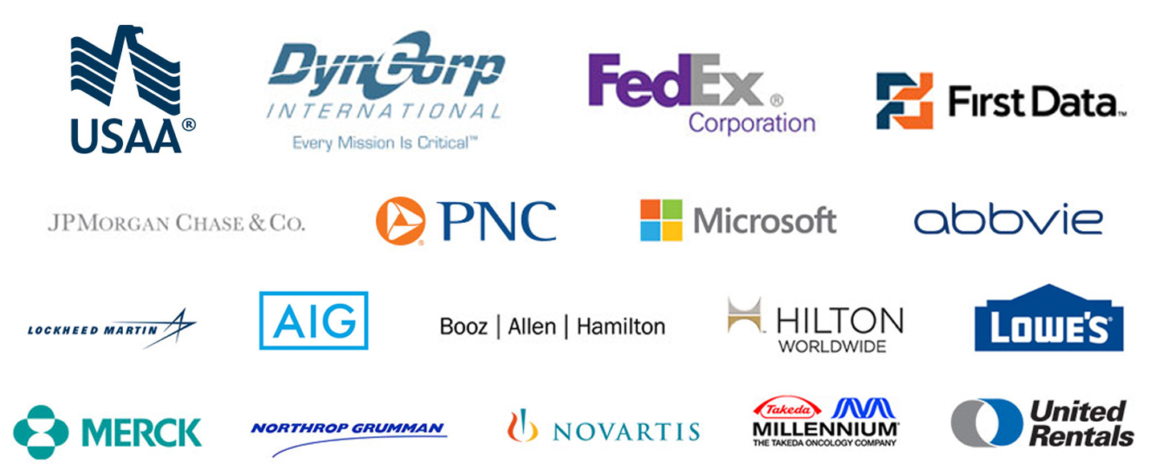

Slide 20
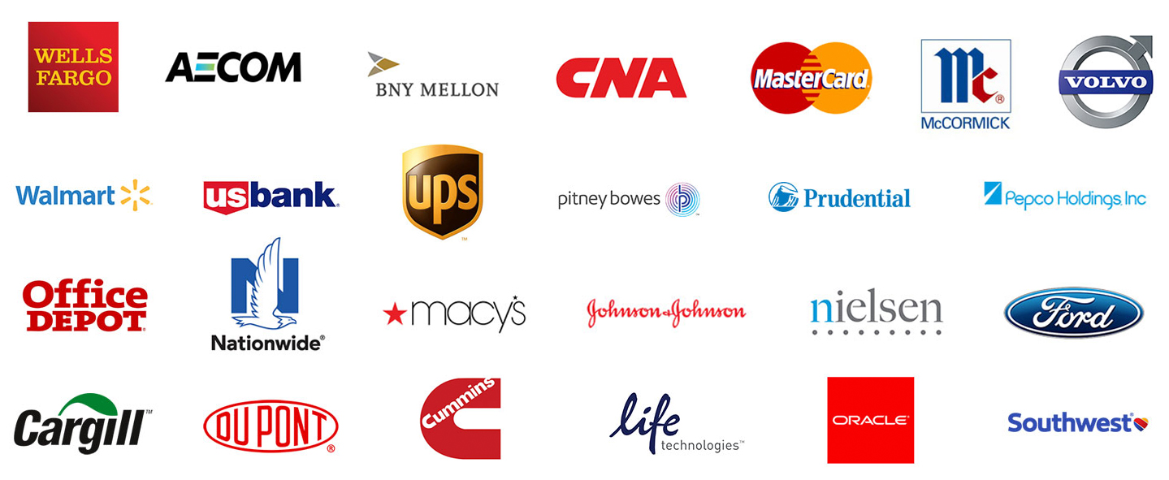

Slide 21
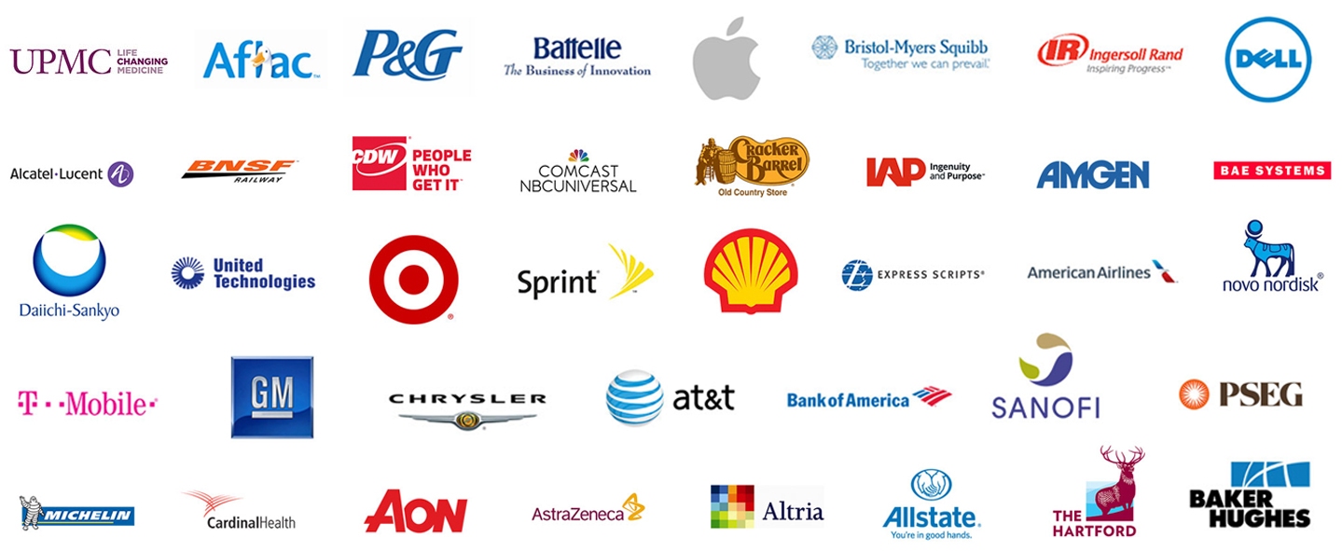

Slide 22
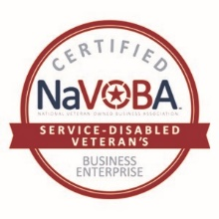
How can you get involved?
Veteran-Owned Businesses
Apply at www.navoba.org/certification
Leverage your certification with current and prospective clients
Participate in NaVOBA events
Tell your fellow Veteran and Service Disabled Veteran business owners

