Slide 1
GSA Schedule Revolution – The Facts You Need to Know
How To Get In Front Of Your Federal Buyer So You Can Win The Business You Deserve

Slide 2
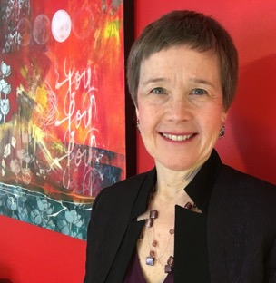
Welcome! Judy Bradt, CEO
Extraordinary, Results-Driven, Experiences
To Grow Your Federal Business
© Summit Insight 2019

Slide 3
Once Upon A Time… I Had A Dirty Little Secret

Slide 4
The Heart of Darkness of Federal Sales
Come with me…

Slide 5
Expert, Right?
25 years. Books. Webinars. Thousands of clients. Millions of dollars in wins for them.

Slide 6
Me? Just Three. Little. Tiny. Federal Contracts.
Just Based on conversations With Friends. No big proposals.
Not one worth more than $10,000.

Slide 7
“FRAUD.”

Slide 8
I could tell you firsthand anything about Federal business…

Slide 9
Except This One Thing:

Slide 10
How Do People Win Serious Federal Contracts?

Slide 11
I Knew It Was Your Biggest Problem.
I just couldn’t help.
No matter how much you offered me.

Slide 12
And the people who did know… weren’t talking.
(Ever see any courses on THAt?)

Slide 13
I Figured It Didn’t Really Matter.

Slide 14
Then This Happened…

Slide 15
The Big Contract ☺
Me: Strategy. Research. Sales training. Sales plan. Coaching.
Client: sell.
PERFECT.

Slide 16
It Was All Going Great!
Then they asked….

Slide 17
“When Are You Making The Introductions?”

Slide 18
WHOOPS.

Slide 19
New Mission: Thousands of Calls. Hundreds of Leads.
Forty Weeks. Epic, right?

Slide 20
Three Little Problems
I’m An Expert (Not A Seller). I Need This Win.
I’m Scared Of Failing.

Slide 21
JUST DO IT.

Slide 22
Open Plan. Pick Up Phone… And…

Slide 23
Awkward.
(at first)

Slide 24
Then This Happened.
People were nice. People were… people.

Slide 25
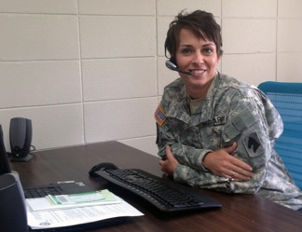
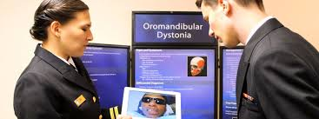
People…
With Promotions. Home Décor. Travel…
And problems!
Notes:
Images: man sewing curtains; female army warrant officer (from defense Media site); Uniformed Services University Postgraduate Dental College

Slide 26
Who told me just what I needed to succeed
When I slowed down
to care about who THEY were
before “selling” anything.

Slide 27
There Was No “Heart of Darkness.”
Only Hearts of GOLD

Slide 28
Three Things Hit Me.

Slide 29
Federal Sales Is Very, Very, Human.
Curiosity | Courage | Connection

Slide 30
Persistence
Homework
Focus
Research
Sure, you need all that….

Slide 31
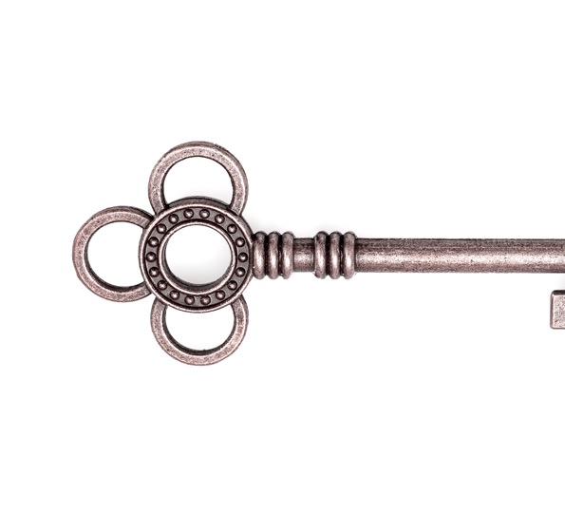
But My Dirty Little Secret— Personal Relationships Were Really The Key To Success!

Slide 32
I met my goal…and…
Transformed my fears into unstoppable momentum

Slide 33
My New Mission: Turn My Hard-Won Lessons Into Your Easy Steps.

Slide 34
Agenda
Why They Don’t Take Your Calls (and what to do next)
The Five Worst Mistakes (and how to avoid them)
How To Prepare For Your Call (and get invited back)
The Magic of Micro-Engagement
The Easier Road To Q4 Success
Your Next Wins

Slide 35
Getting in front of the right federal buyers is a million-dollar problem.
Nearly 50% of govcon c-suite execs said this is their top challenge.
33% said failure to solve this problem will cost them $1M - $10M million this year.
Federal Buyers? Who Needs ‘Em?
Who else has this problem…
And wants to know how to solve it?

Slide 36
So, What Do Contracting Officers Think Of Vendors?

Slide 37
What’s Your Top Challenge To Getting In Front Of Federal Buyers?
<< POLL >>
They don’t return my calls or emails.
I never get past a first meeting.
Small business specialists don’t help.
Tons of meetings, nothing ever happens.
They always pick the other guys.

Slide 38
What’s the one thing that’s always true when they don’t take your call?
Just that. they didn’t pick up your call.

Slide 39
Why They Actually Don’t Take Your Calls (And What To Do Instead)
Rude voicemails
Inappropriate questions
Solicitations on the street
Out of the office!
I don’t buy what you offer.
I don’t need what you do right now.
It’s not personal! It’s business.

Slide 40
The Rule That Can Open Doors: FAR Part 15.201
“Exchanges with industry…” “…from the earliest identification of a requirement through receipt of proposals, are encouraged.”
Notes:
Rules of Engagement = The Federal Acquisition Regulations
Are there primarily to protect the buyer. Don’t wield them over the contracting officers. There’s a lot of room for interpretation.
88,000 Contracting officers…88,000 interpretations. Treat EVERY Contracting Officer as an expert. Some have graduate degrees in the FAR! These are HER rules.
Here’s what you can always say: “I just want to follow proper protocol. What are yours?”
The Contracting Officer can use ANY FAR rule to make you go away if she wants to. If so, just move on. But if you are patient, talk to her with an appreciation for how hard her job is to comply with all those rules, and she sees you get it, she’ll guide you through her processes and protocols.
Learn FAR 15.201
Take a look at this rule. It says that Federal buyers are ENCOURAGED to speak to vendors. Even if someone say “I can’t talk to you,” there may be any number of reasons why not! Be brave; remember that the FAR supports you…and move on to another one of the 87,999 buyers.

Slide 41
The Five Worst Mistakes CO/KO’s Say That Vendors Make
(and what to do instead)

Slide 42
Top Mistake #5: “Ask Me About Something I Don’t Do”

Slide 43
Better Tactic #5: “Ask Me About Something I DO Handle.”

Slide 44
Top Mistake #4: “Ask Me Who Won the Contract.”

Slide 45
Better Tactic #4: Research Awards Yourself.

Slide 46
Top Mistake #3: “Ask Me For Matchmaking With Primes.”

Slide 47
Better Tactic #3: Do Your Own Networking & Matchmaking

Slide 48
Top Mistake #1: Go Fishing. “Got anything coming up?”

Slide 49
Better Tactic #1: “Have A Specific Ask About Something I Do.”

Slide 50
“I’m a small business. What do you have for me?”
Oh yeah, and just in case…
Avoid The Biggest Goof.

Slide 51
3 Ways To Prepare For Your Call…
And Get invited back! ☺

Slide 52
3 Ways To Prepare For Your Call
So you get invited back
1. Research the PERSON you’re calling
As well as where, and when, they might need what you do

Slide 53
3 Ways To Prepare For Your Call
So you get invited back
2. Know what the agency buys
and what’s happening to their budget
(Up or down both represent opportunities!)

Slide 54
3 Ways To Prepare For Your Call
So you get invited back
3. Relax and be yourself!
Connect with the person they are.

Slide 55
Got Goals? Great!
What might a major federal business goal be?

Slide 56
You’re in a hurry.

Slide 57
Your buyer…
not so much.

Slide 58
“Who are you, again?”
Except Q4… but even then:

Slide 59
What’s the risk of rushing the relationship?

Slide 60
Take your time. What could you win?
What’re you afraid of missing?
How could you temper that risk?

Slide 61
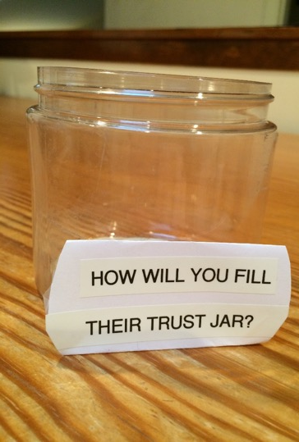
How do you fill a jar of marbles?
Trust is built one small interaction at a time.

Slide 62
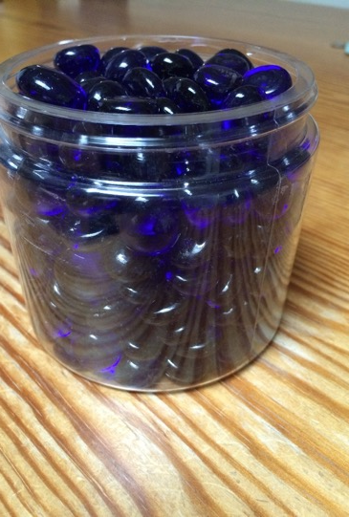
Let’s Look At “Marble Jar” Opportunities More Closely

Slide 63
CONCEPT: Micro-Engagements!
Micro-Engagements Let You Fill The Jar Completely!

Slide 64
Micro-Engagement:
An interaction between you and your buyer
that either of you can initiate
And which moves each of you closer to your goals.

Slide 65
Each action has a purpose. For both of you!

Slide 66
What could be important to them?
Small Business Specialist
Contracting Officer / Specialist
End User/ Program Manager
Stakeholder

Slide 67
What kind of micro-engagement could you offer to your federal buyer?
/
Why Would it be valuable?
Example…

Slide 68
What kind of micro-engagement might they offer, and that you might MISS?
/
Why Would it be valuable?
Example…

Slide 69
How About Milestones?
Give you a sense of direction, of progress.
Keep you engaged.

Slide 70
Milestone:
An interaction between you and your buyer
that represents significant progress toward your next step or result.

Slide 71
In Federal contracting, what could a milestone look like for you?

Slide 72
In Federal contracting, what could a milestone look like for your buyer?
Oh. Them.
Yeah. It’s about THEm.

Slide 73
Some Milestone Examples
Getting a debrief (you get measurable knowledge about your performance and how to get to the next step that could change something within your company, how you respond to next solicitation, how you price, who you team with).
New signed teaming agreement that opens access to a specific buyer and opportunity.
Closed invitation-only short-list event Encouragement to bid, Invitation to “Loser-Bid”, Invitation to compete
They invite you to demo. They invite you to bid. They shortlist you. They invite you to orals. You win a contract award.
Even a micro-purchase adds to your past performance

Slide 74
You & Your Federal Buyer Are On This Journey Together.

Slide 75
It Took Me 25 Years To Figure This Out
And Over $1,000,000 Lost Opportunity

Slide 76
Start creating opportunities with your best federal prospects now…

Slide 77
…so you can win new work and grow your business, as you serve the country.

Slide 78
Now, Back To My Mission: Turn My Hard-Won Lessons Into Your Easy Steps.

Slide 79
Okay, Let’s Talk About September 30th!

Slide 80
What % Of Federal 2018 Contract Spend Happened in Q4?
Come on. Shout it out.

Slide 81
Take Your Best Shot.
32%
25%
38%
17%
43%
57%

Slide 82
What effect do you expect that’ll have on 2019 Q4?
It’s Time to get calling!

Slide 83
You Can Tackle Q4 Alone.
Even With These Steps
Your Next Win
Could Still Take You
Over 12 months.
And $30,000 to $233,000.

Slide 84
OR It can be easier.

Slide 85
How To Pick Your Best Federal Prospects Right Now
These four actions help achieve these goals!
Leads
Referrals
Proposals
“Add On” Modifications
Teaming Partners
Under the Radar Orders
New Customers
Current Clients
Shadow Opportunities
Revise Your Pipeline
Revisit Their Forecast

Slide 86
How To Spend Your Time Where The Money Is
Be Top Of Mind
Focus On The Easiest Wins
Show Appreciation
Talk To Your Buyers
Focus On Your Best Values
Be Where They Can Find You When They Need You
Be Set Up For A First Win In A New Agency

Slide 87
Introducing… The Federal Q4 Online Planning Slam
Now through august 30th…

Slide 88
Focused On Building The Connections You Need To WIN
Action plan, training, tools, coaching, network connections, And a whole lot more

Slide 89
Win full registration for your whole team right now.

Slide 90
I Found The Hearts of Gold That Can Grow Your Business.
They Grew My Client’s business…
and My heart, too.

Slide 91
Thank you! Judy Bradt, CEO
Your Next Wins:
Pick the next winning team
Check out GrowFedBiz.com/Q4-Planning-Slam
Let’s talk on site.
Book a chat https://judybradt.as.me (703) 627 1074
© Summit Insight 2019

