Slide 1
SAN ANTONIO
9th Annual Veteran Entrepreneur Training Symposium
May 29 – 31, 2019 | San Antonio, Texas

Slide 2
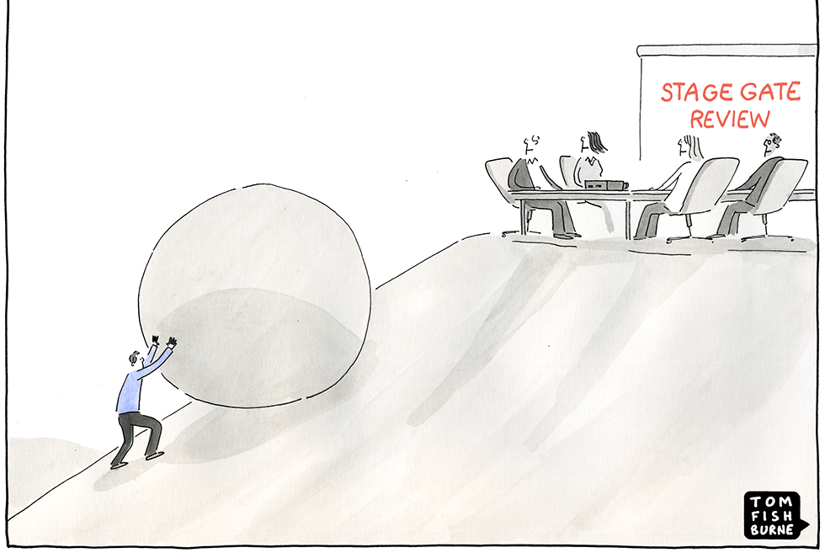
Bid Decision Gate Reviews
Tan V. Wilson, PMP
President of Entellect, LLC

Slide 3
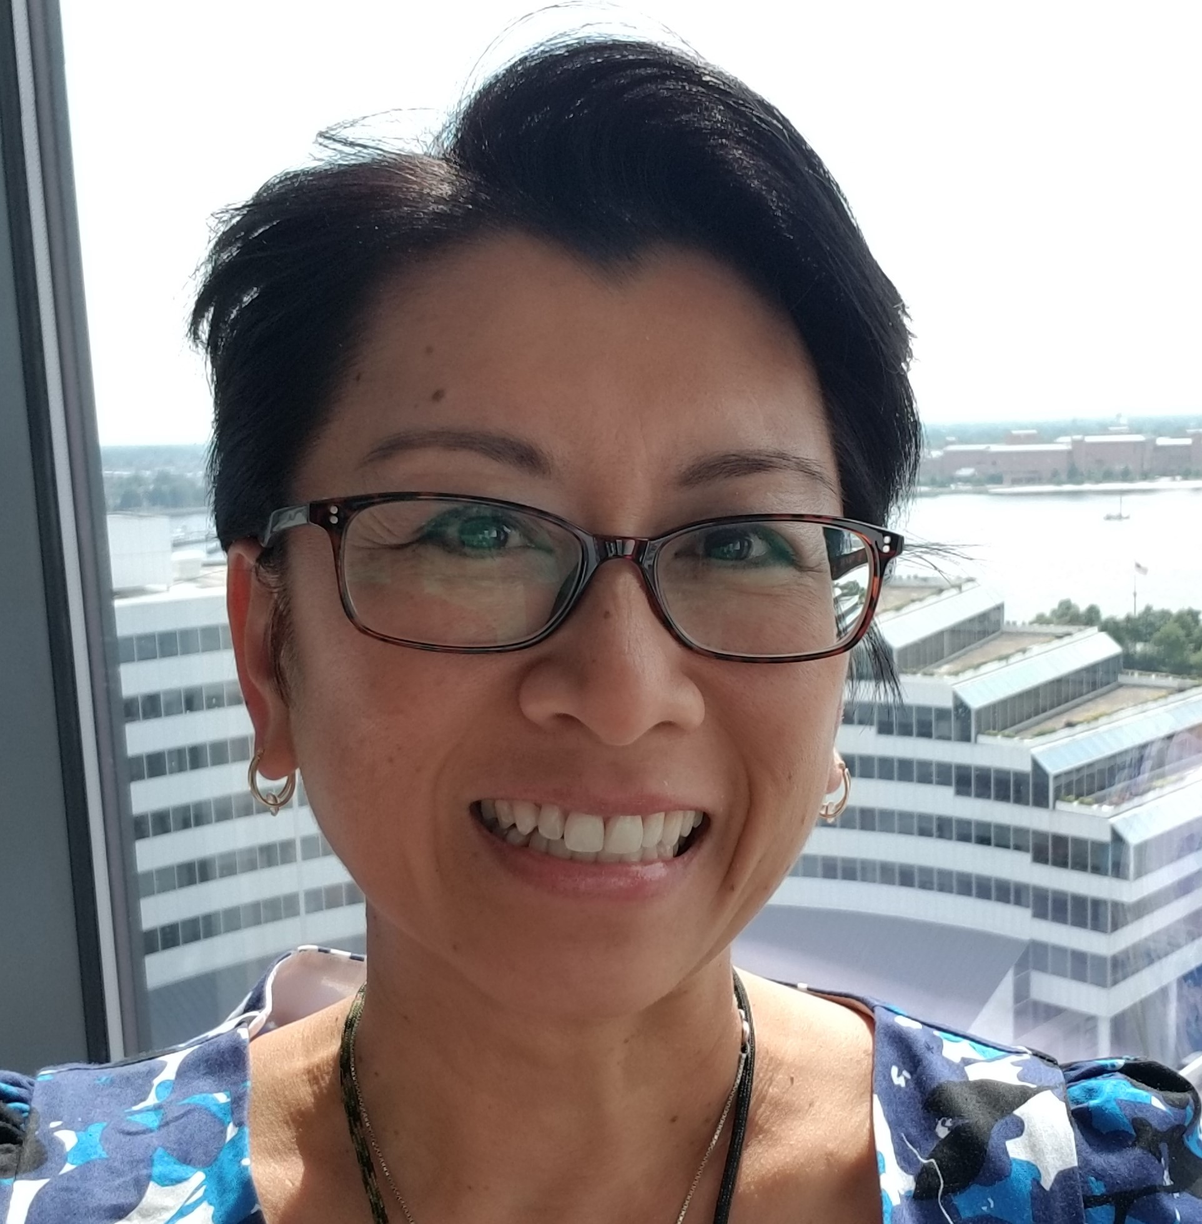
Tan V. Wilson Background
Entellect LLC’s Capture and Proposal Management Services are led by our Founder and President, Ms. Tan V. Wilson, PMP. Ms. Wilson is an experienced and successful entrepreneur with more than 23 years of experience in business development and program management across Federal and commercial IT business sectors. With more than $100B in contract wins, she brings her extensive management experience leading large project teams of diverse stakeholders from scientists to C-level executives.
Ms. Wilson has served as the Director of Federal Programs for an 8a Graduate, Minority- and Woman-Owned HUBZone, and Service-Disabled Veteran-Owned Small Business. She was instrumental in establishing disciplined capture and proposal processes based on Shipley, Business Development Institute, and PMI’s PMBoK Knowledge Areas.
Army RS3 and ITES-3SB
VA VECTOR
GSA OASIS SB Pool 2
NRL ITS IDIQ
INSCOM Global Intelligence Support Services
DHS S&T FBD Financial Support Services
NIH CIO-SP3
DHS EAGLE I
8a STARS II
SAMHSA I Domains IV and V Contracts
Entellect has supported over 200 proposals, securing over $150B in IDIQ wins and over $10.7B in non-IDIQ wins

Slide 4
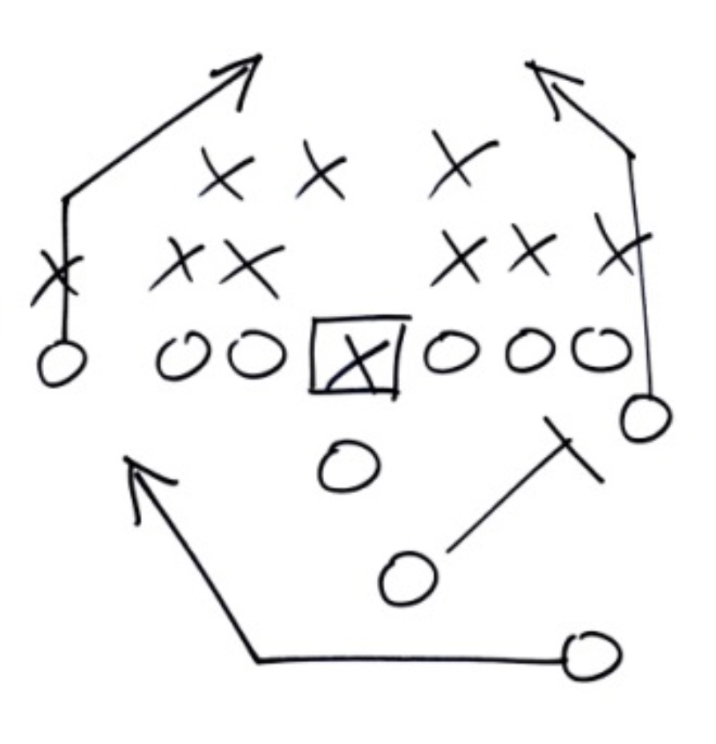
Session Topics
Understanding BD lifecycle and stages of capture
Importance of pipeline
Stages of a pipeline
People, processes, and tools
Shipley Color Team Review definitions and timeline
Purpose of each Gate Review
Each Gate Review and the corresponding Color Team Review

Slide 5
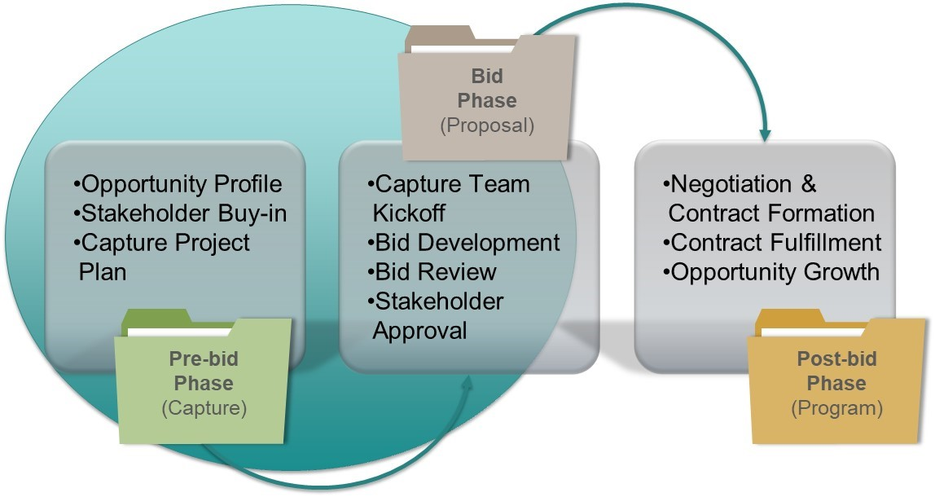
Business Development Lifecycle

Slide 6
Why is a qualified pipeline important?
Stability
Minimizes the ebbs and flows
Forecasts and visualizes new potential business to help set and maintain business goals
Balances short- and long-term opportunities
Long-term Focus
Minimizes the immediacy to produce sales now
Forces more critical and strategic review and consideration of potential new opportunities
Better Allocation of Resources
Align the appropriate BD professional with the best opportunities for success
Allows BD professionals to better qualify and nurture new opportunities

Slide 7
Stages of a Developing a Pipeline
Identification
Are your leads aligned with your services and qualifications?
Have you identified short and long term opportunities?
Are your leads too heavily focused towards GWAC/IDIQ/MATOC or single-award contracts?
Are your leads aligned with your Tier 1 (current work) and Tier 2 (future or similar work) agencies/customers?
Qualification
Do you know the customer, scope of work, have the right past performance, etc.?
Is there an incumbent, is it wired, or does it require esoteric certifications or experience?
Have you performed an SWOT analysis?
Have you conducted critical gate reviews?
Opportunity
Opportunity
Opportunity
Bid
Bid
No Bid

Slide 8
Stages of a Pipeline (continued)
Pursuit
Have you made bid/no bid decisions?
Do you have the resources to develop a compliant and compelling proposal?
Are there too many bids?
How may bids are outstanding?
Are you able to bid and make a reasonable profit and provide an adequate return on investment?
Award
Allows BD professionals to better qualify and nurture new opportunities
9th Annual Veteran Entrepreneur Training Symposium
May 29 – 31, 2019 | San Antonio, Texas

Slide 9
Shipley Defined Color Review Teams
Team | Objective
Purple Team | Approves opportunity analysis report
Blue Team #1 | Reviews initial capture plan and approves capture strategy
Black Hat Team | Predicts competitor solutions
Blue Team #2 | Approves updated capture plan and solution set for use in kickoff meeting packet
Pink Team | Reviews storyboards and mockups to verify alignment with capture strategy and execution of customer issues
Red Team | Reviews final draft to predict proposal scoring
Green Team | Reviews cost/price solution and alignment with strategy
Gold Team | Approves final proposal and price
White Team | Compile “lessons learned” to improve future competitiveness

Slide 10
Right People, Processes, and Tools
Executive Leadership, Business Development Managers, Capture Managers, Proposal Managers, Program Managers, Consultants, SMEs
Pre-bid (BD and Capture)
Bid Gate Reviews
Bid (Proposal) Post-bid (Program/Project)
EZGovOpps, GovWin, Bloomberg Government, FPDS, Capture Plan, Checklists, Score Sheets
“Surround yourself with the best people you can find, delegate authority, and don’t interfere.” – Ronald Reagan
Notes:
Prepare:
Plan and schedule the review. (“Plan the work.”)
Train the reviewers and the staff who will respond to their findings
How to perform the review
What to expect
How to keep the process positive and constructive
Perform:
Execute the review as planned and scheduled. (“Work the plan.”)
Project a positive tone
YES: How we can improve our Pwin?
NO: What is wrong with this document?
Respond:
Give a summary report of the review team’s findings.
Perform detailed, one-on-one debriefs as needed.
Determine whether or not each recommendation is valid.
Document accept-or-reject decisions.
Execute recommendations and verify their completion.

Slide 11
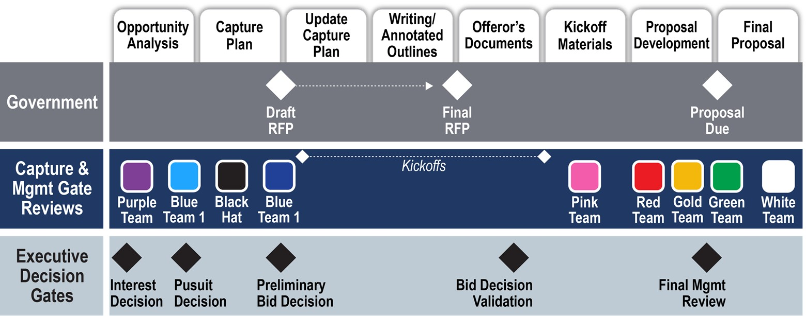
Shipley Timeline Capture and Proposal Activities

Slide 12
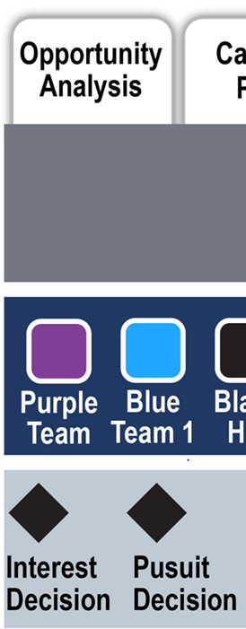
Purpose of Different Review Stages
Gate Review 1: Interest Decision
Verify that the opportunity is aligned to your corporate capabilities and qualifications
Determine whether the opportunity is sufficiently defined
Validate if opportunity is real and funding is available
Gate Review 2: Pursuit Decision
Determine whether to initiate formal capture process
Determine key customer hot buttons
Determine key win themes
Validate or adjust win strategy
Develop price to win analysis/strategy

Slide 13
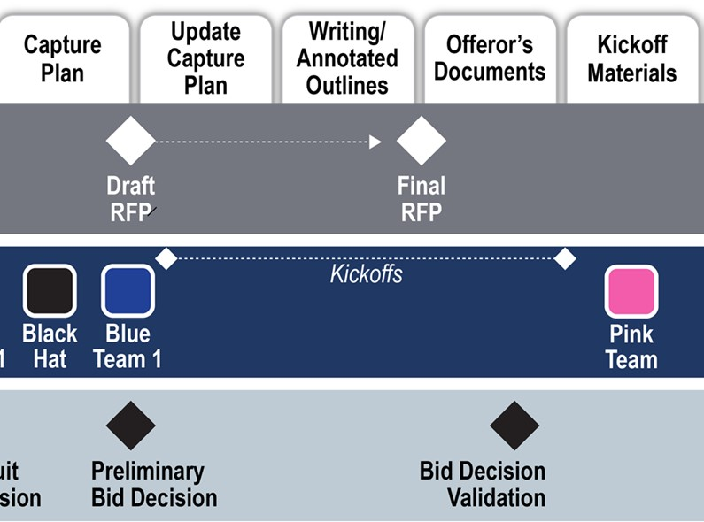
Purpose of Different Review Stages (continued)
Gate Review 3: Preliminary Bid/No-bid Decision
Verify the ability to win (win themes, discriminators, key personnel, team members, etc.)
Address any gaps or proposal risks
Complete capture process
Gate Review 4: Bid Decision Validation
Conduct after final RFP is released
Determine if there are any “deal breakers”

Slide 14
Same Process for Any Color Review
Consistent application of a successful review process earns respect and acceptance
Prior to the review, “train” the proposal team in what to expect from the reviewers
Likewise, train the reviewers as to their “mood & manner” used with the proposal team on debriefs
Use simple techniques like a “red-marked” copy for each appropriate proposal team member
Provide “one-on-one” debriefs
Post corrections required and require proof of compliance - signed off by PM and author

Slide 15
Gate Review 1: Interest Decision
“Winning isn’t everything, but wanting to win is.” – Vince Lombardi

Slide 16
Gate Review 2: Pursuit Decision

Slide 17
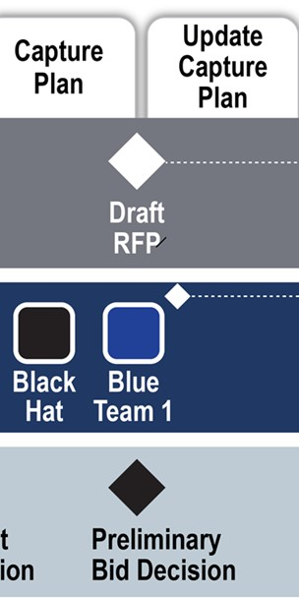
Gate Review 3: Preliminary Bid/No Bid Decision

Slide 18
Gate Review 3: Preliminary Bid/No Bid Decision
“If you change the way you look at things, the things you look at change.” – Wayne Dyer

Slide 19
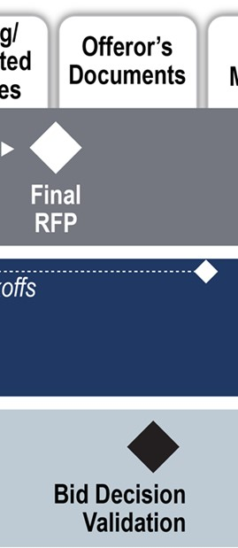
Gate Review 4: Bid Decision Validation

Slide 20
Key Takeaways
Plan and understand the pre-RFP timelines
Color Team and milestone gate reviews become more difficult and require more information the closer you are to the final RFP release
Develop a repeatable and scalable processes tailored to your company and bid opportunity
Plan, Prepare, and Expect to Win!

Slide 21
Questions?
Tan V. Wilson, PMP
President of Entellect, LLC
Phone: 703.489.1947
Email: tanwilson@entellectllc.com
Website: www.entellectllc.com

