Slide 1
Notes:
PULL People In
For events with multiple breakout sessions, promote the day before and day of to each person you meet with a rack card
Go into the hallway
Ask “Are you coming to the 5HoP workshop? Learn about having more money, more time and more fun”
Speak with passion, make eye contact, don’t hold back
Guidelines
These are our people - be yourself and have fun
Walk around the room to interact (use clicker to move the slides)
Speak with passion and perform like Broadway (do not read slides)
Be relatable that building business is challenging
Plant the seed that there is a better way with Clarity, Confidence, and Impact
Less is More (slow down to relate)
Ask Questions to make this about them (don’t tell them all the great things you did)
Solicit relatable experience overcoming challenge (don’t tell people what to do, they are the hero of their story, we are the high growth guide)
Engage Participants by Asking Questions
(these are basic non threatening questions to warm up)
What industry are you in?
How many employees?
Locations?
For Large Groups Do Hand Raising based on who is in the audience
Who is in the [X industry including gov’t contracting]
Who has 20+ employees, 50+, 100+
Who is challenged by growing the top line?
Who feels the cash crunch?
Put Energy into the Room
Are you Ready?
When I say “Ready”
You respond “Born Ready!” (if you have guts have them stand up with hand gesture as well)
Are you Ready?

Slide 2
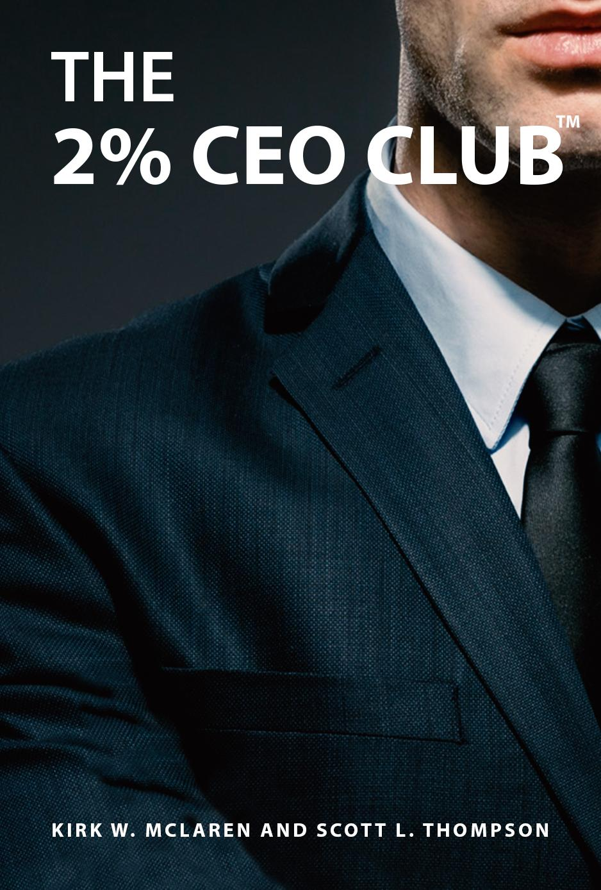
Who are the 2% CEO’s?
Notes:
Our Lens …
State question at the top of the slide … Who are the 2% CEO’s
(dramatic pause)
(practice this to say it naturally)
Define the 2% CEO’s ...
They are the ones who focus on growing the top line.
They are the ones who achieve top percentile valuation so that they are not leaving money on the table.
This gives them more time and money TODAY
And provide them succession options for TOMORROW
The 2% CEO’s have the right people on the team who are doing the right things
This is a Champion mindset
Introduce Self and Foresight
My name is Kirk. I am the CEO of Foresight CFO
I’ve been building private businesses for almost 28 years
I teach graduate students at Georgetown University
I am the husband of 1 and father of 2
I served in the US Army and my sons are currently blazing their own path at West Point
Our approach goes beyond revenue and profit optimization through building a business where you have options.
This gives you the time and money to do what you want when you want.
Whether you want to accelerate your business, sell it, buy one, or raise capital, our Habits of Profitability Growth System™ is proven.
We team with the 2% CEO business owns as their high growth CFO and provide Accounting services.
Benefits include clarity, confidence, and impact
You will see what I mean through the Habits
State we are releasing The 2% CEO Club Book this summer
Pass the Business Card Bag/Bowl
This is how you get contact information for almost all of the participants; exchanging business cards reduces the count dramatically
Get sturdy gift bag, small so that it is easy to pass around, and put the Foresight Sticker to brand it
To stay in touch, I am passing around this bag … drop your business card in to stay in touch and learn about the Habits
Call to Action - 2% Score, identify which growth options move the dial
Call to Action >$3 million revenue we can do a competitive benchmark for you
I will show you how these help you do even better

Slide 3
Think about this
Only 12% of businesses
make it through their 5th year
Only 5% are able to sustain
annual growth rates of 20% or more
GovCon is competitive pricing pressure and demand for value is intensifying
88% of 8a’s fail within 2 years of graduating
Some feel like they are Leaving Money on the Table
Notes:
Transition by saying … “Think about This” then click through the points
State statistic 1 then 2
Express with Heart - “Business is Hard for Startups” (only if there are start-ups in the room)
Express - “Business is Hard for Growth Companies”
Even when you build a successful business
When you are bankable and have time and money in your pocket
Even then decision making and follow through can be tough
Raising capital can be tough
Even then Succession has its challenges, real challenges
3

Slide 4
To Win and Deliver More Contracts ...
What challenges are you facing?
What does your Contract Officer care about?
Notes:
Issues
Going Concern
Non Value Pass Through
Contracting offices know that only 2% are real businesses. So they have lots of anxiety in awarding contracts, especially multi year.
Contracting officers are looking at you proving your technical ability and business capacity (value) to reduce anxiety. Habits is about business value (capacity).
How to prove value/capacity to contracting officer? Line of credit and bonding capacity on capability statement. Higher line of credit and/or bonding capacity the more confidence. Demonstrates a 3rd party underwriter has faith the business has value /capacity.
How to prove to bank or bonding underwriter you are a valuable investment? (Loan officers / agents only caries message you give them they don’t make lending / bonding decisions). Underwriters want to see if you are in the 2% or the 98%. They are looking at...(5 Habits). The high the business value the higher their confidence.
What do you want from your business? Exit value to cash out to meet personal goals. What do prospective buys want? You to prove that you are a good investment, same as bank / bond underwriters.
5 habits focus = Win. Win. Win! All 3 want the same.
Win for you to build value to exit and enjoy life
Win for underwriters that demonstrates valuable investment
Win for contracting officers proves you have capacity.
Win. Win. Win = Winning More Contracts
You can’t do it on your own. 2% have a CFO and mastermind group. CFO experiences in working with underwriters.
Everyone in this room knows that building a business is tough
There are many things that we carry on our own shoulders without having the right person to bounce ideas around
In this room you can take the“Take the Armor Off”
Let’s identify some of our challenges
List Your top 5 challenges, give 1 or 2 minutes
In small groups/table identify your top 3 challenges together - 3 minutes
Then have 1 person from each group state their top 1-3 challenges
Write their challenges on a whiteboard, piece of paper, etc.
At the end of the experience you will show them how the Habits gives them a way to solve their challenges
The approach and numbers varies based on the number of people and how the room seating is set up.
4

Slide 5
Today - Let's Stack the Odds in Your Favor
Learn the 2% CEO Habits of Profitability™
Implement them
Win More Contracts and Keep Them
Notes:
Speak to title and bullets
State …
The Habits are a proven methods based on 100’s of growth companies
The Habits of Profitability is a Growth System - its not a narrow focus such as on e channel to generate leads
Instead the Habits are about give you clarity about building your total business, like a hub
In a nutshell, they are identifying growth options across your entire business, selecting the best one, then using the financial scoreboard to follow through base
When established as a habit they give you a way to make decisions
and to be in the top percentile
In most cases, this means that you have the resources to do what you want when you want
Ready = “Born Ready”

Slide 6
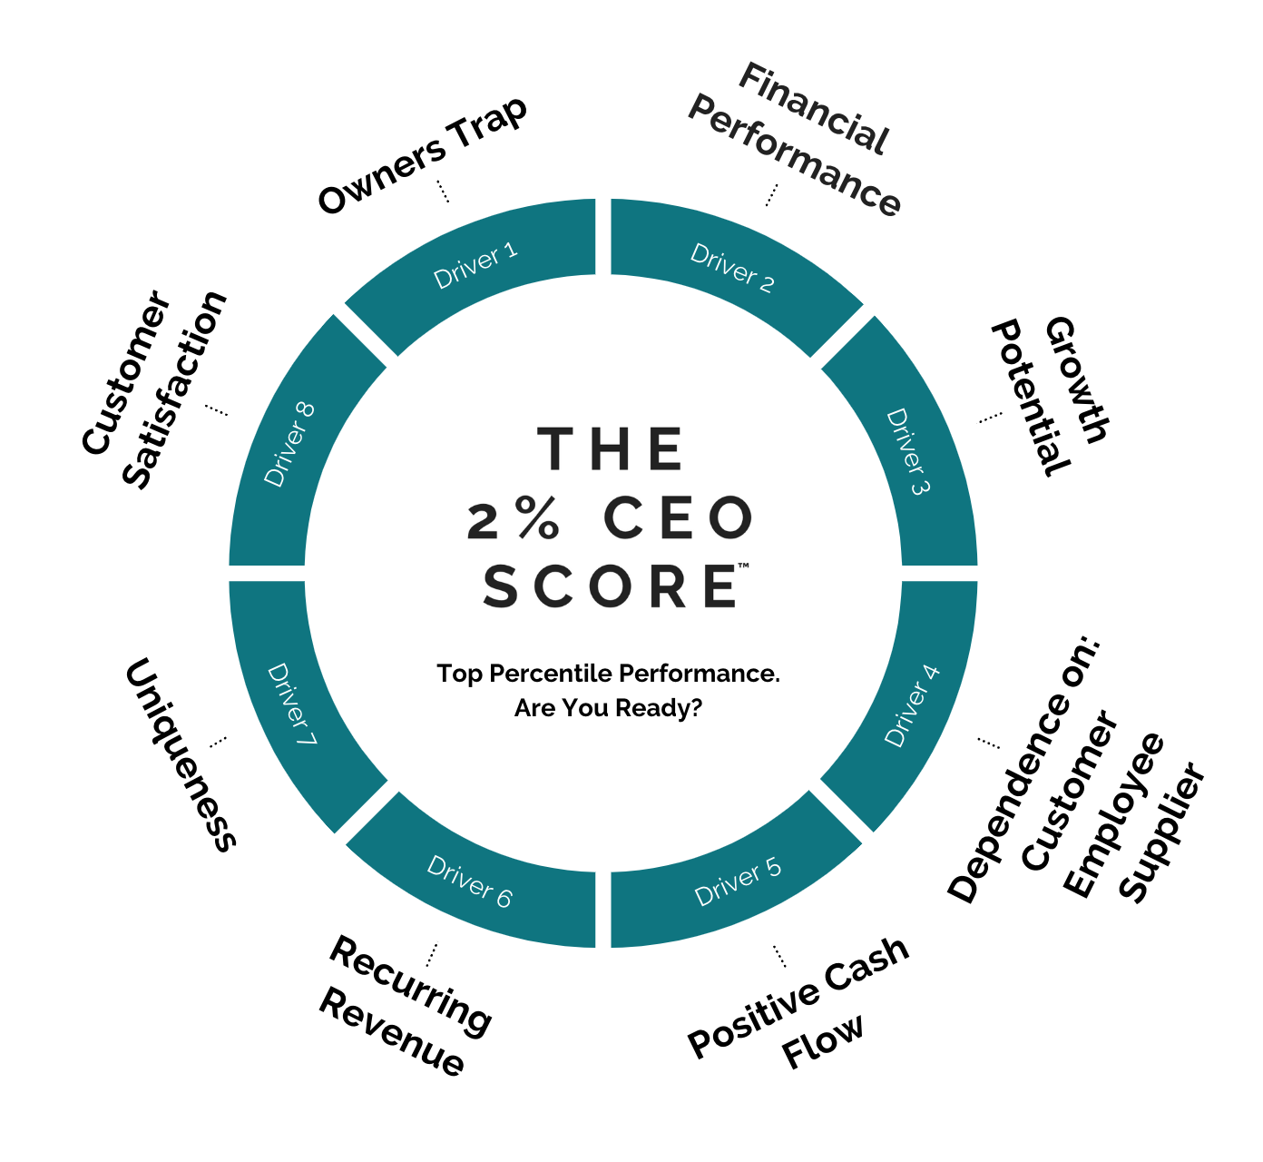
Habit 1: Identify Growth Options
Notes:
Add Talking to Position that We Have the 2% CEO Score, we know that biz that score 80+ are 71% more valuable. The average initial score is 59. Maybe show an image of the report and dial.
Brainstorm to Identify Growth Options ...
Reference a few of the top challenges that they identified (typical #1 is top line and #2 is staff)
Use questions to identify practical examples
Write these down but don’t get glued to the whiteboard
What options do you have to grow the top line sales?
What about recruiting? Onboarding? Training? Managing? To have the right team.
Operations - office space? Equipment? Software apps? process?
What about raising capital? LOC?
What about assessing M&A?
How do you identify growth options in your business?
Is it intentional or ad hoc?
Let me hear it …
What else?
This is a way that you can run your business and it has measurable and trackable outcomes.
What if there is a better way?
To make yourself more approachable, open the door to new habits instead of telling people what to do
The First Habit - is Identifying Growth Options
The good news is that 8 drivers are proven to drive performance
Its not 18 or 36 drivers, It’s 8
These drivers are proven to make your business 71% more valuable than competitors on average if you score 80+
The Habit is to use the framework to make intentional decisions and follow through month to month
Ask them questions …. Only define 2 to 3 drivers by asking questions then use Growth Potential as your focus since this ties into our Habits
Uniqueness - what could this mean? why do customers choose you over other options? Is your intellectual property secure?
Key point for Uniqueness … this is the top of the decision making pyramid. It determines your approach to the marketplace - sales, marketing, what you deliver, and how
Financial Performance - can you sustain 20%+ year over year top line growth? Is your bottom line net income in the top percentile (how do you know)? How clean and strong is your recording keeping (in shoe box)? Do you have a 3rd party audit/review your financials?
Recurring Revenue - what is recurring revenue? How does it compare to project revenue? Get to the predictability element and hint that this increases the value of your business
Diversified Customer Base - vs dependence on a few large; even govcon is concentrated
Owner Dependence - what is this? If you called in tomorrow to inform your staff that you are leaving for 2 weeks and will not be in touch while you are out, what would happen to your business?
This is the one that you want to end with because it fits our Growth narrative.
Growth Potential - How do you evaluate the growth potential of your business? new/same product/service, new/same customer; territory, segments; how do you figure out the low hanging fruit from this combination?
Identify growth options in relation to new vs existing customers and new vs existing products/services
The Habits is working through these drivers on a systematic and consistent basis.
Doing so establishes a way to intentionally develop the right growth options
This gives you Clarity to grow your business
Reference Call to Action (CTA)
We have a method to score the eight 2% CEO drivers
Placing your business card in the bag allows us to prepare the score for you.

Slide 7
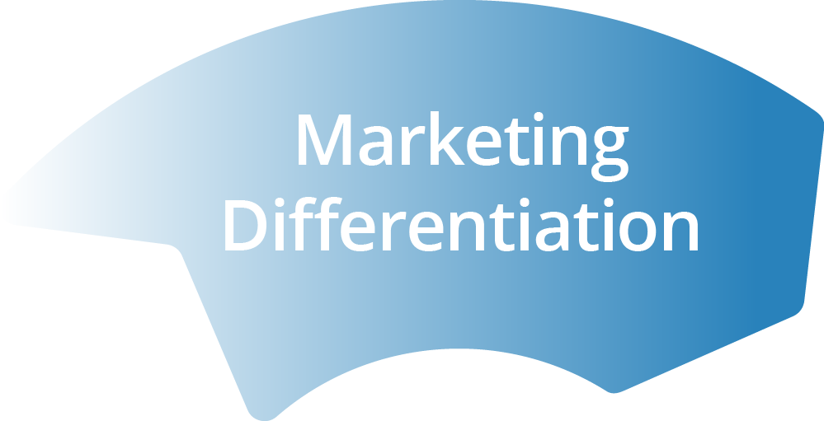
Uniqueness Driver
Notes:
The 6th factor that drives your company’s value is something we call “Uniqueness”
It refers to how well differentiated your product or service is
Sometimes this speaks to how you do something that produces an advantage
THE VIRTUOUS CYCLE OF DIFFERENTIATION
Your goal should be to find an attribute or benefit of your product that makes it unique in the market which will give … diagram

Slide 8
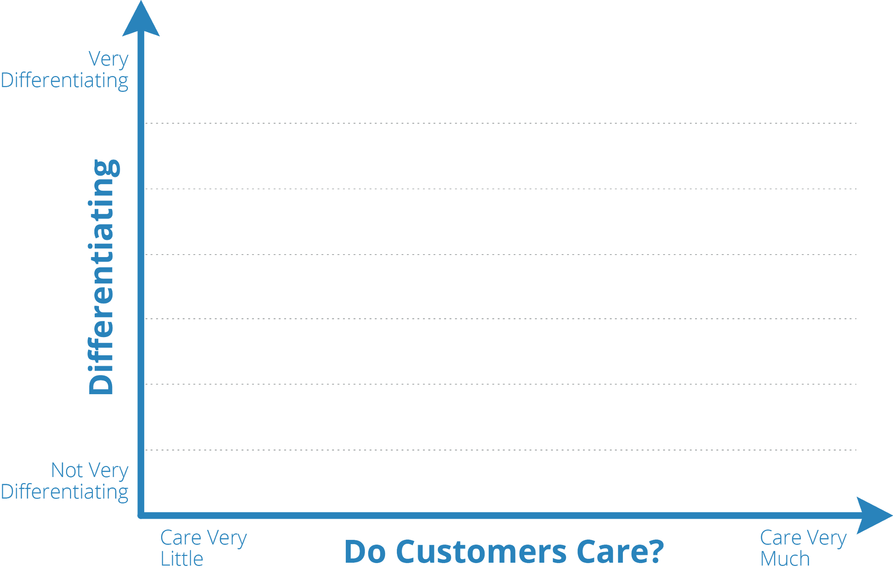
Intentional Market Segment Selection
Notes:
Think about where you fit …
Case Study …
Take for example the Panasonic’s entry into the crowded laptop market.
When they entered, established brands already owned the attributes customers cared about
Apple was seen as sexy,
HP was technically innovative and
Dell owned the benefits of buying direct
So if you’re Panasonic, all of the obvious market positions are already taken. If they had tied to compete directly with any of the incumbents, their only weapon would have been a lower price which would have led to lower margins. They may have picked up some price sensitive customers but as soon as one of the big incumbents matched their price, Panasonic would have been nudged out of the market.
Instead, they asked themselves the two questions you need to ask in order to identify a marketing strategy:
What do customers care most about
How differentiating would that benefit be if we offered it
There was a segment of the market that cared about TOUGH - police and military
Bang around, dust, water,
Panasonic therefore launched the ToughBook brand
Didn’t have to compete on price
This is tough in the government market … AI, cybersecurity, etc.
“Butts in Seats is not competitive”
Take a few minutes and plot the product/services you offer on the extent to which they make you different and how much customers care.
The attribute at the top right hand side of the page is the product/service that offers the best opportunity to differentiate.
If you market one product or service, plot all of the marketing messages you use to market that offering on the same X and Y axis.
One Driver per Month - working on the business
Once you do this exercise with you leadership team to elevate awareness
Opportunities to de-risk your business become continuous
Focus on where you will win!

Slide 9
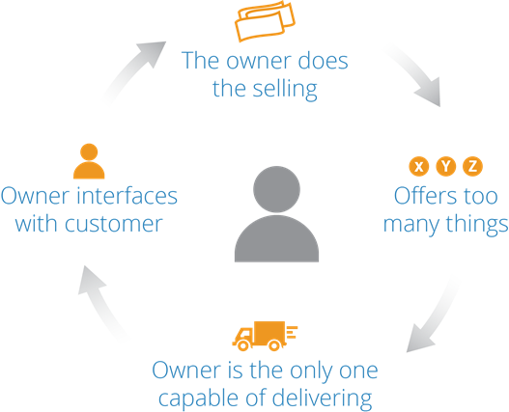
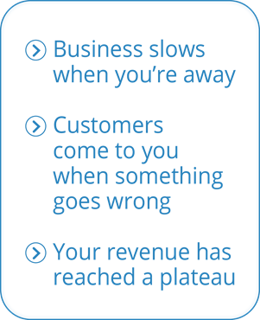
The Owners Trap Driver
Notes:
Step through what the owner trap is
What would happen if you call in tomorrow and say that you will not be in for a month?
How does the owner dependency impact …
Ability to sell more
Ability to deliver more
The value of your business
The ability to transfer it to the next generation or a 3rd party

Slide 10
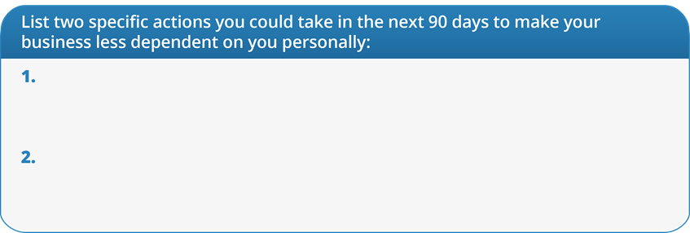
Exercise: Escape the Owners Trap
Notes:
Turn to the person next to you to identify two actions …
Write them down in the handout
Ask 2 people to share what they came up with
One Driver per Month - working on the business
Once you do this exercise with you leadership team to elevate awareness
Opportunities to de-risk your business become continuous
Focus on where you will win!
Reference Diagram is a Circle because the learning, action, results feedback loop is contentious when building business
I walk the walk … I have a Coach and part of a mastermind plus 4 partners

Slide 11
Habit 2: Select Growth Options to
Engineer Profit
Notes:
Habits is Have a Method instead of ad hoc, shooting from the hip, using just your gut
Use the Numbers … synergy; the # set management criteria to help implement
Transition … Ok from Habit 1 - you are intentionally and consistently developing the right growth options
Ask questions …
Who is able to come up with more options than they ever could afford or implement?
Now what?
How do you decide which one is the best fit for you?
How do you know if you can afford it?
How do you choose between growth options?
Many biz owners describe stressing out then using their gut instinct.
Most admit that this doesn’t lead to the best result

Slide 12
Do it with the Numbers
 | Plan A |  |  | Plan B
Revenue | $100,000 | 1.0% | 1,000 | $101,000
Cost of Sales | 62,888 | -1.0% | 629 | 62,259
Overhead | 20,365 | -1.0% | 204 | 20,161
Other | 12,000 |  |  | 12,000
Net Income | 4,747 |  | 1,833 | 6,580
% of Revenue | 4.7% |  | 38.6% | 6.5%
Notes:
Transition … Check this out. Once you get your baseline 12-month forecast
Then run scenarios.
This is what the 2% CEO’s do
Check out this example …
Step through the 1% changes to revenue, cost of sales, and overhead
1+1+1= 39% increase in profit
This is how you make the best selection between your growth options
This is how you engineer profitability
Can you see how much more Clarity and Confidence you have from Habit 1 and 2?
Could we tackle these Challenges (the ones they listed) like this?

Slide 13
Habit 3: Use the Financial Scoreboard to Drive Execution
Like the 2% CEO’s
Notes:
Transition … now you have a 12-month game plan based on your operational and financial priorities
Ask questions to learn how they operate now ...
Who looks at their financials every month?
Do sales P&L managers join you? Operational?
Do you get your financials in a timely manner?
Are they accurate?
Are you on an accrual basis?
What if …
What if you use the financials like a scoreboard every month?
What if your sales and operational managers came to the meeting prepared?
Where they know how actual results compare to the forecast
Where they understand why
Where they already identified actions to take ownership to drive performance at or better than the forecast
What if?
Habit 3 is teaching the team and using the financials like a scoreboard every month
This aligns all team members
Reliable Accounting is the foundation for good decision making with the numbers
Plus organizing reports to match how you make money makes the scoreboard intuitive.
Profit Centers
Cost of Acquisition
Job Cost
Sometimes it is a leap of faith to share P&L with managers
13

Slide 14
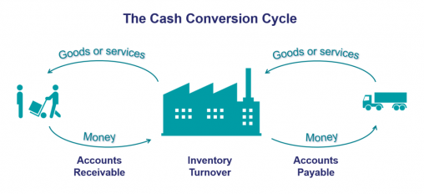
Habit 4: Achieve Predictable Positive Cash Flow
Notes:
Before we unpack Habit 4 I am passing around a rack card about The 2% CEO Mastermind. Over 28 years of business building I started to know the difference between CEO’s who are part of masterminds and those who are not. So I am sharing information about the one I am part of and co-founded.
Transition … Now let's talk about keeping enough fuel in the tank to get you across the finish line
Let's talk about Cash
Cash is not profit
For example you could have profit on the P&L but if your customers haven’t paid you there is no cash in the bank
Ask questions …
Has anyone ever stressed out the night before payroll?
Felt the cash crunch?
How can it be that you are growing and have no cash?
Habit 4 is ensuring that there is cash in your bank
Ask questions to illustrate the traditional Billing to Collections Cycle...
Do the work in month 1
Bill the customer in the 1st or 2nd week of month 2
Terms n/30
Customer may pay you in month 3 or 4?
Meanwhile you are making payroll every 2 weeks starting in month 1
Paying for material
Paying rent and overhead
Who thought of this?
What if … open minds to possibilities
Customers prepaid you or gave a deposit?
For large invoices bill 2x per month?
Ensure that the customer received the invoice even before its overdue with a phone call?
Immediately collect overdue payments?
What if?
Inventory Example… we only do this if this type of biz are in the room
reducing inventory turn from 335 days vs 111
based on benchmarks freed up $498 k of working capital
Being deliberate about achieving positive cash flow changes the ability to fund growth
This reduces the cycle and in some cases can become positive when you get paid before the work is done.
Having positive working capital also increases the value of your business. When you transfer often times seven figures is retained in the business to fund it. With positive cash flow it is paid to you instead.
Would this help you?
The Habit is to work on this at least twice a year

Slide 15
Habit 5:
Beat Competitor Benchmarks &
Reach Your Top Percentile Valuation
Notes:
Bank score
Underwriters for lines, surety bonds, etc.
Conclude Habits are a win for you, your team, underwriters, and contracting officers = win, win, win
Transition … Now that we are building a better business and have cash through the first four Habits
Lets get intentional about top percentile performance
Ask questions ...
How do you compare to your competitors?
What is the value of your business?
Are you bankable?
How do you know? (This is a key questions, because most of the time they don’t know)
If you don’t have a defendable basis, you are leaving money
Step through 2 examples where 5x profit is possible
The Habit is using Competitive Benchmarks and Valuation once a year
This informs growth options & selection when planning
This makes you think critical about what is giving you lift vs drag
This gives you a defendable loan score and valuation
CTA … If your business is >$3 million we can prepare a benchmark analysis for you since you participated in this event
Would getting your benchmark and valuation be useful?
Does this give you Clarity, Confidence, and Impact?

Slide 16
Don’t ask your Tax Preparer to help GROW your business!
Growth CFO
Accountant
Tax Preparer
Evaluate Growth Decisions
Achieve Implementation Accountability
Increases Revenue, Profit,
and Valuation
Forward Looking
Day to Day Transactions
and Processes
Prepares Financial Reports and Reconciles Accounts
Historical Looking
Prepares Federal and State
Tax Returns
Quarterly Payments
Compliance
Notes:
Transition… this is not Tax Prep or Accounting work
This is Growth CFO
Don’t do it alone
At the very least will leave money on the table
Most CFO’s are really Accountants Controllers
Only 5% have what it take to be high growth partners
16

Slide 17
What Makes Us Unique
Impact Financial Management Certification
3 Person Team
90-Day Sprints focused on Your Priorities
Measurable Impact on profit, cash, and the value of your business
Notes:
What makes us different is … step through bullets
What if … the Habits were working for you
Key Point Must State … This means that services pay for themselves
HG CFO -
Accountant -
VP Team Member - Is going to understand things differently then a HG CFO and Accountant. The VP is a check and balance to ensure that we are on point aligned with the CEO.

Slide 18
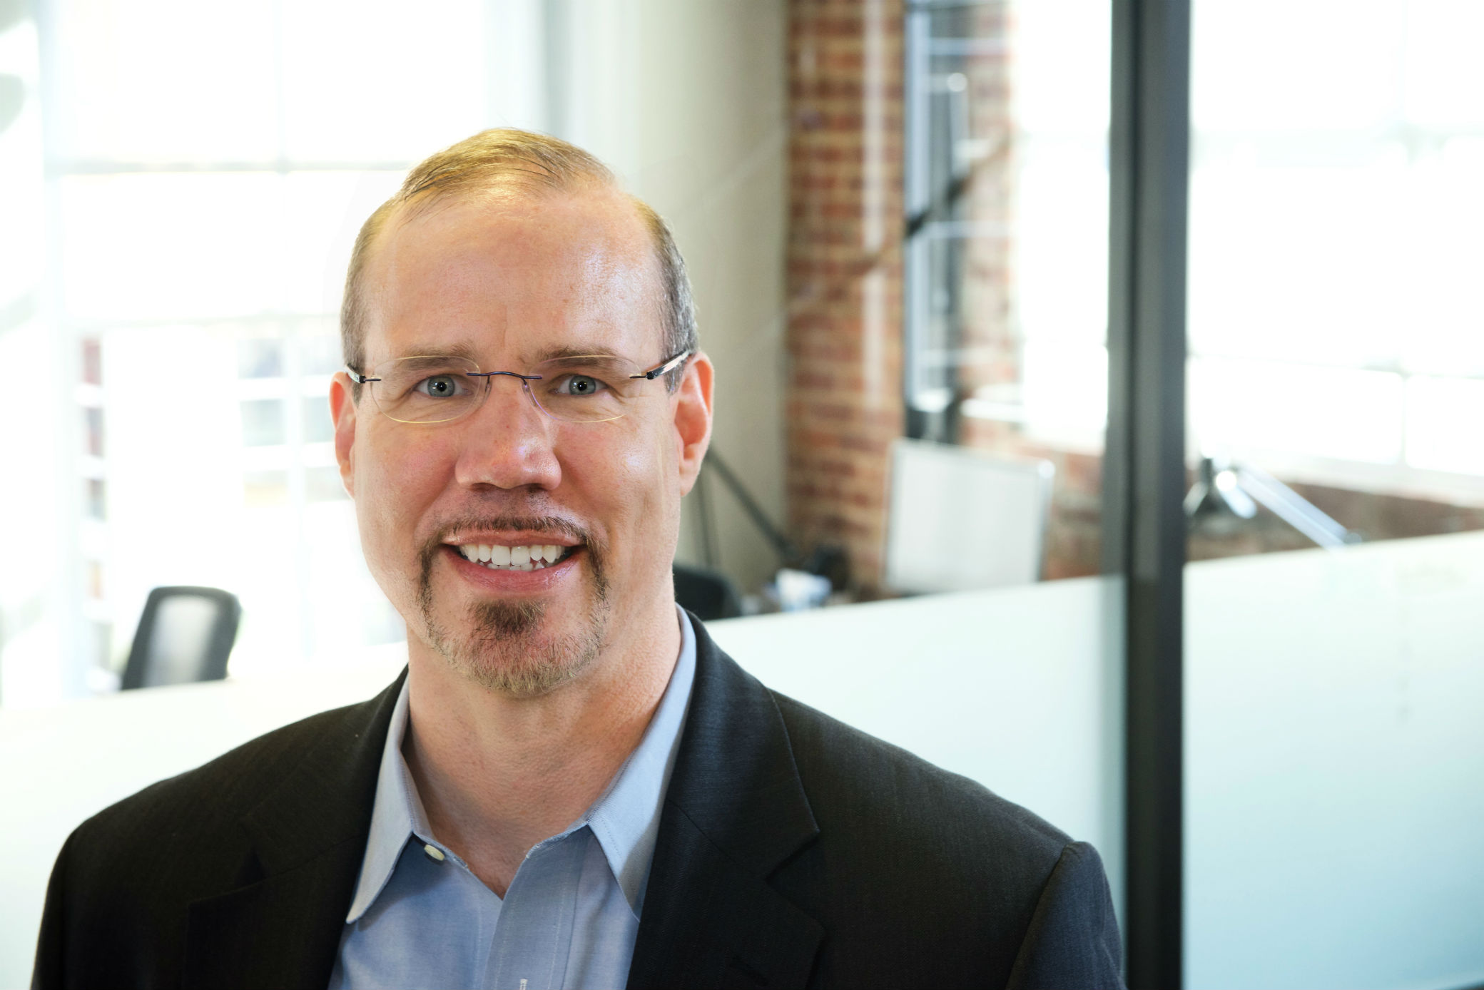
Let’s Connect Today … text me at 202.262.1231
Get the 2% CEO Habits working for you
Kirk. W. McLaren, MBA, CPA
Chief Executive Officer
Kirk@foresightCFO.com
202.262.1231
Notes:
Remember the 8 drivers 2% CEO Score … Add Talking to make Get Your Score the Clear Call to Action (CTA) - We Have the 2% CEO Score, we know that biz that score 80+ are 71% more valuable. The average initial score is 59. It takes 13 minutes initial read, services pay for themselves.
I love to talk with business owners
Please come up introduce yourself
Definitely place your card in the bag.
Kathryn or Sean will reach out to provide the 2% CEO Score or Competitive Benchmarks if you are doing $3 million +
This will help you achieve you reason for going into business
18

