Slide 1




Slide 2
Advanced Master Class:
Using Your VOSB and SDVOSB Certification to Drive Growth Now
Gloria Larkin
President, CEO
TargetGov

Slide 3
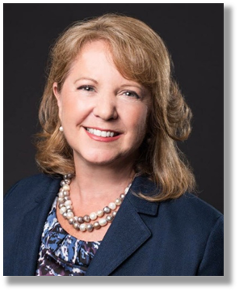
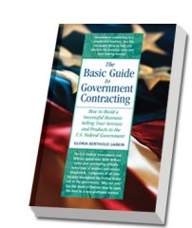

Gloria Larkin
President, CEO
Creator of the FAST™ Process and KickStart Program™
Clients have won $4+ billion in federal contracts
Nationally recognized federal contracting business development expert
Quoted in Wall Street Journal, Washington Post, INC Magazine, Bloomberg
Author of The Basic Guide to Government Contracting
Educational Foundation Board Chair Emeritus for WIPP.org
GloriaLarkinTG@targetgov.com 866-579-1346

Slide 4
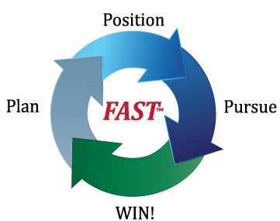
AGENDA
Plan: Market Research
  Identifying targets
Position: How to get noticed—positively!
  Relationship-based market
Pursue:
  Layers of decision-makers
  Mitigating risk
  Tools required to get noticed
  Mistakes to avoid
Win!

Slide 5
Sales Goals and Transactions Worksheet 1
Revenue & Sales Goals
Year 1 Year 3 Year 5
New Government Business Goals $ ______ ______ ______
Transaction Value Range: From $____________ to $____________
Ex: From $100,000 to $10,000,000
Or from $75 to $10,000

Slide 6
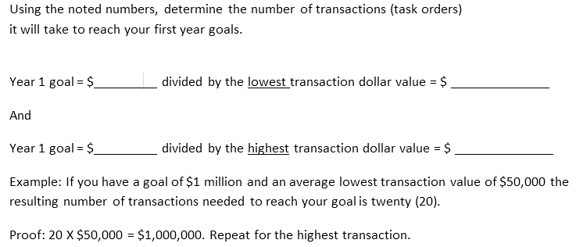
Sales Goals and Transactions Worksheet 2

Slide 7
Sales Goals and Transactions Worksheet 3
Results: To reach the first year goal of new government sales revenues, of $ _____________, in the following range of dollar value transactions:
From $ __________________ to $ __________________
(low end transaction) (high end transaction)
It will take from ___________ to ___________ transactions.
You will need up to __________ completed transactions!

Slide 8
What is Your Close Ratio?
If you usually close 1 out of every 10 pursued
This is a 10% close ratio
You may be higher or lower
Therefore if we want to have
____ to ____ successful transactions,
we should plan for
____ to ____opportunities in the pipeline or sales funnel

Slide 9
Business Strategies Worksheet
Your Firm’s Role % of contracts last year % of contracts this year
Prime Contractor ___________________ ___________________
Subcontractor ___________________ ___________________
Teaming Partner ___________________ ___________________

Slide 10
Possible Targets
Federal agencies, bases, departments, offices:
_____________________________________
Prime Contractors:
_____________________________________
Teaming partners:
_____________________________________
Realistic number?

Slide 11
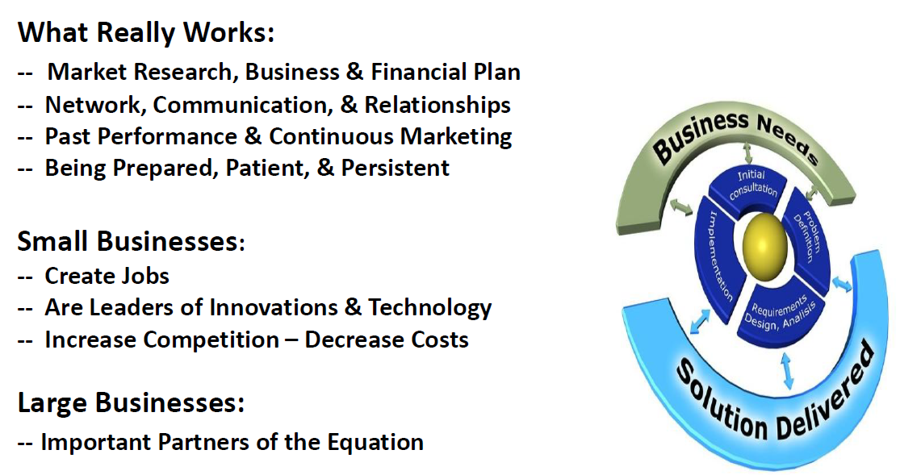
Insider’s View: What Works

Slide 12
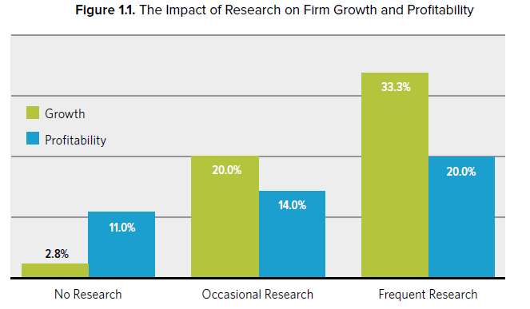
The Impact of Customer-Based Research
Source: “Inside the Buyers Brain” (email me for entire book as PDF)
Published by Hinge Research Institute

Slide 13





Market Research
Past: FPDS.gov at fpds.gov
Present: FedBizOpps fbo.gov
Future: Agency Forecasts acquisition.gov search for “procurement forecasts”
Competition: USASpending.gov
  Primes: USASpending.gov
  Teaming: Small Business Dynamic Search dsbs.sba.gov

Slide 14
Research Resources
PAST:(Identify Top Agency Targets)
Federal Procurement Data System (https://www.fpds.gov)
CURRENT:
  www.fbo.gov
GSA eBuy; FedConnect, FedBid, others
FUTURE:
  Agency Forecasts (through each agency’s website)
Research Tools
  Subscription based
  GovWin, BGov, Onvia, Set-Aside Alert, etc.

Slide 15
Data Sources
Free:
  FedBizOpps, FedConnect, FPDS, DOD eMall,
  SBA Pro-Net & DSBS, Agency web sites
  PTACs, association-related sources
Subscription:
  EZGovOpps, BloombergGovernment, GovWin, ePipeline, GovTribe, etc.
  More popping up every day!
You can drown in data unless you have the sales process identified!

Slide 16

Identify Opportunities
Under $25K (not publicly advertised):
Each agency
Each base
Each office, decision-makers!
Over $25K (publicly advertised):
FedBizOpps.gov
  Sources Sought Notices (2,500+ in last 30 days!)
FedConnect.net
Social media!

Slide 17
Size Matters to Decision Makers
Under $3,000 per transaction
Immediate credit card sale (anyone)
Under $25,000 per transaction
3 bids, same day decision (CO)
Between $25,000 and $150,000
Advertised, best value (CO & PM)
Over $150,000
Competitive bid, 3-6+ months (CO, SB & PM,
entire team)

Slide 18
Identifying the Real Decision Makers
Government Contracting: Strict Process as per the Federal Acquisition Regulations
NOT Top-Down
Three layers of decision makers
Size of purchase determines decision makers
Each layer has different purpose and responsibility

Slide 19
Three Layers of Decision Makers
Small Business Representatives (OSDBU, SBR, OSBP, PCR, CMR)
1
Purpose: Help agency meet SB Goals: 23%
Agency web site: search for OSDBU, OSBP
Contracting Officers (CO or KO)
2
Purpose: Make legal purchase, provide government with appropriate services and products; total responsibility
www.FedBizOpps.gov or other opportunity posting site
Program Managers (PM), technical representatives
3
Purpose: Technical expertise, end-users, can make tech or vendor recommendations
The most difficult to locate, use OSDBU & CO to refer you, a relationship is required!

Slide 20
Success Happens When All Three Layers of Decision Makers Know You!
Small Business Representatives
(OSDBU, SBR, OSBP, PCR, CMR)
2. Contracting Officers (CO or KO)
3. Program Managers (PM), technical representatives, end users

Slide 21

Business Strategies
You as the Prime Contractor
You as the Subcontractor
You as the Teaming Partner

Slide 22
TargetGov Rule of Three℠
Never reach out to any decision-makers for a meeting
This includes all targets!
  Agencies, Primes, Teaming Partners
Until:
You have identified at least three solid opportunities to discuss
Be prepared, no matter with whom you are meeting, to discuss at least 3 upcoming opportunities
Use: Forecast, sources sought, recompetes, FPDS, EZGovOpps, USASpending

Slide 23
Relationships
Government: 3 layers of decision-makers
Small business reps
Contracting and acquisition
Program managers and end users
Primes, subs and teaming partners
Leadership
Business development
Capture
RFP

Slide 24
VA Mentor Protégé Program
The VA Mentor-Protégé Program is designed to assist service-disabled Veteran-owned small businesses (SDVOSBs) and Veteran-owned small businesses (VOSBs) in enhancing their capabilities to perform contracts and subcontracts for VA. The Mentor-Protégé Program is also designed to improve the performance of VA contractors and subcontractors by providing developmental assistance to protégé entities, fostering the establishment of long-term business relationships between SDVOSBs, VOSBs and prime contractors, and increasing the overall number of SDVOSBs and VOSBs that receive VA contract and subcontract awards. A firm’s status as a protégé under a VA contract shall not have an effect on the firm’s eligibility to seek other prime contracts or subcontracts.

Slide 25
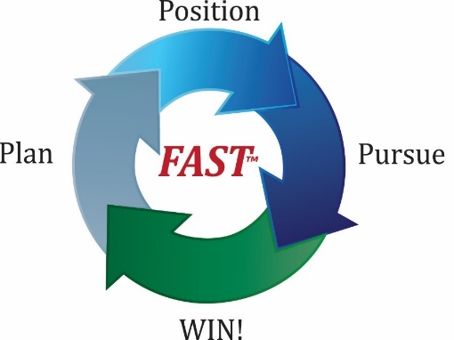
FAST™ Process
Do you want to dramatically increase revenues?
The proprietary, proven TargetGov FAST™ Process is the most cost-effective approach to planning, positioning, pursuing and winning, profitable government contracts. You can take advantage of our 20+ year track record and national reputation for success to build your revenues.
The TargetGov FAST™ Process leverages where you are now: your strengths, core competencies, past performance and relationships and propels you to higher revenues. Large, mid-size and small businesses see dramatic results and high ROI.

Slide 26

An intense look into how to successfully market your company to the federal government.
This program is specially designed for small companies wanting to make an accelerated entry in the federal marketplace.
It is a unique combination of training and consulting – leaving you with the knowledge you need and actual tools for implementing the plan.

Slide 27
Handouts
Session Slides
Matchmaking Pitch Format
TargetGov Rule of Three™
FAST™ Process and KickStart Program™

Slide 28
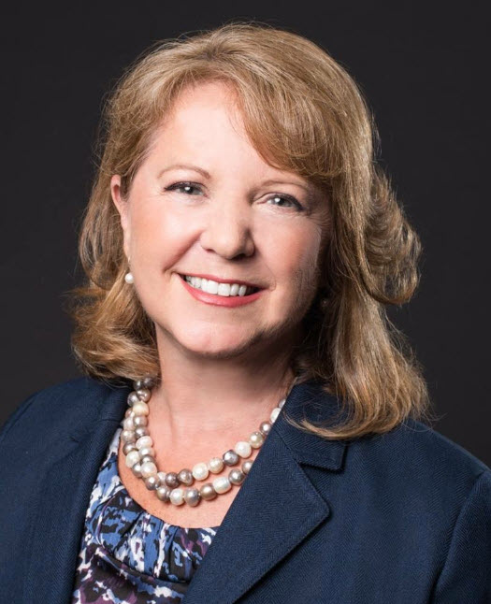
Gloria Larkin
President, CEO: TargetGov
Questions?
Contact:
  GloriaLarkinTG@TargetGov.com
  Toll-free: 866-579-1346 x 325
  www.TargetGov.com

