Slide 1
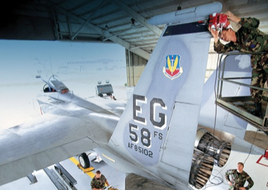

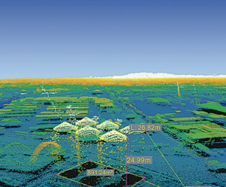

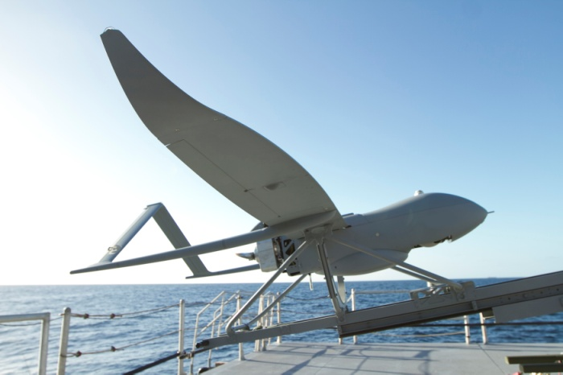
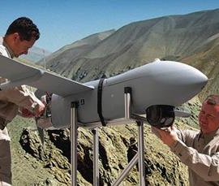

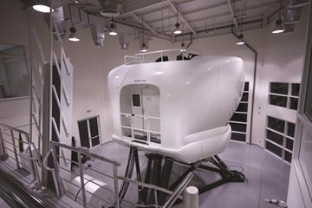
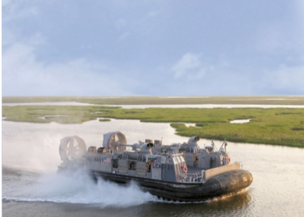
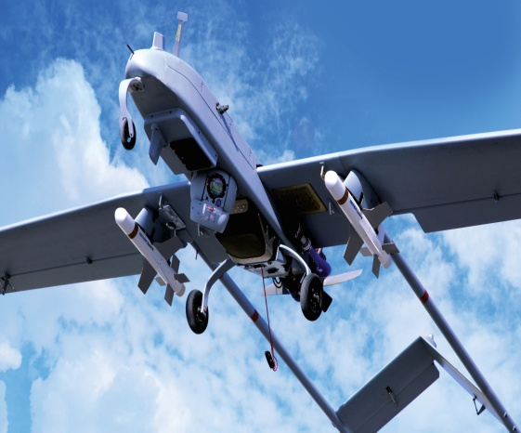
A leader in aerospace, defense, vehicles, fuel systems, tools and test equipment
PORTFOLIO
Electronic Systems
Geospatial Solutions
Lycoming Engines
Unmanned Systems
Support Solutions
Textron Airborne Solutions
TRU Simulation Training
PRODUCT AND SERVICE LINES
Unmanned Platform and Control Systems Ground Control Stations & Situational Awareness
Aviation Services Marine & Land Systems Services
Operations & Sustainment Support Performance Based Logistics
Aerospace Curriculum Development & Training OEM Applications & Engines from General Aviation to Military
Electronic Warfare Systems Custom Software Development & COTS/GOTS Solutions
Electromagnetic Spectrum Systems (Ems) Command & Control Solutions
Test And Training Systems, Services & Centers Multi-Source Intelligence Solutions
Protection Systems & Unattended Ground Sensors Flight Simulation for Corporate, Military and Airliners
Missile, Space & Smart Weapon Systems Advanced Cloud & Thick Client Geospatial Solutions
Multi-industry enterprise recognized around the world for its powerful brands and highly-engineered products
Marine & Land Systems
Weapon &
Sensor Systems
COMPANY PROPRIETARY
© 2018 Textron Inc., Textron Systems Corporation, AAI Corporation, Overwatch Systems, Ltd., Avco Corporation, and TRU Simulation + Training, Inc. All rights reserved

Slide 2
SOURCING OPPORTUNITIES
Capital Equipment • Chemicals • Connectors • Educations & Training • Electronic Fab & Assembly Outsourcing • Electronics Components (active & passive) • Explosives • Facilities Improvements • Fasteners • Ferrous & Non-Ferrous Metal • Finishes • Hardware • Hydraulics • Leasing • Machining, Outsourcing • Microwave Components & Sub Systems • Network Communications Equipment • Petroleum, Oil & Lubricants • Plant “MRO Items • Pneumatics • Power Supplies Raw Material (alloys, ferrous/ non-ferrous) (plastic & composites • Relays • Sheet Metal Fabrications • Switches • Wire & Cable
POTENTIAL SUPPLIERS
To submit your inquiry in becoming a supplier at Textron Systems, please follow the steps outlined below:
Visit our website to learn more about our products and services
Contact the Supplier Diversity Program Office as your initial point of contact at Textron Systems.
Complete our Potential Supplier form on website
Our Small Business Program Manager is available to provide the following assistance:
Advise supplier on potential subcontract opportunities
Forward materials to Purchasing / Engineering/ Other Using organizations for consideration
Answer any questions or concerns
FOR MORE INFORMATION PLEASE CONTACT:
Rita Brooks
Small Business Program Manager
Textron Systems
rbrooks@textronsystems.com
124 Industry Lane
Hunt Valley, MD 21030
https://www.textronsystems.com/who-we-are/supplier-info/diversity-programs
410-628-3197
COMPANY PROPRIETARY
© 2018 Textron Inc., Textron Systems Corporation, AAI Corporation, Overwatch Systems, Ltd., Avco Corporation, and TRU Simulation + Training, Inc. All rights reserved

