Slide 1
Advocacy. Networking. Matchmaking. Education.
Welcome! We start at top of the hour.

Slide 2
Your Next Federal Buyer: Find, Woo, And Win Them
Grow Your Federal Business
With judy bradt, CEO, Summit Insight

Slide 3
Welcome!
Judy Bradt, CEO 30 years’ Federal contracting expertise
Proven Strategies That Drive Revenue
Author, “Government Contracts Made Easier”
Host, “Grow Your Federal Business” webinar series
VP Education & Training DC Chapter
© NVSBC 2018

Slide 4
What We’ll Cover
What’s A Lead?
The Players and Layers
Five Places To Find Them
Ways To Woo Them
Ways To Win Them
Tools and Templates
Next Steps
© Summit Insight 2017

Slide 5
The Three R’s: Essential For Success
Research.
Relationships.
Requirements.
© Summit Insight 2018

Slide 6
What’s challenging about building relationships with Federal buyers?
Email marketing doesn’t work.
We can’t find the buyers.
I don’t cold call.
Federal buyers won’t talk to us.
Buyers don’t come to small business events.
What else?
© Summit Insight 2018

Slide 7
What’s A Lead?
Person whose role, activity & visibility points to potential opportunity.
© Summit Insight 2018

Slide 8
Many Leads Build A Story!
© Summit Insight 2018

Slide 9
Four “Players”, Four Layers
Contracting Specialist Usually listed in RFP. Serves Contracting Officer | Contracting Officer (CO / DoD “KO”) Awards and signs the contract. Serves End User | End User Serves the Stakeholder Needs your help! | Stakeholder Commander, base chief, Cabinet Secretary, Appointee
If they have a warrant, can buy (sign contracts) |  | Can’t actually BUY anything (sign contracts)
Contracting Officer’s (Technical) Representative CO(T)R often bridges these two.
© Summit Insight 2018

Slide 10
Quiz: Where are…
Contracting Specialist Usually listed in RFP. Serves Contracting Officer | Contracting Officer (CO / DoD “KO”) Awards and signs the contract. Serves End User | End User Serves the Stakeholder Needs your help! | Stakeholder Commander, base chief, Cabinet Secretary, Appointee
Primes?
Small Business Specialists?
© Summit Insight 2018

Slide 11
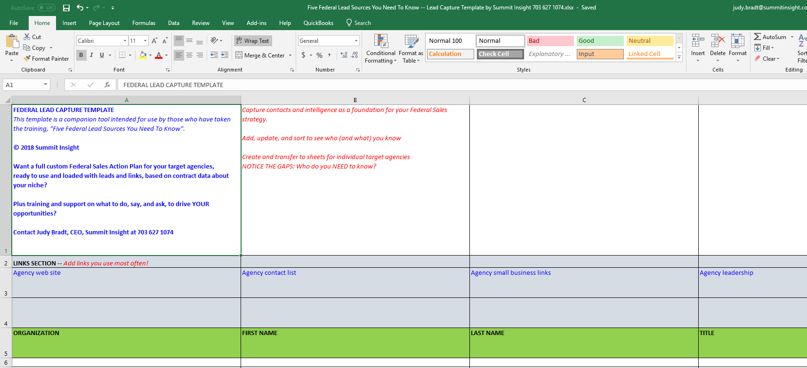
In Your Target Agency: Who Do You Know? Who’s Missing?
© Summit Insight 2018

Slide 12
Cold Call No More.
© Summit Insight 2018

Slide 13
Lead Source #1: Clients Government, Partners, Commercial
Know Your Past Performance
Know Your Strengths
Professional Network
Want You To Thrive
What can you say, do, and ask?
© Summit Insight 2018

Slide 14
Lead Source #1: Clients Government, Partners, Commercial
Come Bearing Research.
“If You Were Me, Who Would You Be Talking To?”
© Summit Insight 2018

Slide 15
Lead Source #2: Current & Past Contacts
People you’ve…
Met recently
Bid to (but not yet won)
Not spoken with in a while
What can you say, do, and ask?
© Summit Insight 2018

Slide 16
Lead Source #2: Current & Past Contacts
Come Bearing Research.
“Here’s what I know…Can you point me in the right direction?”
© Summit Insight 2018

Slide 17
Lead Source #3: Buyers / POC’s of Record
FedBizOpps Notices
Agency Forecasts
Federal Procurement Data System
GSA E-Buy
What can you say, do, and ask?
© Summit Insight 2018

Slide 18
Lead Source #3: Buyers / POC’s of Record
Build On What You Have
P.S. Re your data subscription: Use It, Or Lose It.
© Summit Insight 2018

Slide 19
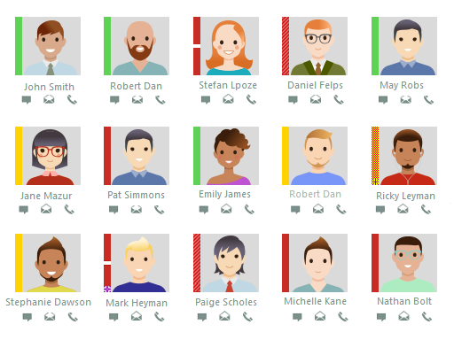
Lead Source #4: Agency Directories
Agency main web site
Regional / District web Site
Small Business / OSDBU Page
Facility Directory
Public Affairs Officer
Paid resources
What can you say, do, and ask?
© Summit Insight 2018

Slide 20
Lead Source #4: Agency Directories
Track Down The Ones You’ve Missed
“I’ve been looking for X. I’ve found ***. Who would be the right person?”
© Summit Insight 2018

Slide 21
Lead Source #5 : LinkedIn
“Contracting Officer”
Department / Agency
What can you say, do, and ask?
19,963 Results
© Summit Insight 2018

Slide 22
Lead Source #5 : LinkedIn
Learn Who They Are.
P.S.: FOCUS.
Who do you know can tell you more? Introduce you?
What’s in it for them?
© Summit Insight 2018

Slide 23
BONUS Lead Source #6 : Seriously.
Partial info / clues lead to more in…
Presentations
Conference Programs
Outreach documents
Agency reports
Contract records
What can you say, do, and ask?
© Summit Insight 2018

Slide 24
Your Buyers Are People. Risk-Averse People.
© Summit Insight 2018

Slide 25
So, Let’s Talk About “Woo”
© Summit Insight 2018

Slide 26
Um, Let’s Start Over. How Did You “Woo” Back Then?
© Summit Insight 2018

Slide 27
Today, How Do You “Woo” And Build Trust With Federal Buyers?
© Summit Insight 2018

Slide 28
Two Keys To Success: Top Advice From Federal Winners
Start Small.
Be Persistent.
© Summit Insight 2018

Slide 29
The Monkey’s Fist
Heaving line pulls across a heavier line e.g. for towing or docking.
Landing the thrown end takes a little weight!
Knot = “Monkey’s Fist”
© Summit Insight 2018

Slide 30
What Could You Do To Woo Someone New? Two Great Options
Mighty Micro-Purchase
< $10,000
Simplified Acquisition
$10,000 - $250,000 Small Business
And OVER $250,000! ALL Business
© Summit Insight 2018

Slide 31
Action Steps You Can Take Today
1. RESEARCH
Clients & Contacts
Buyers/POC’s of Record
Agency Directories
LinkedIn
RELATIONSHIPS
Four Layers + Primes Gap Analysis
REQUIREMENTS
Federal Sales Action Plan
Bid/NoBid Process
© Summit Insight 2018

Slide 32
Leave Card, Get Tools: Tip Sheet & Worksheet
© Summit Insight 2018

Slide 33
Leave Card, Get Tools: Federal Lead Capture Template
© Summit Insight 2018

Slide 34
We Covered A Lot!
What’s A Lead?
The Players and Layers
Five Places To Find Them
Ways To Woo Them
Ways To Win Them
Tools and Templates
Next Steps
© Summit Insight 2017

Slide 35
Thank you! Judy Bradt, CEO
(703) 627 1074
Judy.Bradt@SummitInsight.com
Now, Let’s Talk...
© Summit Insight 2018

Slide 36
Research. Relationships. Requirements.

