Slide 1
13 June 2018
Williamsburg VA
Mark R. “Hawk” Thomas, Esq.
Reid Law PC

Slide 2
Introduction
Your Federal Business Legal Team
____________________________________________
SBA/VA Certifications
Teaming & Joint Ventures
Subcontracts & Suppliers
Solicitations & Bids
Cost & Labor Standards
Contract Negotiation
ITAR & Export Control
Inventions & Data Rights
Inspection & Warranty
Size Determinations
Protests & Appeals
Contract Termination
Dispute Resolution
False Claims & Fraud
Suspension & Debarment
______________________________________________
Enabling Your Success!

Slide 3
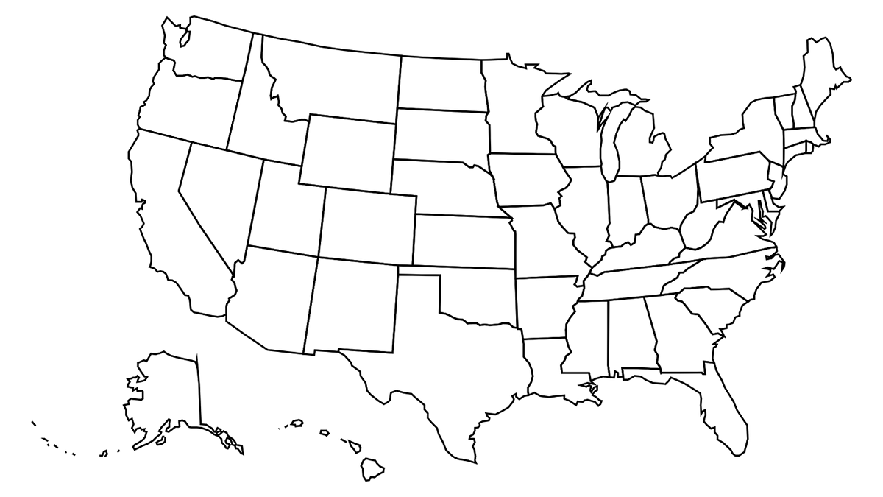
Representative Clients

Slide 4
Formation & Governance: Control; Affiliation; Ostensible subcontractor; Bonding
Hawk’s Top 10 List

Slide 5
Formation & Governance: Control; Affiliation; Ostensible subcontractor; Bonding
Customers: One client; Mission pull vs. capability push; Life post-Kingdomware
Hawk’s Top 10 List

Slide 6
Formation & Governance: Control; Affiliation; Ostensible subcontractor; Bonding
Customers: One client; Mission pull vs. capability push; Life post-Kingdomware
Alliances: The “DD Form 398” rule; Teaming boundaries; Prime-sub vs. JV vs. M-P
Hawk’s Top 10 List

Slide 7
Formation & Governance: Control; Affiliation; Ostensible subcontractor; Bonding
Customers: One client; Mission pull vs. capability push; Life post-Kingdomware
Alliances: The “DD Form 398” rule; Teaming boundaries; Prime-sub vs. JV vs. M-P
Solicitations: Read, Realize, and Respond; Excellent AND informed writing wins
Hawk’s Top 10 List

Slide 8
Formation & Governance: Control; Affiliation; Ostensible subcontractor; Bonding
Customers: One client; Mission pull vs. capability push; Life post-Kingdomware
Alliances: The “DD Form 398” rule; Teaming boundaries; Prime-sub vs. JV vs. M-P
Solicitations: Read, Realize, and Respond; Excellent AND informed writing wins
Protests: Analysis vs. emotion; The forums; Count the costs; Pre vs. post-award
Hawk’s Top 10 List

Slide 9
Formation & Governance: Control; Affiliation; Ostensible subcontractor; Bonding
Customers: One client; Mission pull vs. capability push; Life post-Kingdomware
Alliances: The “DD Form 398” rule; Teaming boundaries; Prime-sub vs. JV vs. M-P
Solicitations: Read, Realize, and Respond; Excellent AND informed writing wins
Protests: Analysis vs. emotion; The forums; Count the costs; Pre vs. post-award
Contracts: Sub-K limits; The audit trail; Constructive changes; Past performance
Hawk’s Top 10 List

Slide 10
Formation & Governance: Control; Affiliation; Ostensible subcontractor; Bonding
Customers: One client; Mission pull vs. capability push; Life post-Kingdomware
Alliances: The “DD Form 398” rule; Teaming boundaries; Prime-sub vs. JV vs. M-P
Solicitations: Read, Realize, and Respond; Excellent AND informed writing wins
Protests: Analysis vs. emotion; The forums; Count the costs; Pre vs. post-award
Contracts: Sub-K limits; The audit trail; Constructive changes; Past performance
Ethics Program: Mandatory >$5M; 30 days post-award; training; culture controls
Hawk’s Top 10 List

Slide 11
Formation & Governance: Control; Affiliation; Ostensible subcontractor; Bonding
Customers: One client; Mission pull vs. capability push; Life post-Kingdomware
Alliances: The “DD Form 398” rule; Teaming boundaries; Prime-sub vs. JV vs. M-P
Solicitations: Read, Realize, and Respond; Excellent AND informed writing wins
Protests: Analysis vs. emotion; The forums; Count the costs; Pre vs. post-award
Contracts: Sub-K limits; The audit trail; Constructive changes; Past performance
Ethics Program: Mandatory >$5M; 30 days post-award; training; culture controls
Financials: Trust and verify; QuickBooks; Source documents; Independent auditors
Hawk’s Top 10 List

Slide 12
Formation & Governance: Control; Affiliation; Ostensible subcontractor; Bonding
Customers: One client; Mission pull vs. capability push; Life post-Kingdomware
Alliances: The “DD Form 398” rule; Teaming boundaries; Prime-sub vs. JV vs. M-P
Solicitations: Read, Realize, and Respond; Excellent AND informed writing wins
Protests: Analysis vs. emotion; The forums; Count the costs; Pre vs. post-award
Contracts: Sub-K limits; The audit trail; Constructive changes; Past performance
Ethics Program: Mandatory >$5M; 30 days post-award; training; culture controls
Financials: Trust and verify; QuickBooks; Source documents; Independent auditors
Dispute Resolution: Design for it, deal with it, dispose of it; Litigation losers; Perform
Hawk’s Top 10 List

Slide 13
Formation & Governance: Control; Affiliation; Ostensible subcontractor; Bonding
Customers: One client; Mission pull vs. capability push; Life post-Kingdomware
Alliances: The “DD Form 398” rule; Teaming boundaries; Prime-sub vs. JV vs. M-P
Solicitations: Read, Realize, and Respond; Excellent AND informed writing wins
Protests: Analysis vs. emotion; The forums; Count the costs; Pre vs. post-award
Contracts: Sub-K limits; The audit trail; Constructive changes; Past performance
Ethics Program: Mandatory >$5M; 30 days post-award; training; culture controls
Financials: Trust and verify; QuickBooks; Source documents; Independent auditors
Dispute Resolution: Design for it, deal with it, dispose of it; Litigation losers; Perform
False Claims Act: Statements and inducement; Implied Certification; Cooperation credit
Hawk’s Top 10 List

Slide 14
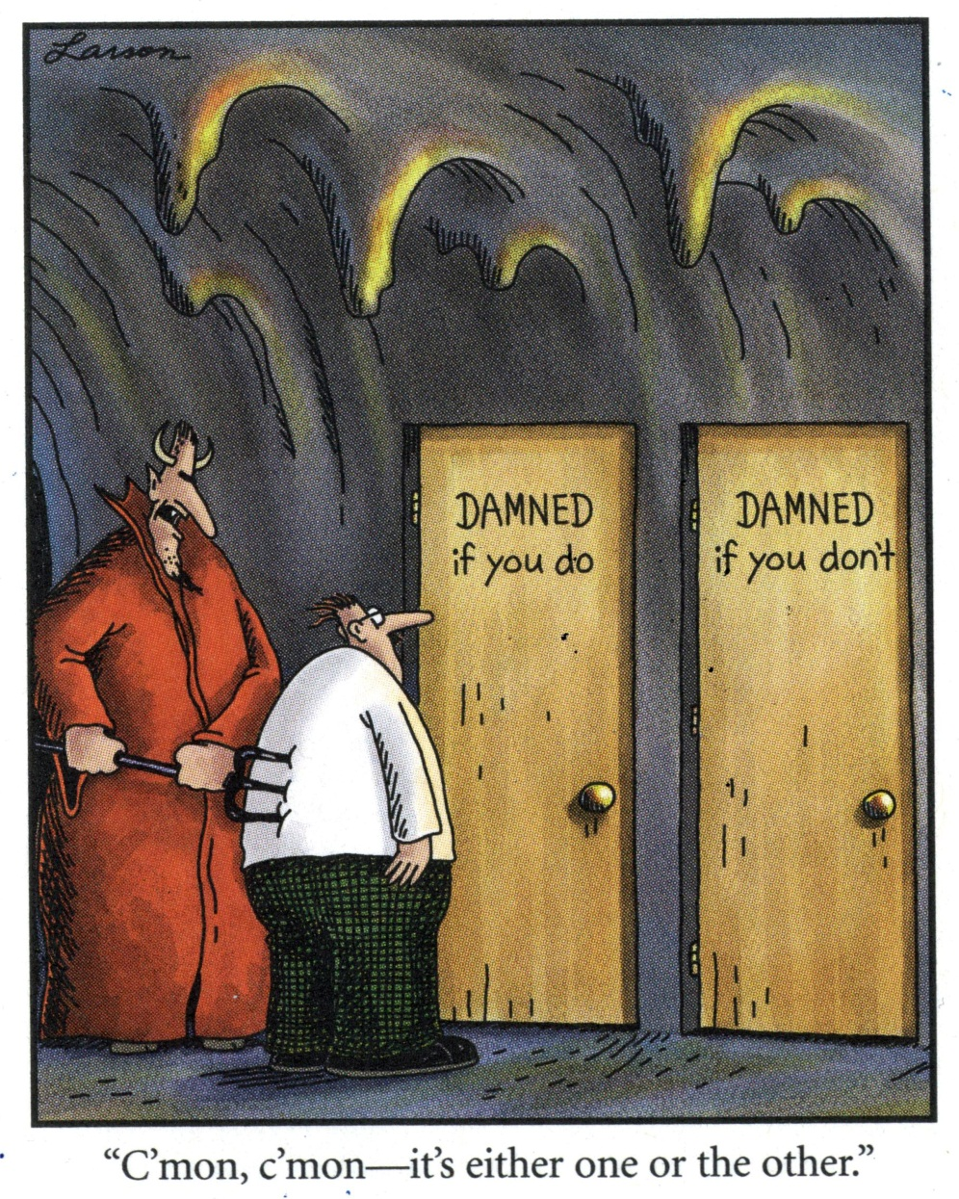
A Bit of Levity
HOW MANY SMALL CONTRACTORS VIEW HIRING LAWYERS
YOU ARE HERE
BTW: Somebody smarter than you has already tried whatever angle you’re contemplating and wish they hadn’t.

Slide 15
The Fine Print
DISCLAIMER
The information contained in this presentation is provided for informational purposes only, not for the purpose of providing legal advice or giving a legal opinion on any specific facts or circumstances. Every situation is unique, and the only way to ensure that any of the information contained herein is applicable to a given situation is for a prospective client to meet individually with a licensed attorney well versed in those areas of international, federal, state, and local law that apply to the client’s situation. While we attempt to update the information in this presentation periodically, the law is always changing. Statutory, regulatory, and other developments may affect the validity of the materials contained herein. As a result, we give no guarantee that the information provided herein is correct, complete, or up to date. Reid Law PC expressly disclaims all liability in respect to actions taken or not taken based on any or all the contents of this presentation.

Slide 16
Contact Information
QUESTIONS?
Mark R. “Hawk” Thomas, Esq.
Reid Law PC
4610 S Ulster St Ste 150
Denver CO 80237-4326
303.641.9988
hawk@fedbizpro.net
www.FedBizPro.net
Better Way: Grab a Card & Let’s Talk!

